Slide 1
When are confident eyewitnesses correct?
Investigating the impact of type and order of questions on eyewitness confidence and monitoring.
Alessandra Caso & Fiona Gabbert
SARMAC XIV

Slide 2
OVERVIEW
Background & rationale
Some empirical findings
Final point
- When eyewitnesses confidence and monitoring is more effective

Slide 3
Eyewitness testimony & confidence
Eyewitness testimonies are used across countries and legal systems (e.g., Sporer & Antonelli, 2022, see also Fitzgerald et al., 2021)
Confident eyewitnesses - independently of their accuracy - tend to be more compelling (e.g., Key et al., 2023)
People can effectively monitor the accuracy of their memory, by aligning confidence and accuracy (e.g., Luna & Martin-Luengo, 2012; Pansky et al., 2005), but this process is not perfect and the relation between confidence and accuracy can break down e.g.,
in response to misleading and suggestive questions (e.g., Howie and Roebers, 2007; see also Bohnam & Gonzalez-Vallejo, 2009; Tomes & Katz, 2000).
after a time interval (Goldsmith et al., 2005; Shapira & Pansky, 2019; Spearing & Wade, 2022).
in response to difficult questions (Kebbell et al., 1996).
Less is known about the characteristics of a forensic interview that might influence (i) confidence, and (ii) monitoring, i.e. alignment between confidence and accuracy.

Slide 4
this research
In this study we investigated the impact of the interview question (i) type and (ii) order on confidence, and monitoring (CA calibration)

Slide 5
Method
Procedure
Sample
124 subj (age M=21.85 SD=5.06)
Stimulus
Mock crime video
Manipulation
Free Recall (FR): open invitation
89 Cued Recall (CR): focused prompts
compatible CR
incompatible CR
Measures
Aggregate Confidence
Item by item Confidence
Baseline confidence
Group 1
89 Cued Recall
T2 confidence
Free Recall
post interview confidence
Group 2
Baseline confidence
Free Recall
T2 confidence
Incompatible CR
Compatible CR
post interview confidence
Baseline confidence
Free Recall
Group 3
T2 confidence
Compatible CR
Incompatible CR
post interview confidence

Slide 6
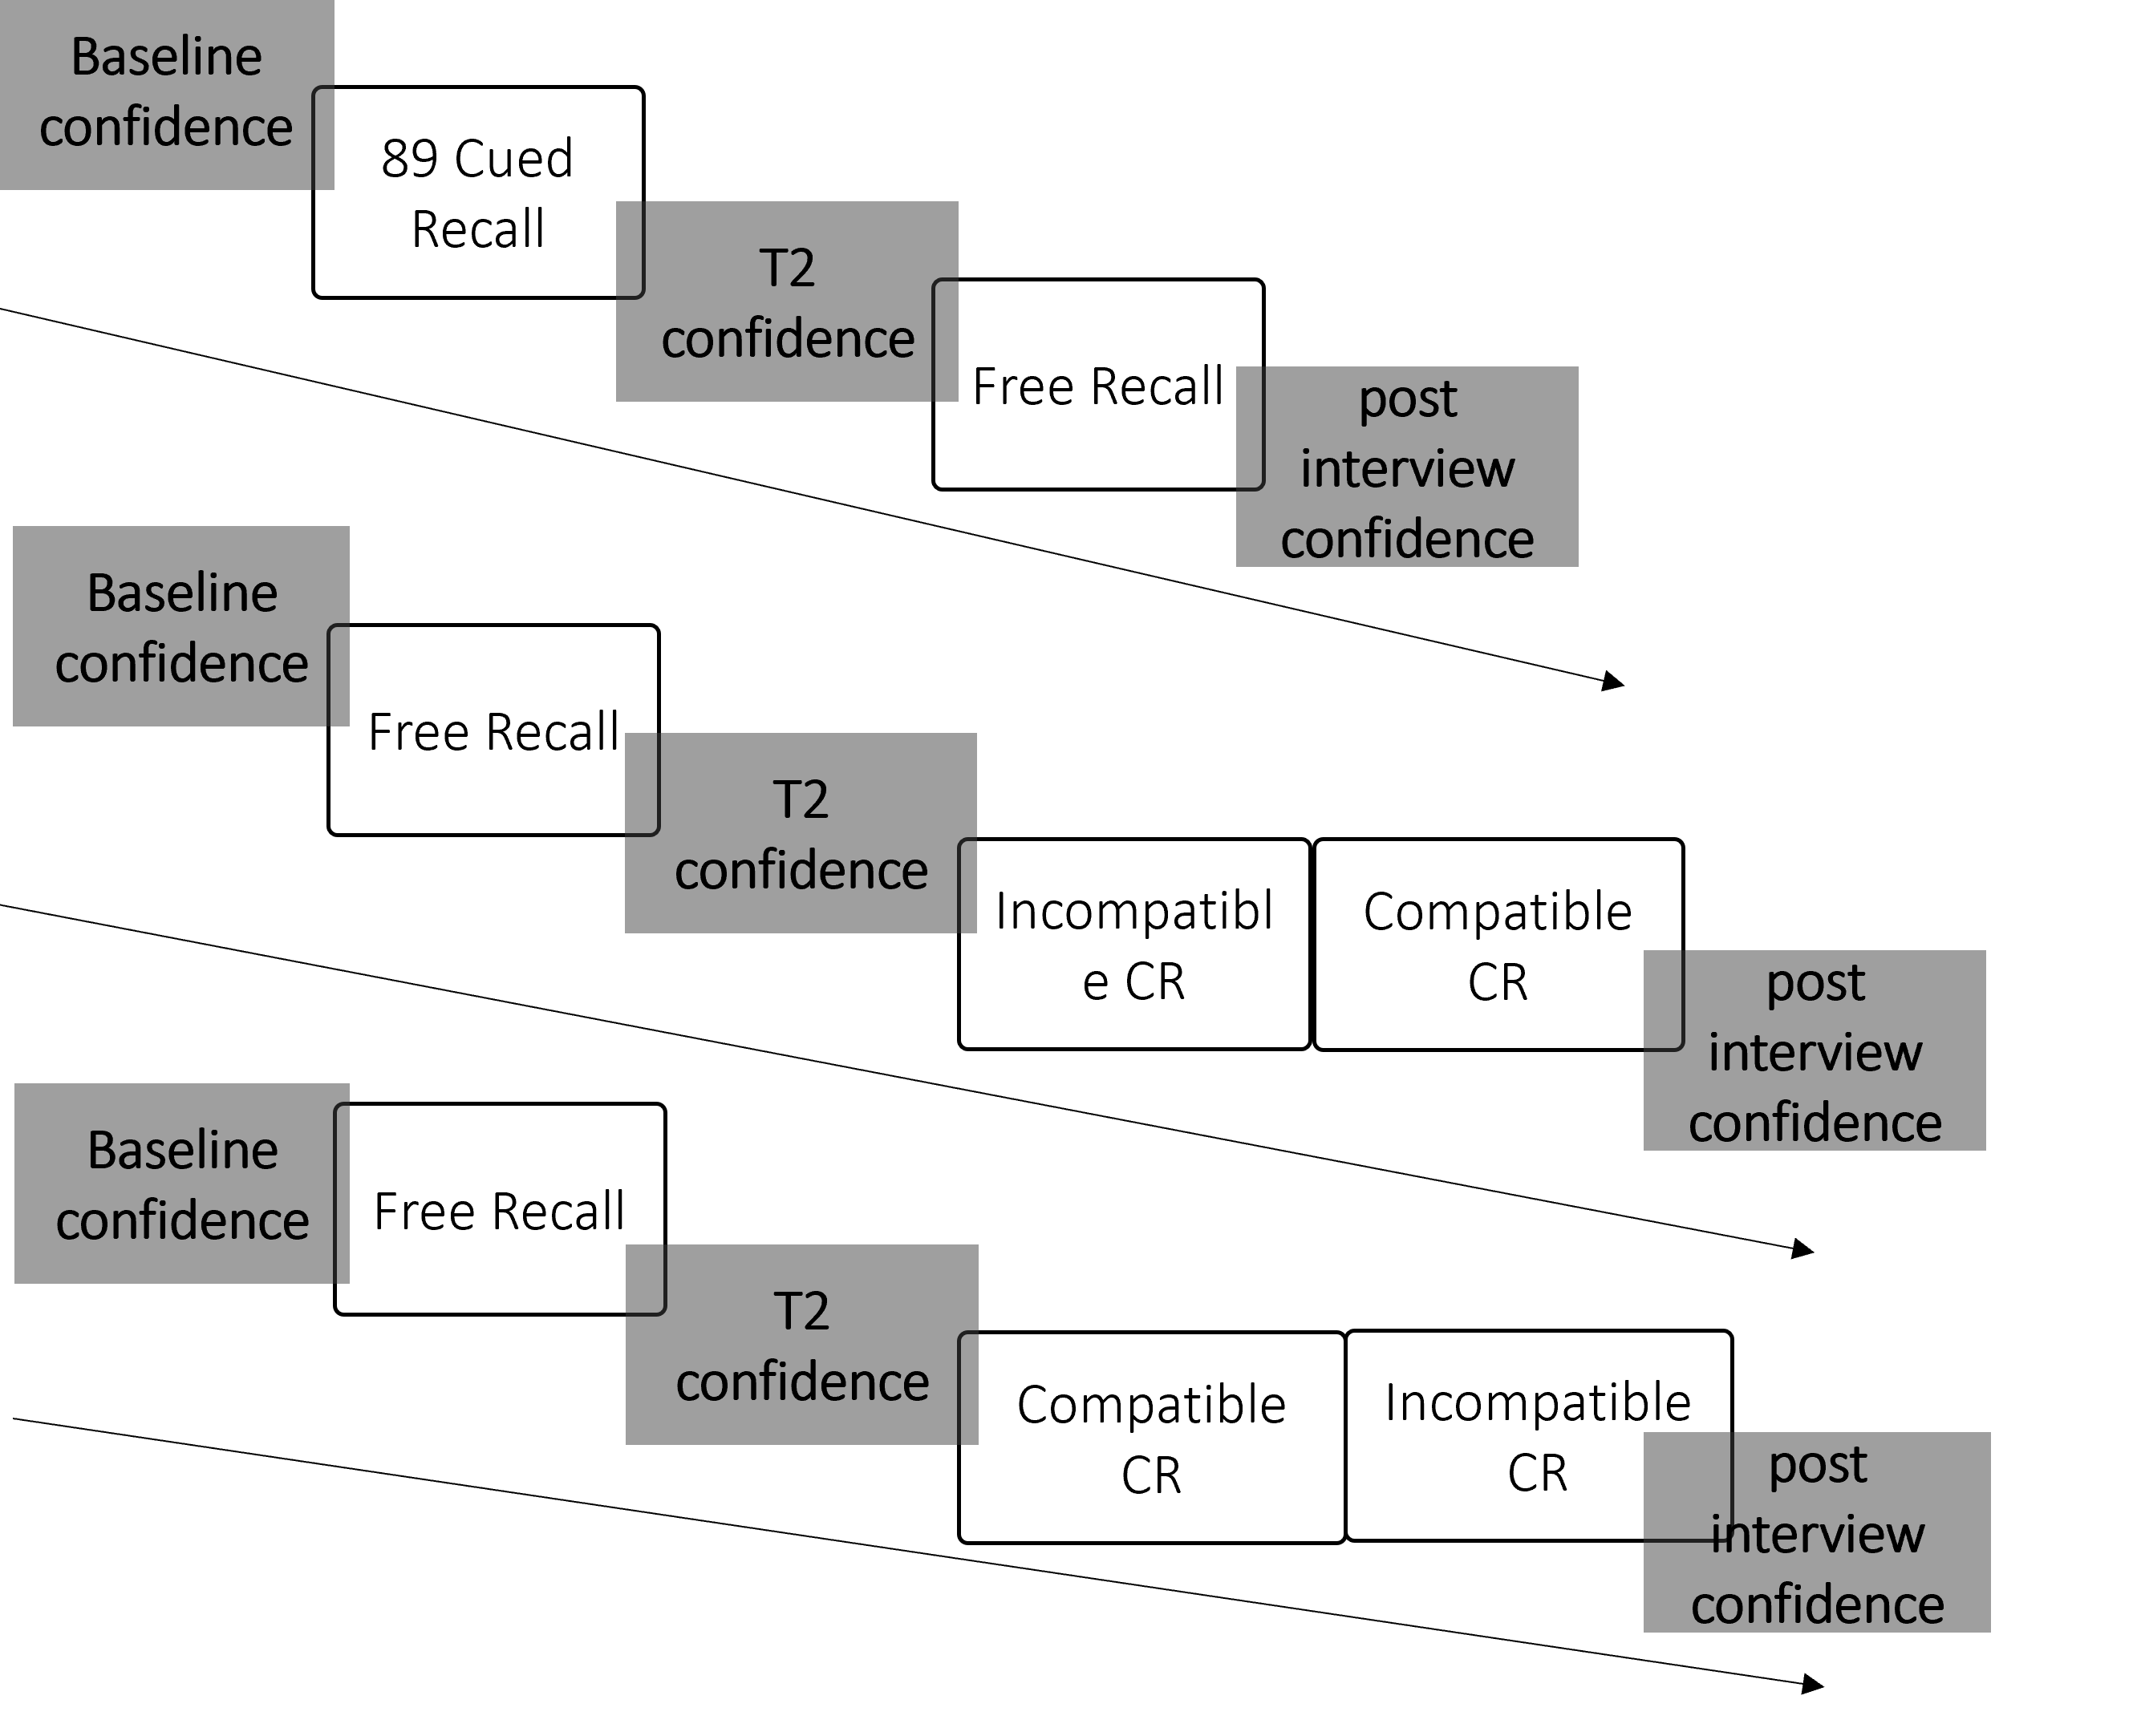
Results: shifts in aggregate confidence
Group 1
Group 2
Group 3
- main effect of time on confidence F(1.87,226.83)=22.83, p<.001, η²_{p}=.16
- main effect of group F(2,121)=4.05, p=.02, η²_{p}=.06
- interaction F(4,226.83)=11.51, p<.001, η²_{p} =.16
- baseline: no sign. dif.
-T2 conf.: confidence for group 1 sign. lower compared with confidence for the group 2 and 3
- post-interview conf.: no sign dif.

Slide 7
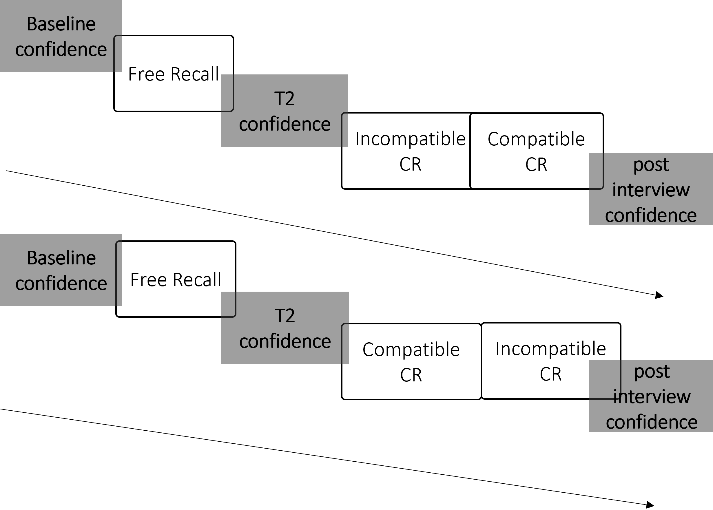
Results: shifts in aggregate confidence
Group 2
T3 confidence
Group 3
T3 confidence
- main effect of time on confidence F(2.50,203.09)=26.22, p<.001, η²_{p}=.25
- main effect of group F(1,81)=13.21, p=.001, η²_{p}=.14
- interaction F(2.50,203.09)=14.03, p<.001, η²_{p}=.15
- baseline &.T2 conf.: no sign. dif.
- T3 conf.: confidence for group 2 sign. lower
- Post interview conf.: no sign dif.

Slide 8
Summary
Aggregate confidence
Effect of interview questions type
Incompatible CR questions are more likely to lead to decreased confidence
Free Recall & compatible CR questions are more likely to promote confidence stability

Slide 9
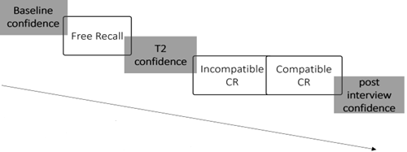
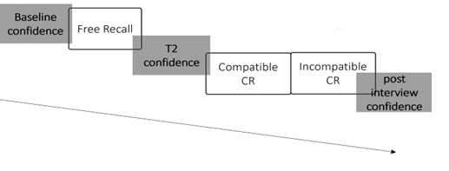
Results: item by item confidence & calibration curves
Group 2
Group 3
Compatible CR
Compatible CR
Incompatible CR
Incompatible CR
Notes:
Calibration curves show the extent to which subjective confidence matches objective accuracy. We plot the proportion of correct answers given in each confidence category (i.e., 0-20%, 30-40%, 50-60%, 70-80%, 90-100%). A participant is perfectly calibrated if as an example, 80% of the correct answers given is associated with 80% confidence.

Slide 10
Results: item by item confidence – Calibration & Discrimination
Group 2
Group 3
Means, 95% CIs
compatible CR
incompatible CR
compatible CR
incompatible CR
-main effect of CR type F(1,81)=20.96, p<001, η²_{p} =.20
-main effect of CR order F(1,81)=.7, p=.351, η²_{p} =.01
- interaction F(1,81)=6.41, p=.01, η²_{p} =.07
-main effect of CR type F(1,81)=22.06, p<001, η²_{p} =.21
-main effect of CR order F(1,81)=1.19, p=.27, η²_{p} =.01
- interaction F(1,81)=.94, p=.33; η²_{p} =.01
Notes:
Finally, a further index - the Adjusted-Normalised Discrimination Index (ANDI) can be calculated to measure whether participants are using their confidence judgements to successfully discriminate between correct and incorrect answers.
Calibration is the degree of correspondence between the variables
Discrimination is ability of the model to correctly separate the subjects into different groups

Slide 11
Summary
Aggregate confidence
Item by item confidence
Effect of interview questions type
Incompatible CR questions are more likely to lead to decreased confidence
Free Recall & compatible CR questions are more likely to promote confidence stability
Effect of interview questions type
compatible CR questions promote more effective calibration (if presented before incompatible CR)
compatible CR questions promote more effective discrimination (independently on the order they are presented)

Slide 12
Conclusion
The CJS relies on eyewitness testimony, it is important that monitoring is not disrupted during a forensic interview.
When eyewitnesses are given a poor interview (e.g., lack of Free Recall, or featuring incompatible questions), confidence is likely to decrease, and monitoring weakened.
However, an interviewee-led interview is more likely to promote stable confidence and effective monitoring, e.g.,
The interview follows the ideal structure (e.g., Free Recall precedes the probing questions).
The probing questions are (i) built on the interviewee’s freely reported account, and (ii) not preceded by incompatible questions.

Slide 13
THANK YOU
Dr Alessandra Caso
a.caso2@westminster.ac.uk

