Slide 1
Developing responsible leadership in a cross-cultural setting, using a virtual challenge based learning approach
Dr Sumita Ketkar
School of Organisations, Economy and Society
University of Westminster

Slide 2
University of Westminster, London
Is a signatory to PRME
Committed to the UN Sustainable Development Goal 4.7
First London university to be awarded Social Enterprise Gold Mark
Student body comes from about 165 countries
Staff is from more than 80 countries
Sustainable Development Advisor to support learning and teaching
Green Fund which is an example of students and staff working together (co-creation) on sustainable products/services

Slide 3
Responsible Leadership- Key competencies
(Muff et al, 2020)
Responsible Leadership
Stakeholder Relations
Ethics and Values’
Self-awareness
systems thinking
change and innovation

Slide 4
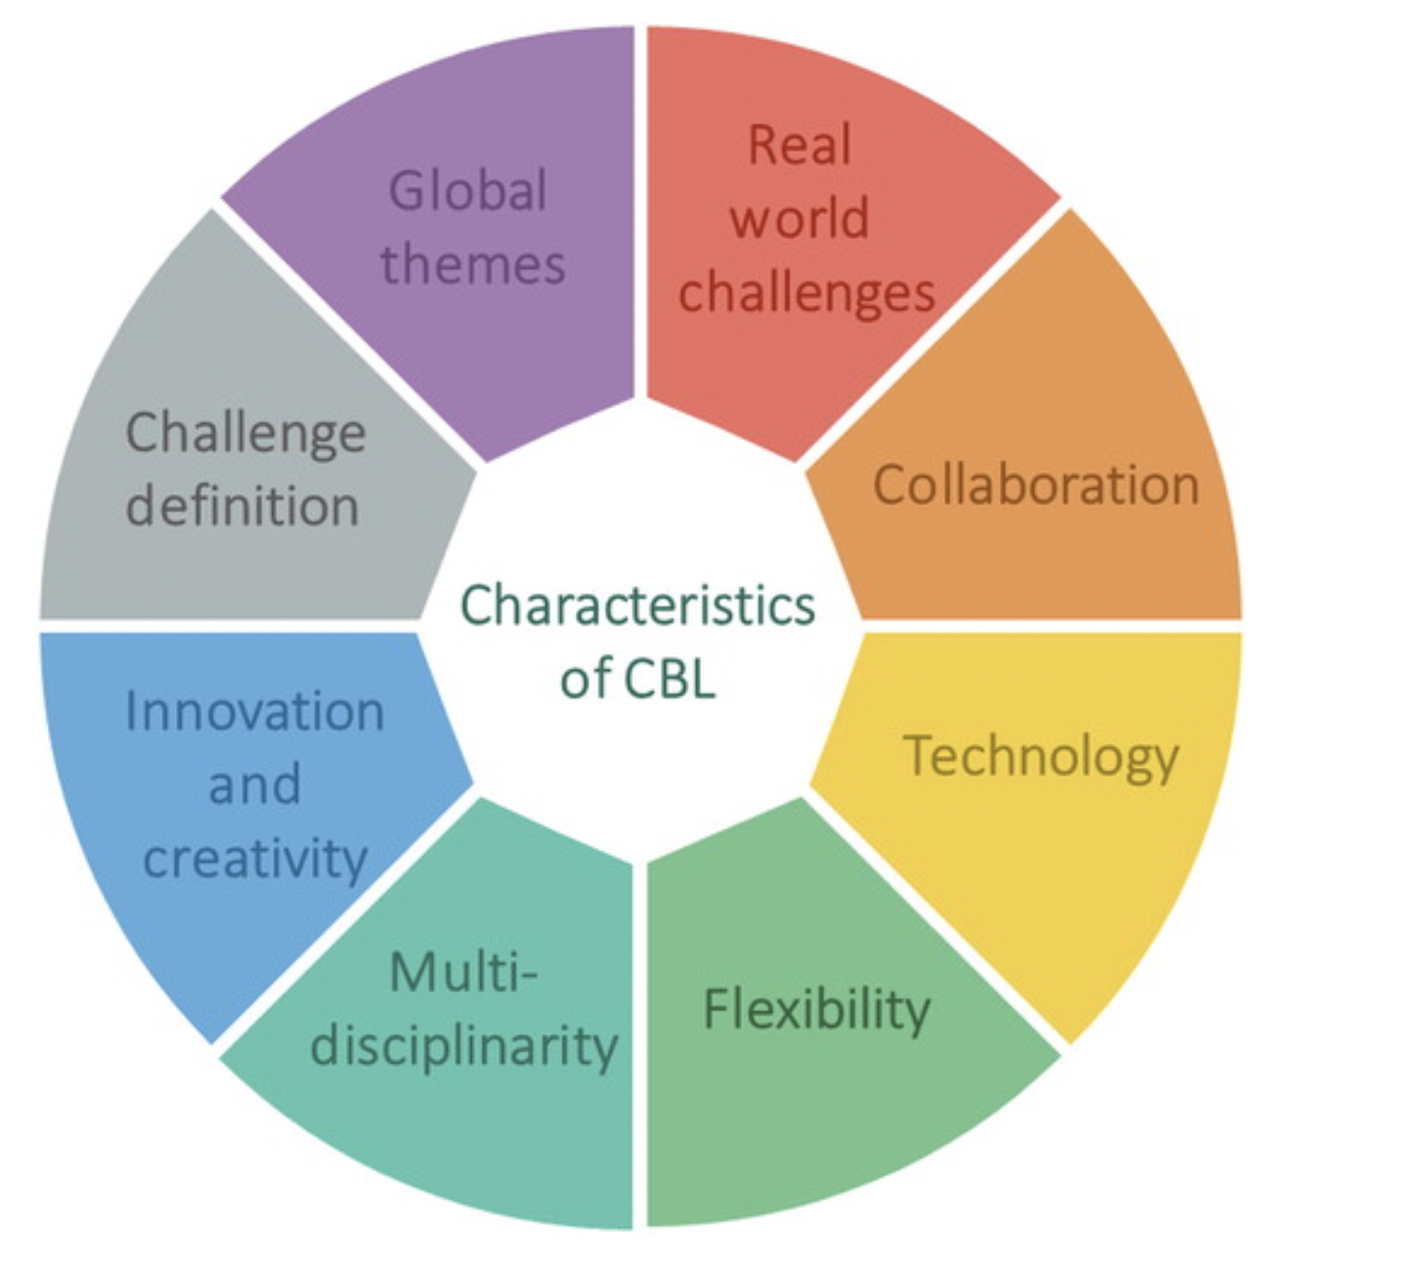
Challenge Based Learning
‘Where the learning takes places through the identification, analysis and design of a solution to a socio-technical problem. The learning experience is typically multidisciplinary, takes place in an international context and aims to find a collaboratively developed solution, which is environmentally, socially and economically sustainable.
(Malmqvist, Rådberg, and Lundqvist, 2017 as cited in Gallagher and Savage, 2020)

Slide 5
Task
To deliver an online poster presentation
Groups were asked to identify an SDG issue within a city, develop an idea for a product or service that could help in mitigating the problem, and present a Sustainable Business Plan

Slide 6
Structure of the Workshop
DAY1
Brainstorming
Ice-breaker and challenging cultural assumptions
DAY 2
Session on steps to be considered while developing a business plan
Identifying a city and the problem and the product/service
PRESENTATION
Pre-workshop briefing and sourcebook
MENTOR
SUPPPORT

Slide 7
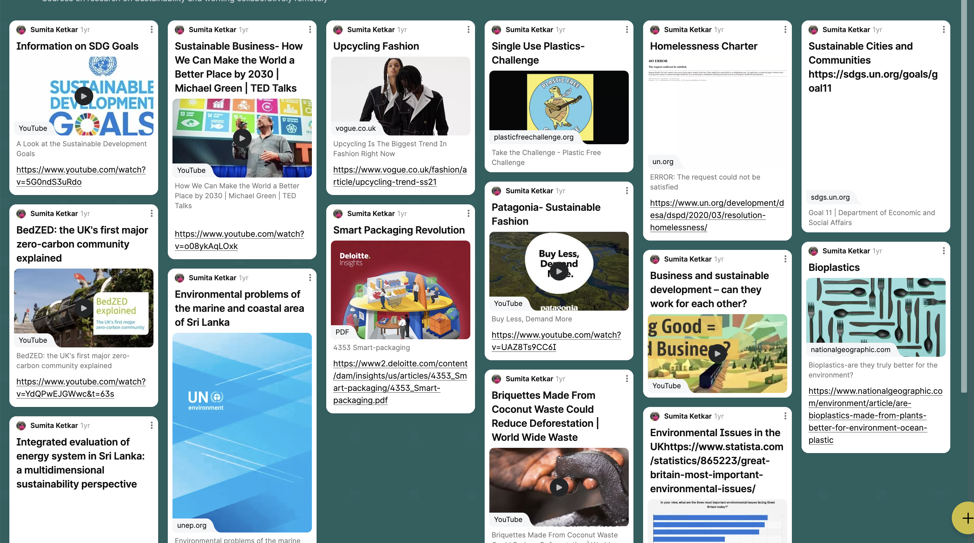
Example of the sourcebook

Slide 8
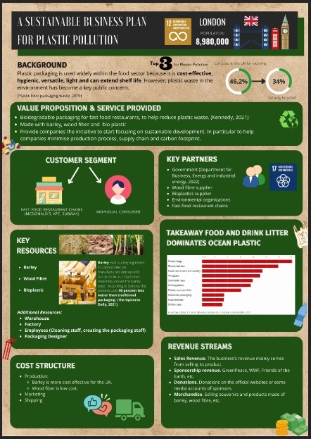
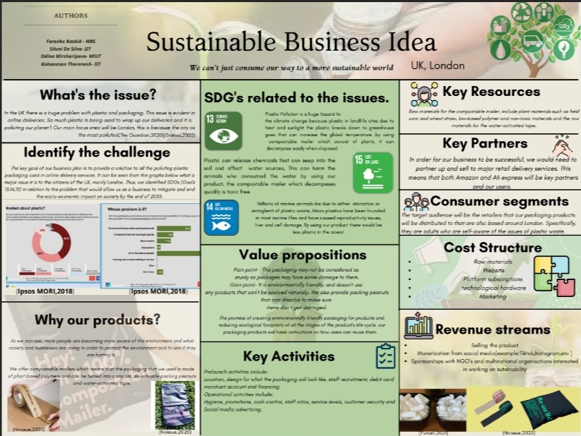
Sample Posters

Slide 9
At the end of two days…
Students were awarded a certificate of participation
The posters were published in the University’s Sustainability Blog.
The workshop contributed towards 20 hours of work-based placement

Slide 10
Impact
Student feedback
“Communicating with other people and creating the idea was fun”
“The cross cultural networking, discussing SDG's and their problems”
“All aspects were important as they contributed to expanding knowledge of sustainability as well as skills in terms of research and time management”
“The overall idea of creating a sustainable business plan
Collaborating with international students and honing my teamwork skills”
“Team working and collaborating with international students”
“Working with international students and using editing skills to create the poster”
“I gained experience in online collaboration, my team-working skill improved significantly”
Student Learning
Developed ability to work in multi-cultural teams, across geographies and across institutions
Made value-based decisions
Ability to work effectively and lead in a virtual environment
Converted ideas into business plans through design thinking approach
Increased employability and communication skills
Feedback from judges and moderators
The sustainability workshop was a wonderful experience for me, albeit challenging given the extent of diversity, the online nature and different time zones. The students found it very useful and suggested many innovative solutions based on their selected ideas.”

Slide 11
Reflections
Success factors
Role of a mentor was critical
Continued discussions within the teaching team was very useful
Pre-workshop briefings- The ice-breaker and cultural assumptions exercise
Clear assessment criteria
Challenges
‘Reward’ is critical in attracting student participants, specially in non-assessed work. (Not just quantity but quality and its value for students)
Timing of the workshop
Technical problems- Lag, buffering, call quality, and internet connection. Issues in Sri Lanka (blackout)

Slide 12
Next Steps
Scaling up
Piloting residential trip
Organise the challenge during term time
Involving an employer

Slide 13
References
Muff, K., Liechti, A. and Dyllick, T., 2020. How to apply responsible leadership theory in practice: A competency tool to collaborate on the sustainable development goals. Corporate Social Responsibility and Environmental Management, 27(5), pp.2254-2274.
Silvia Elena Gallagher & Timothy Savage (2020) Challenge-based learning in higher education: an exploratory literature review, Teaching in Higher Education, DOI: 10.1080/13562517.2020.1863354

Slide 14
Thank you!
Questions

