Slide 1


Practice research voices (pr voices): a case study
Holly Ranger Research Data Management Officer and Nina Watts Repository and Open Access Manager (University of Westminster)
Adam Vials Moore (CoI) )(Jisc)
Notes:
Funded under AHRC’s Scoping Future Data Services call (July 2021) as part of the National Infrastructure for Digital Innovation and Curation for Arts and Humanities (iDAH) programme

Slide 2
persistent identifiers and practice research
“Practice research is a new way of thinking about and engaging in research and so needs new structures and systems to maximise its impact within and outside the academy. The infrastructure for the communication and codification of research emerged with textual outputs in mind. Different approaches are needed to handle the richness and diversity of practice research.
Responding to this need is essential not only for practice research but also for the potential enrichment of the whole research endeavour. Embracing a diversity of research outputs is something that all researchers should consider to maximise their work's reach and impact. Practice researchers are already used to working with diverse outputs, and there will surely be lessons for all research areas to learn.”
Steven Hill, Director of Research, Research England
Foreward to the PRAG-UK Reports https://doi.org/10.23636/1347
Notes:
- Why are we talking about the Practice Research Voices project rather than how we use PIDs at Westminster?
Our broad range of research disciplines include the arts and humanities (including creative arts and architecture) so encouraging researchers to sign up to ORCID challenging – they don’t get the interoperability and time saving benefits that scientific and more traditional text based disciplines do
Rather than (yet again) ‘retro-fitting’ this research into systems built for scientific communication – we have an opportunity to embed these non-traditional / non-text outputs from the beginning
Practice research is carried out across disciplines, including medicine, health sciences, social sciences, nursing, education to name a few
And enables recognition of ‘documentation’ or ‘evidence of impact’ to be recognized alongside traditional research outputs

Slide 3
Practice Research Voices (@PRVoices)
Scoping a national practice research repository using (as a foundation) the Haplo (now Cayuse) repository that embedded practice research (primarily in art and design) from the beginning.
Moving to a repositories, discoverability and interoperability landscape in which practice research disciplines are embedded rather than an afterthought (OTHER).
Bringing together voices from many interested communities to form the PR Voices Choir and working with them to identify what Findable, Accessible, Interoperable and Re-usable (FAIR) and transparent research (which may also be open) looks like for these disciplines and which respects all contributors and their intellectual property.
Notes:
The project aimed to
Scope a national practice research repository using software that already embedded creative arts research
Embed practice research disciplines in existing open standards
Built the intersectional community of practice and work with them to identify what FAIR and transparent research (which may be open) looks like for these disciplines

Slide 4
PR VOiCES PROJECT TEAM
Jenny Evans: Research Environment and Scholarly Communications Lead, University of Westminster
Prof Neal White: Co-Director of the Centre for Research and Education in Arts and Media, University of Westminster
Prof Helen Bailey: Deputy Vice President Global Business Development, Kings College London
Dr Adam Vials Moore: Product Specialist for Persistent Identifiers, Jisc
Rachael Kotarski, Head of Research Infrastructure Services, British Library
Nina Watts, Repository and Open Access Manager, University of Westminster
Dr Holly Ranger, Research Data Management Officer, University of Westminster
Dr Jenny Basford, Repository Services Lead, British Library
Taylor Mudd, Senior Software Engineer and Product Owner, Cayuse
Joshua Mead, Researcher Development Officer, University of Westminster
Notes:
Project team reflected a number of these communities

Slide 5

Building the foundations for pr voices
Development of the Haplo (Cayuse) repository at Westminster built in art and design and architecture practice research outputs from the beginning (in co-design with community) https://doi.org/10.1629/uksg.582
Worked with Jisc (and then the British Library) to raise awareness that practice research outputs were not adequately reflected in the open standards landscape
  FORCE11 2022 https://doi.org/10.5281/zenodo.5767094
  NISO Plus 2022 https://doi.org/10.34737/vv0z9
PRAG-UK reports published – included definitions of practice research and research narrative and made recommendations https://doi.org/10.23636/1347
Notes:
The project built on existing work
Repository development at Westminster (in co-design with community)
Recognition that the open standards landscape do not adequately reflect practice research outputs
Publication of the PRAG-UK reports posed some recommendations we were able to test

Slide 6
Practice research: some definitions
Practice research
“An umbrella term that describes all manners of research where practice is the significant method of research conveyed in a research output. This includes numerous discipline-specific formulations of practice research, which have distinct and unique balances of practice, research narrative and complementary methods within their projects.”
Research narrative
“In a practice research output, a research narrative may be conjoined with, or embodied in, practice. A research narrative articulates the research enquiry that emerges in practice.”
Bulley, James and Şahin, Özden. Practice Research - Report 1: What is practice research? P1. London: PRAG-UK, 2021. https://doi.org/10.23636/1347.
Notes:
Helpful definitions from the PRAG-UK reports

Slide 7
Features of ‘non-traditional’ research outputs?
Often (not always) non-text
Changes over time
Can include multiple files (of different formats) which are closed and/or open
Representation of performance or other live event (remediation)
Research element can be embodied in the work or needs evidencing by a narrative
Process as significant as product
Can be linear or non-linear
Time-based
Often involve a range of contributors that deserve acknowledgement and recognition

Slide 8
Practice research voices (PR VOICES)
Define the technical & academic challenges of an open library of practice research that will effectively share and disseminate practice research to academic and non-academic audiences
Determine the most efficient and successful route by building on existing open-source technology and open standards
1. Repositories
2. Metadata & Persistent Identifiers
3. Creating a Practice Research Community of Practice
Notes:
Aimed to define the… and determine… via three workstreams
We collaborated with a complementary funded project the Sustaining Practice Assets for Research, Knowledge and Education (SPARKLE) – led by the University of Leeds, in collaboration with York, Sheffield, British Library, Digital Preservation Coalition and EDINA at the University of Edinburgh

Slide 9
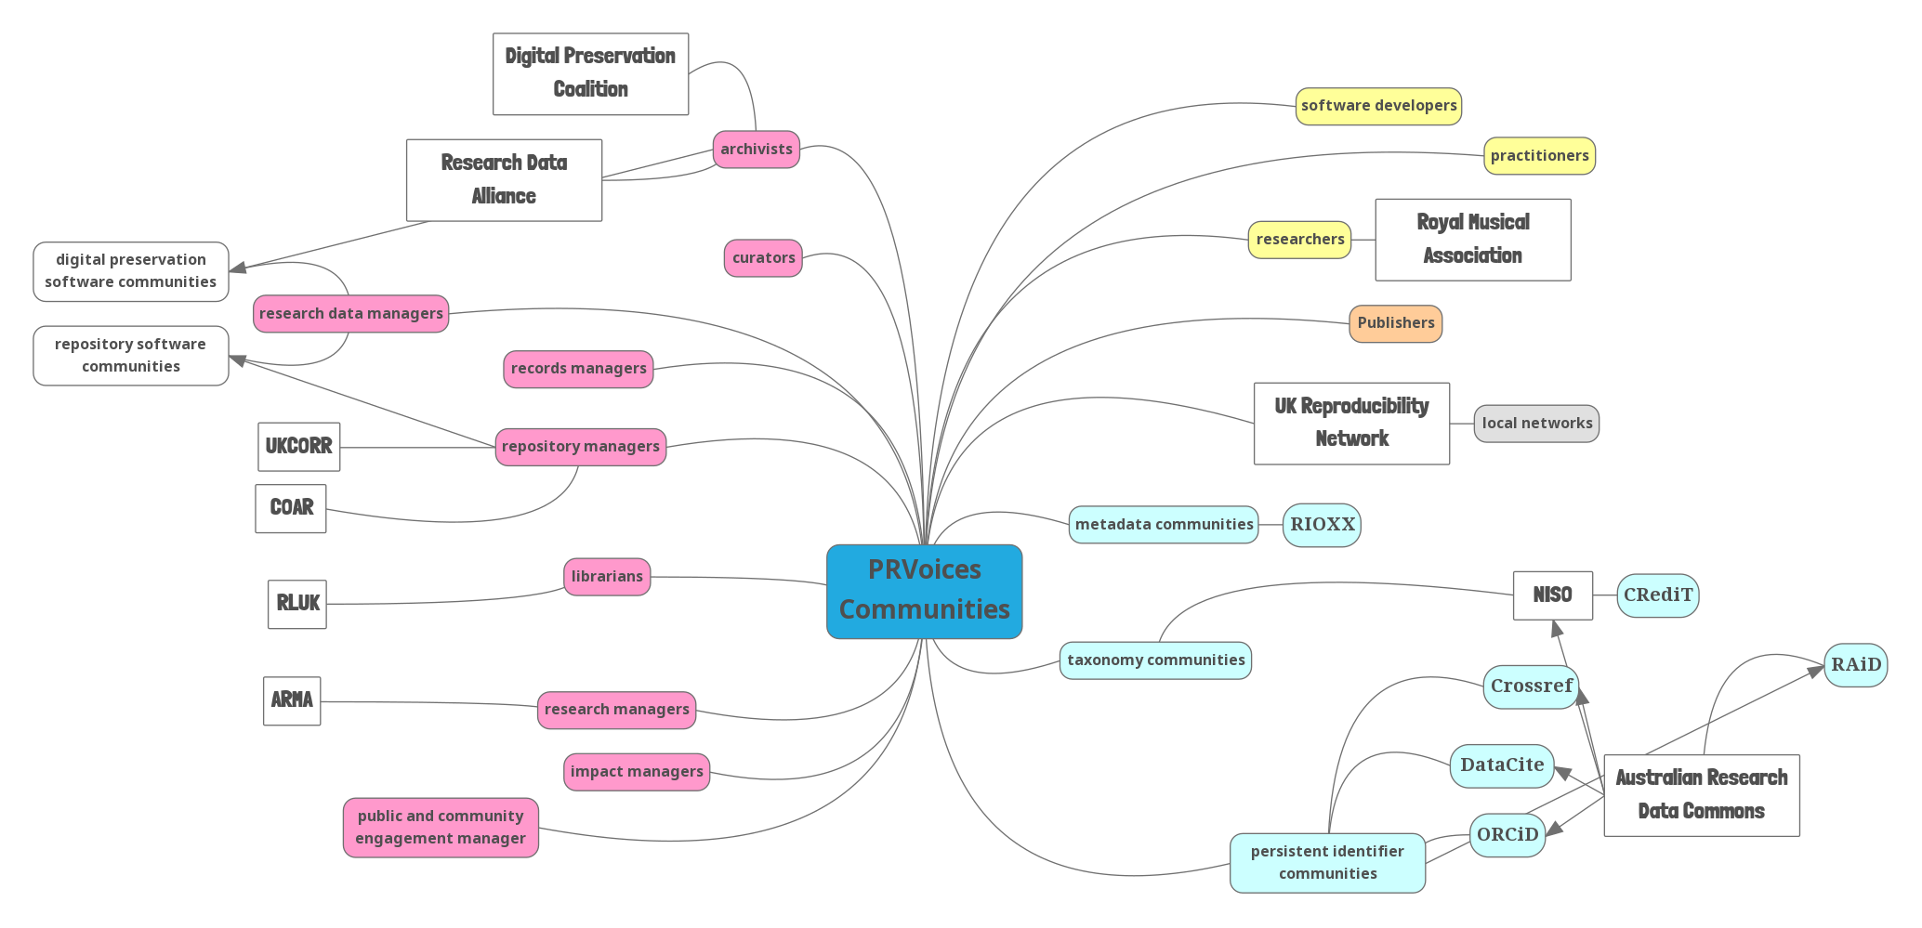
Creating the intersectional practice research community of practice
Notes:
We have brought together (and gone out to) many different existing communities – different researcher and practitioner communities – and those who work with researchers and practitioners to enable them to capture and share their research

Slide 10
Pr voices findings and recommendations (with a little sparkle)

Slide 11
PR Voices findings and recommendations
Findings
Ongoing community engagement is key to success
Platform needs to be interactive (capture alongside the project not retrospectively), embedded in community, respect form and function, enable discoverability, citation and preservation, recognize contributors, process AND product
Open standards must underpin this work
Challenges include sustainability, expertise, preservation
Recommendations
Co-design with community
Embed Practice Research in open standards
More than retrospective archive
Need for training programme
Investment in capacity, people and infrastructure

Slide 12
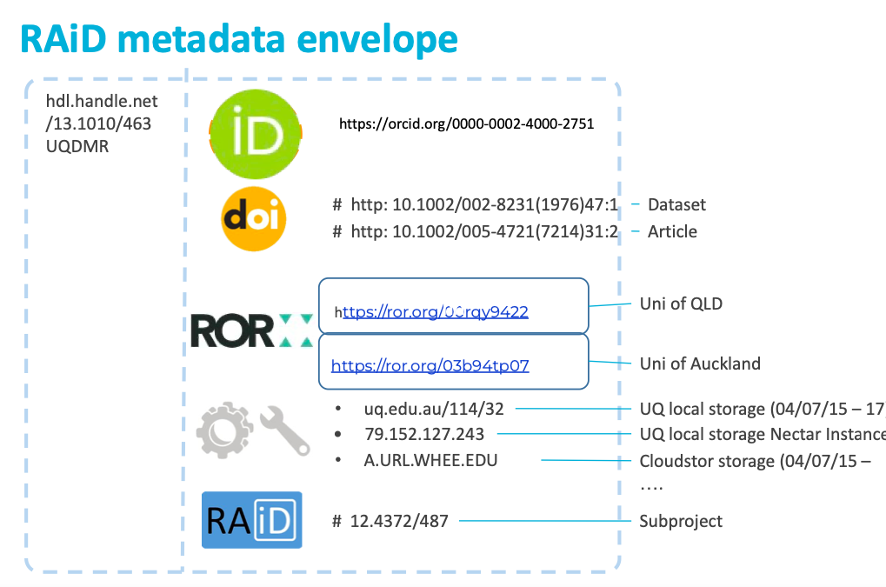
The PR Voices framework: is portfolio the same as collection?
We investigated the suggestion recommended by the PRAG-UK 2 Report: How can practice research be shared of a project item type - also known as a collection or portfolio (p15).
We have identified the need to (1) capture individual objects on an ongoing basis (2) bring those together (collection) and that (3) a portfolio (theme) builds on the idea of a collection, and overlays narrative and context.
Notes:
We have identified the need to (1) capture individual objects on an ongoing basis (2) bring those together (collection) and that (3) a portfolio (theme) builds on the idea of a collection, and overlays narrative and context.

Slide 13
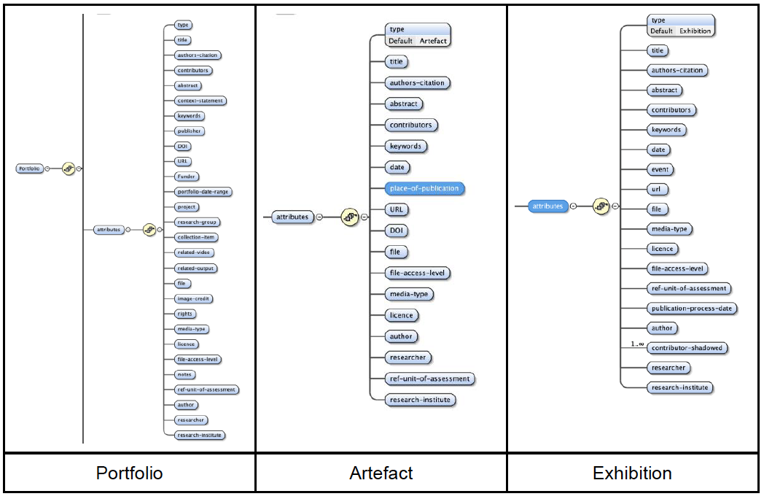
Haplo (BY cayuse) SCHEMA:
Portfolio, artefact, exhibition
Notes:
This extract highlights the relevant schema detail which was validated against the BL’s Cultural Heritage Shared Repository Service.

Slide 14



Metadata and persistent identifiers priorities
Work with existing open standards (rather than creating new ones)
Resource types: DataCite
resourceTypeGeneral has 28 permitted values plus Other.
Exhibition maps to Event?
Does Portfolio/Collection map to Collection?
How does the portfolio record evolve over time? Is RAiD more appropriate?
Creator vs Contributor - where does collaborator map? Work with CRediT on this?
Project item type: Research Activity Identifier (RAiD)
RAiD allows the collection of other persistent identifiers and output objects by acting as an “envelope” identifier.
Each object connected to the RAiD also has a date-stamp for the beginning and end of the connection.
This allows the RAiD to encapsulate narrative, chronological view of activity.
Contributors: Contributor Roles Taxonomy (CRediT)
Founded in scientific research
Embedding the practice research voice in CRediT discussions.
Potential to work with CRediT community on contributor roles that reflect practice research.
Metadata, Persistent Identifiers and a Taxonomy workshop: researcher/practitioner perspective plus presentations from all three communities
https://blog.westminster.ac.uk/prvoices/workshop-metadata-persistent-identifiers-pids-and-a-taxonomy/
Notes:
We prioritized DataCite, RAiD and CRediT – engaging with all three communities.

Slide 15
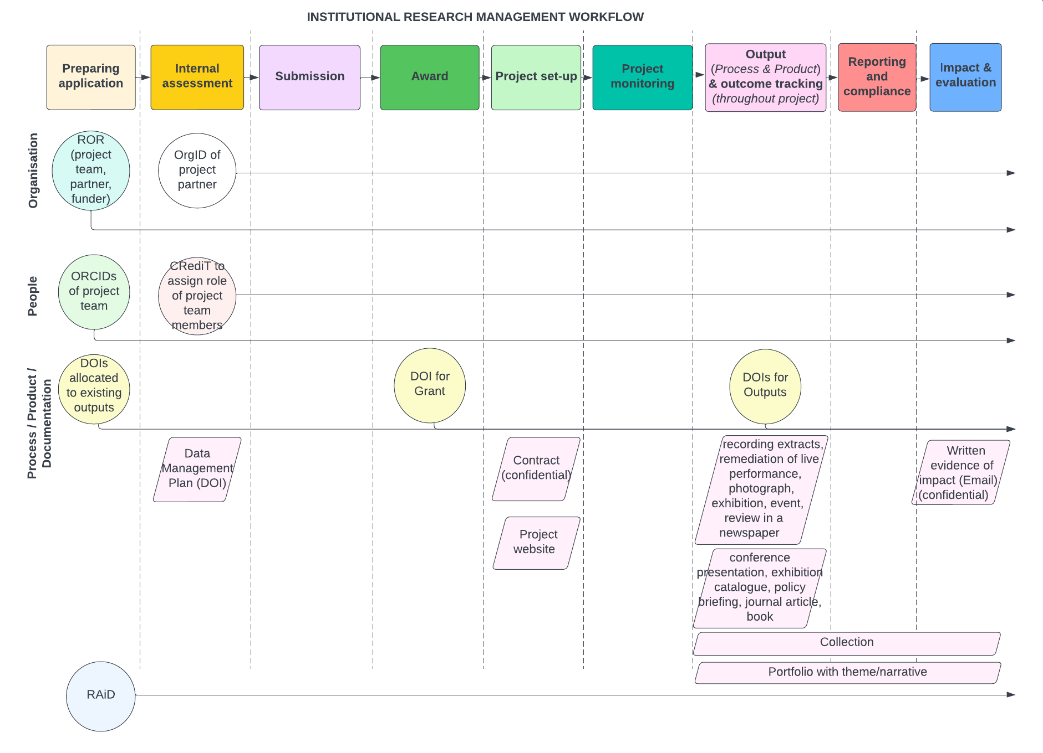
the institutional research management workflow and practice research
Notes:
Current landscape as is

Slide 16
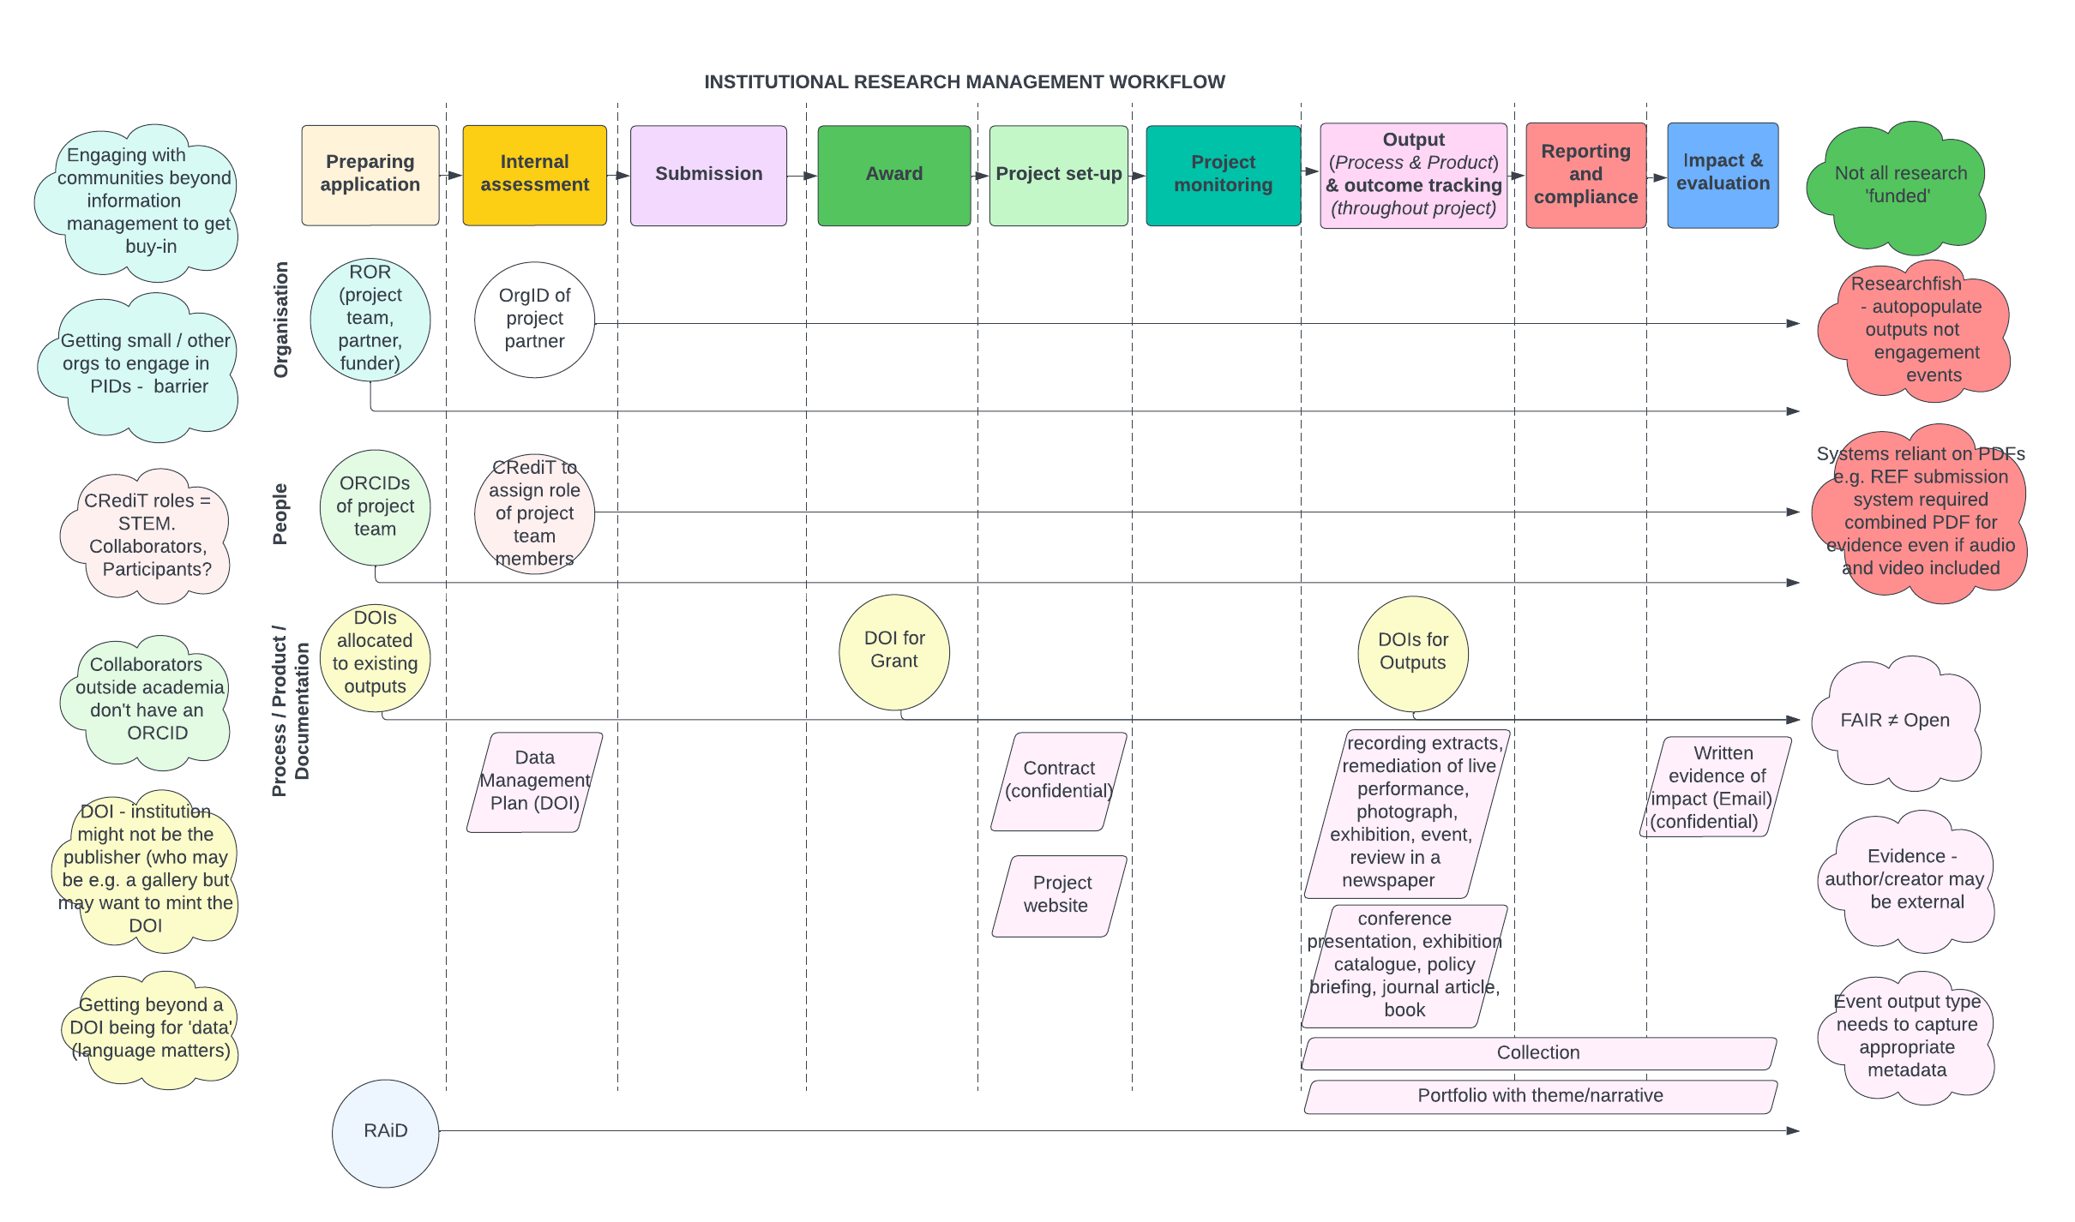
PR Voices FINDINGS relevant to INSTITUTIONAL RESEARCH MANAGEMENT workflow
Notes:
PR Voices findings as relevant to the institutional research management workflow.

Slide 17
Thank you, questions…and contact us
@prvoices
https://blog.westminster.ac.uk/prvoices/
H.Ranger@westminster.ac.uk
wattsn@westminster.ac.uk
adam.vialsmoore@jisc.ac.uk

