Slide 1
The backstage effects of working with metrics
Emma Elkington

Slide 2

My Research
My initial title: Struggling with metrics as a middle manager in a UK Business School
What I came to notice: The ribald acts, gossip and other backstage (or hidden) conversations when metrics were used

Slide 3
My Organisational Context
Training is as an accountant as an audit trainee in a Big 4 Accounting practice
Professional Education
Higher Education in UK Business School

Slide 4
My narrative examples (pre-covid)
Disguise
Anonymity
Gossip
Ribald Acts
Notes:
Pete, who had done badly in the teaching metrics we had been presented with, slapped his own behind, whilst saying, in time to the slaps “you very naughty boy”. My colleagues and I guffawed loudly behind our hands.
I was walking back from the refectory with my sandwich when I heard sounds of running behind me. A colleague, who I knew remotely, puffed up to me and asked me “so, I hear Bernard has been sacked. What’s that all about?”
I received a text from Heidi the night before the away day. “I am so upset she said. I got my personality profile. What did you get?” I replied. “I think I am expected to arrange the orgies”, I responded. “Thruster- Arranger”. “Me too” she replied. We corresponded about what we might wear to demonstrate our ‘personalities’, and in the away day made lewd gestures to anyone we met with our profile was mentioned. Some colleagues laughed along whilst others looked disgusted.

Slide 5

Why pay attention to these acts?
Notes:
Surely these acts are just grumbling or cheating. Why do we think they may be important?

Slide 6
Scott (1990): Domination and the Arts of Resistance
Notes social sciences focus on the official or formal relations between the powerful and the weak
Interested in the wide variety of low profile forms of resistance
Paying attention to acts such as shirking, gossip, and ribald acts helps us to map a realm of possible dissent.
Introduces the term "infra-politics" to capture the notion of an unobtrusive realm of political struggle
Notes:
Writes about slavery and oppression.
Notes social sciences focus on the official or formal relations between the powerful and the weak which he emphasises hardly exhausts what we might wish to know about power.
He was interested in the infra-politics of subordinate groups- a wide variety of low profile forms of resistance that dare not speak in their own name.
Paying attention to acts such as shirking, gossip, and ribald acts helps us to map a realm of possible dissent. Techniques can be divided into those that disguise the message and those that disguise the messenger.
The hidden transcript is, for this reason, the privileged site for non-hegemonic, contrapuntal, dissident, subversive discourse
Scott introduces the term "infra-politics" to capture the notion of an unobtrusive realm of political struggle. It is often invisible, largely by design, born of a prudent awareness of the balance of power.

Slide 7
Elias & Scotson (1994): The Established and the Outsiders
Studied relations between an established group and outsiders in a British housing estate
Argue that social order and the creation and preservation of groups are closely related
Argue that gossip may help maintain identity and power differentials of the insider group.
Notes:
Studied relations between an established group and outsiders in a British housing estate to explore some conclusions on the interplay of individuals and society and the extent that social configurations limit the scope of idviduals decisions in a compelling way
They argue that social order and the creation and preservation of groups are closely related
They argue that gossip may help maintain identity and power differentials of the insider group. In gossiping we surreptitiously maintain/or create alliances and processes of alienation

Slide 8
How do these texts add to our understanding?

Slide 9
What emerging conclusions am I drawing in my work?
Processes of Subjugation and Subterfuge emerge in paradoxical patterns of conforming & resisting and inclusion & exclusion, which have the potential to shift power relations
We are as constrained and enabled by power relations in the hidden transcript as we are in the public transcript
Middle managers are neither totally dominant nor totally subordinate

Slide 10
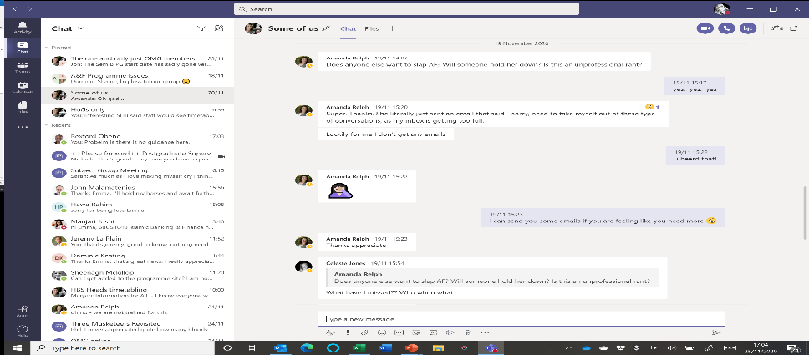
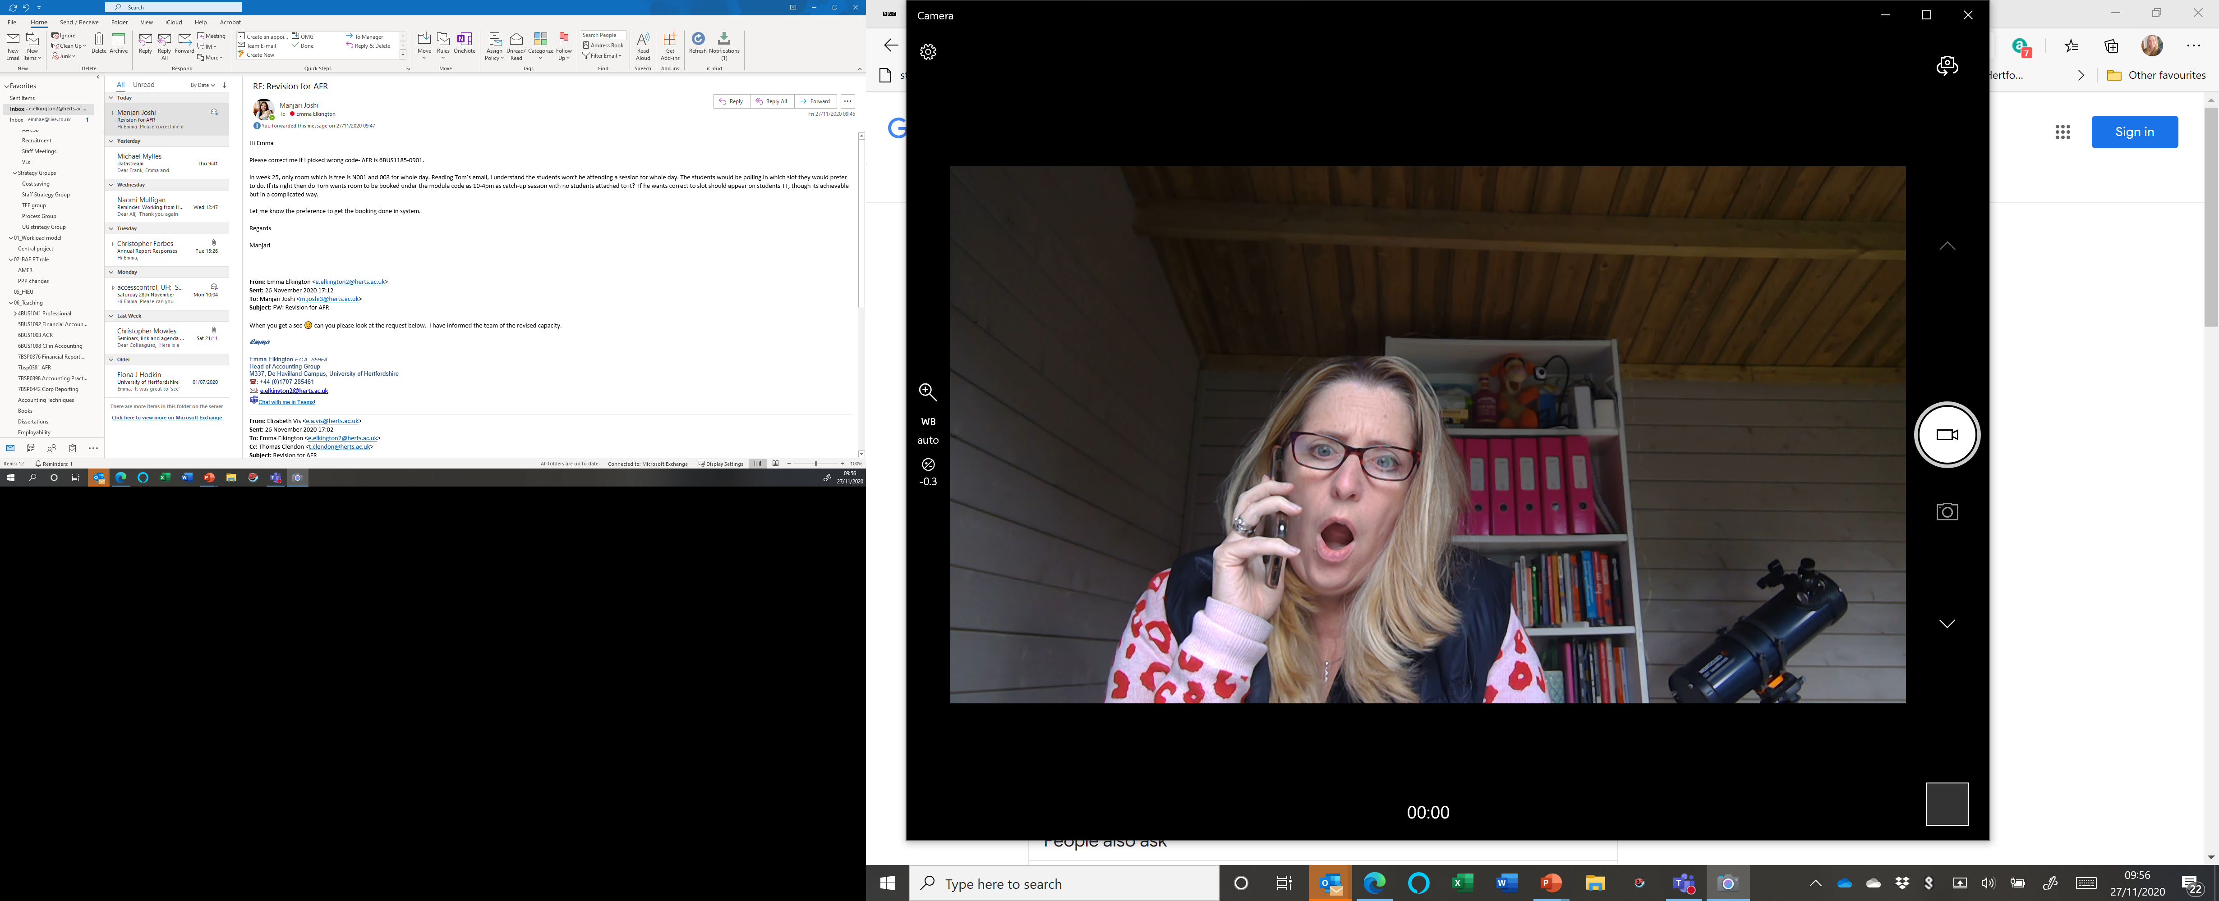
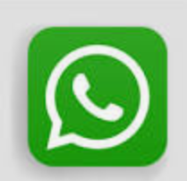
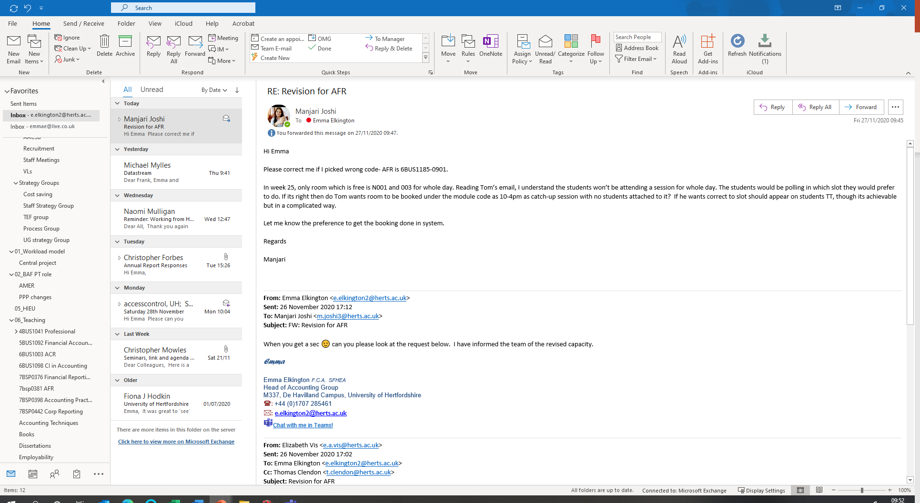
How has gossip transformed post-covid?
Notes:
My life now:
In a shed at the bottom of my garden
Kids and husband in the house – all working all day
Online meetings in MS teams. Rolled out on 13th March 2020. UH meeting etiquette….cameras off. Microphone off unless speaking.
What I became interested in – who talks in meetings, who adds to the chat function in meetings, who is on the heads only chat (and who isn’t!), who texts me separately., when we use the WhatsApp group we also have
Who and how people ‘throw their toys out of their pram’
Who rings me and for what…. Those who cant get teams working…..those who are crying – literally
Walking with the one head who is geographically close to me.
Who I don’t talk to at all - the Dean!

Slide 11
Exploring what has changed and why this may be a problem (or not)?

