Slide 1
Collaborating with users to create a repository fit for practice-based research
A case study from the University of Westminster
Nina Watts, Repository & Open Access Manager
Research & Scholarly Communications,
University of Westminster
e: wattsn@westminster.ac.uk

Slide 2
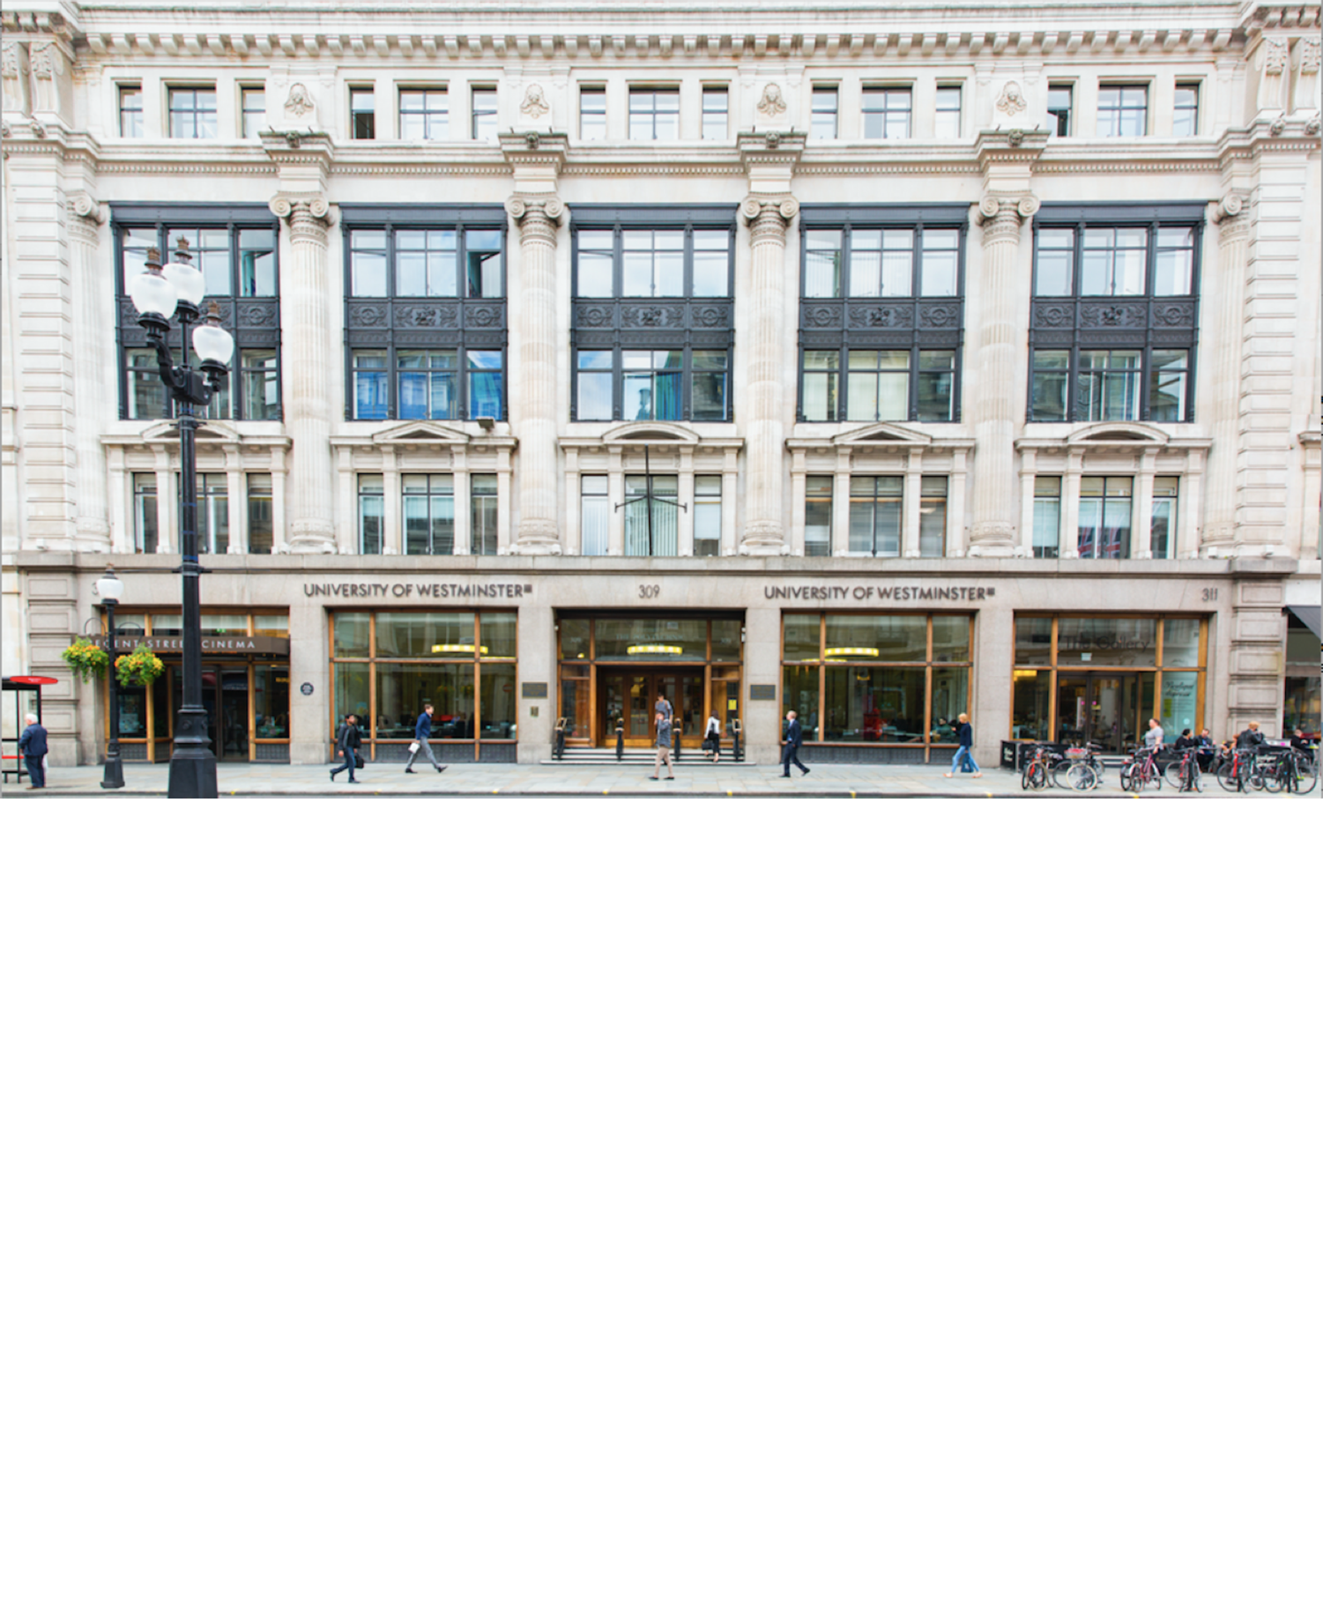
About the University of Westminster
4 campuses centrally located in and around the London area.
Over 19,000 students from 169 countries, 866 academic teaching staff, 680 visiting staff and 928 support staff.
World leading research in Art and Design and Media and Communications; Internationally excellent research in English, Architecture and the Built Environment, and Allied Health; Excellence in Psychology and Neuroscience, Politics, Area Studies and Law (Research Excellence Framework, 2014)

Slide 3
Early Days for WestminsterResearch
2004 Westminster installed an early version of the E-Prints repository
Also in 2004 – I was completing my masters whilst working at the University as a Casual Library Assistant
An annual exercise had been ongoing since RAE2001, gathering publications data on spreadsheets
2006 – no. of outputs had reached critical mass and WestminsterResearch went live

Slide 4
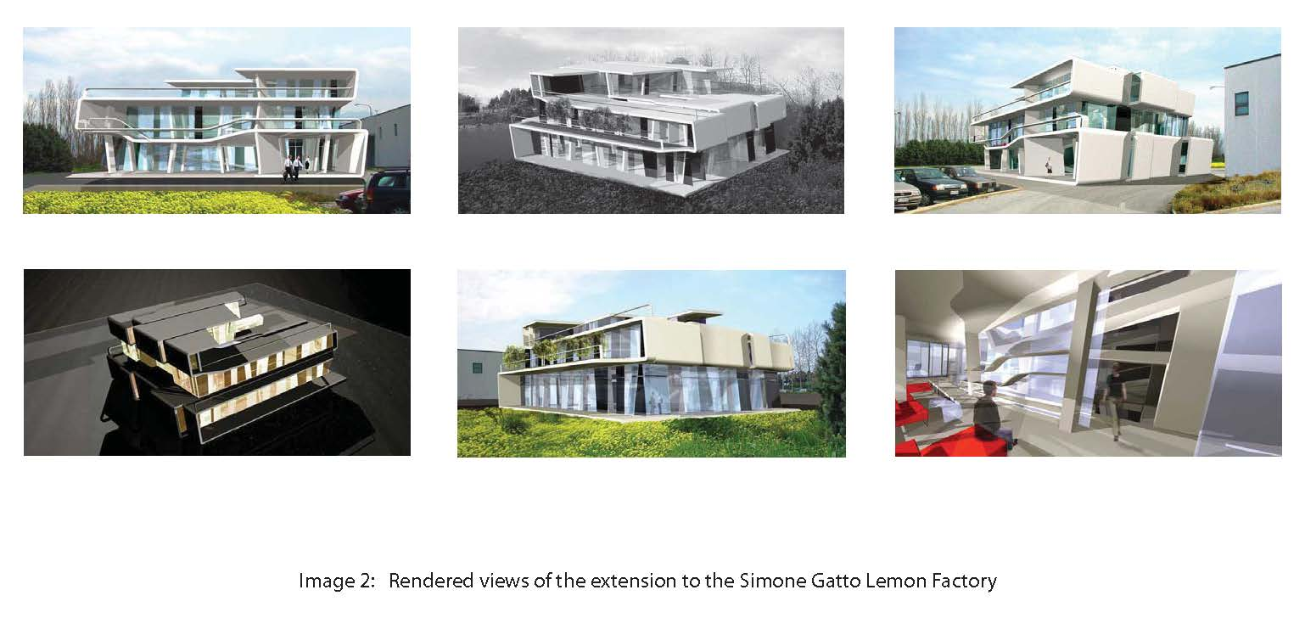
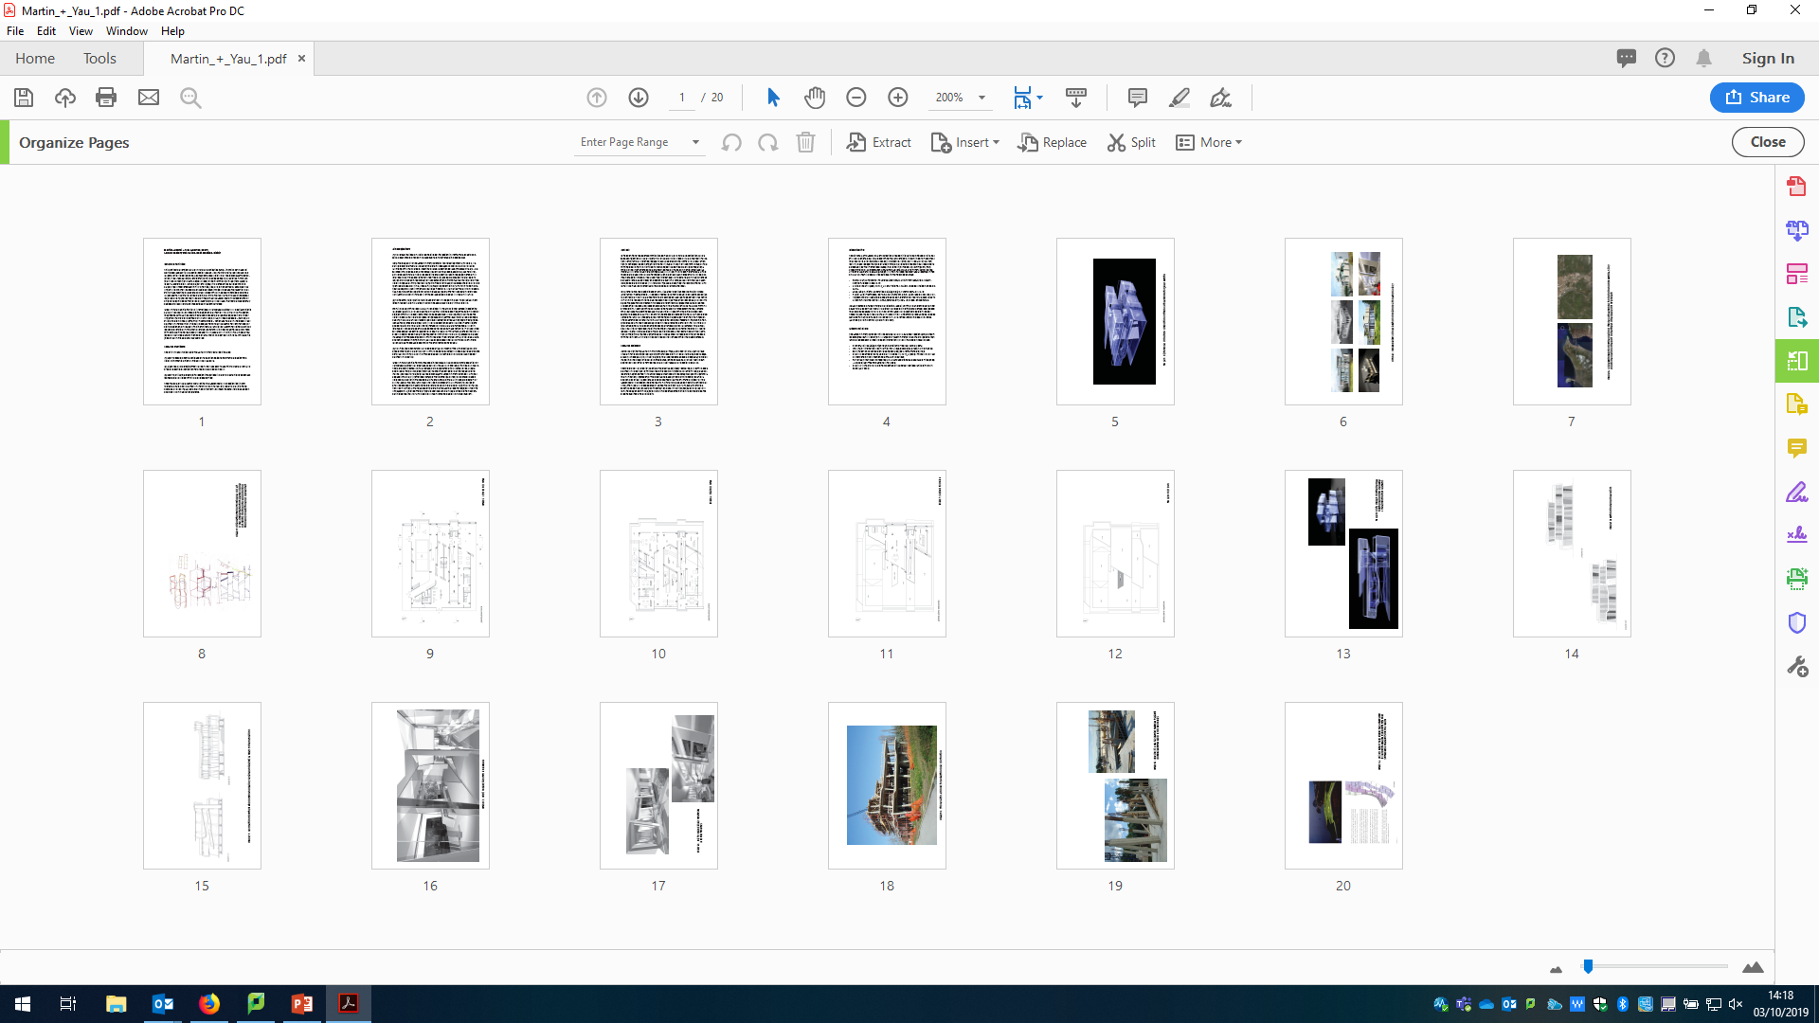
First Steps with Practice Based Research
Good Intentions
Post RAE2008 the Architecture Unit lead gave us their complete portfolios which we added as artefacts.
Taken from https://westminsterresearch.westminster.ac.uk/item/91v79/lemon-factory-extension

Slide 5
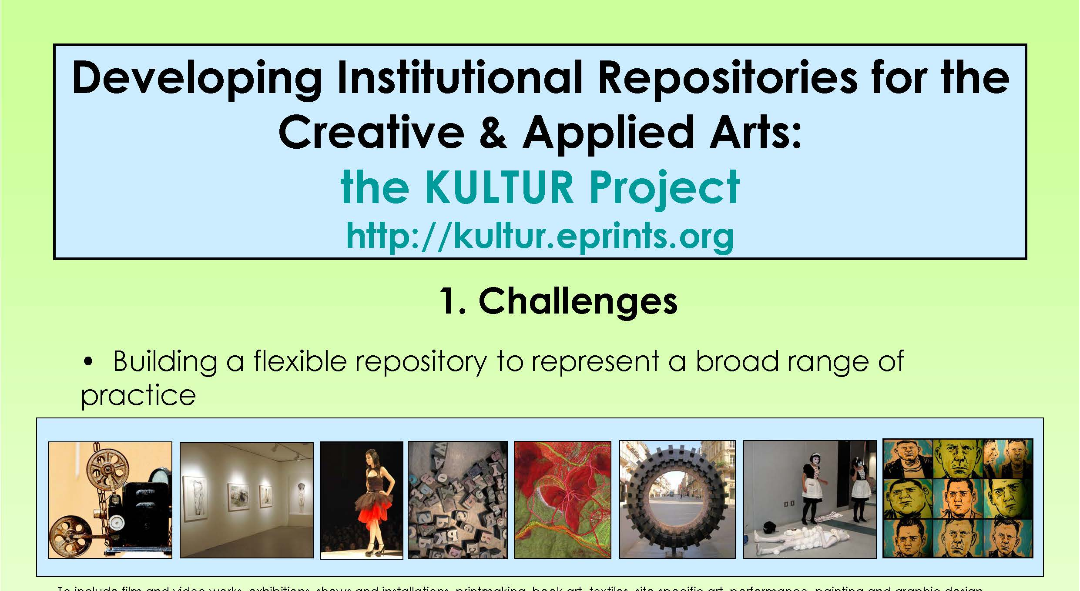
First Steps with Practice Based Research
Initial discussions with practiced-based researchers didn’t go far
WestminsterResearch did not look good
Kultur and Kultivate, etc.
REF2014 – basic records of all outputs added to repository, in order to push to the REF submission system
Section of Kultur Poster from DCC 4th International Curation Conference, Edinburgh (Dec 2008) http://kultur.eprints.org/docs/Kultur%20poster%20DCC.pdf

Slide 6
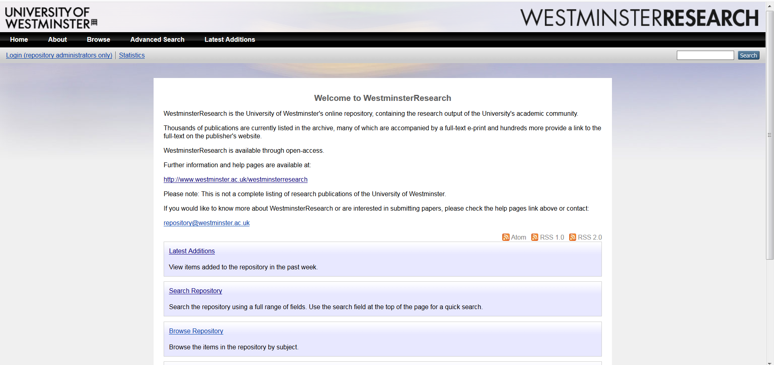
WestminsterResearch Homepage
August 2018

Slide 7




Haplo
2014 Virtual Research Environment
1 - PhD Management
2 - Ethics
3 - Outputs Repository (internal only) > ePrints

Slide 8
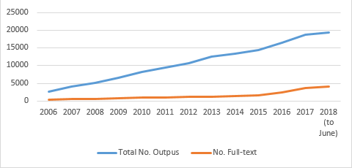
Number of outputs included in WestminsterResearch (2006 – June 2018)

Slide 9
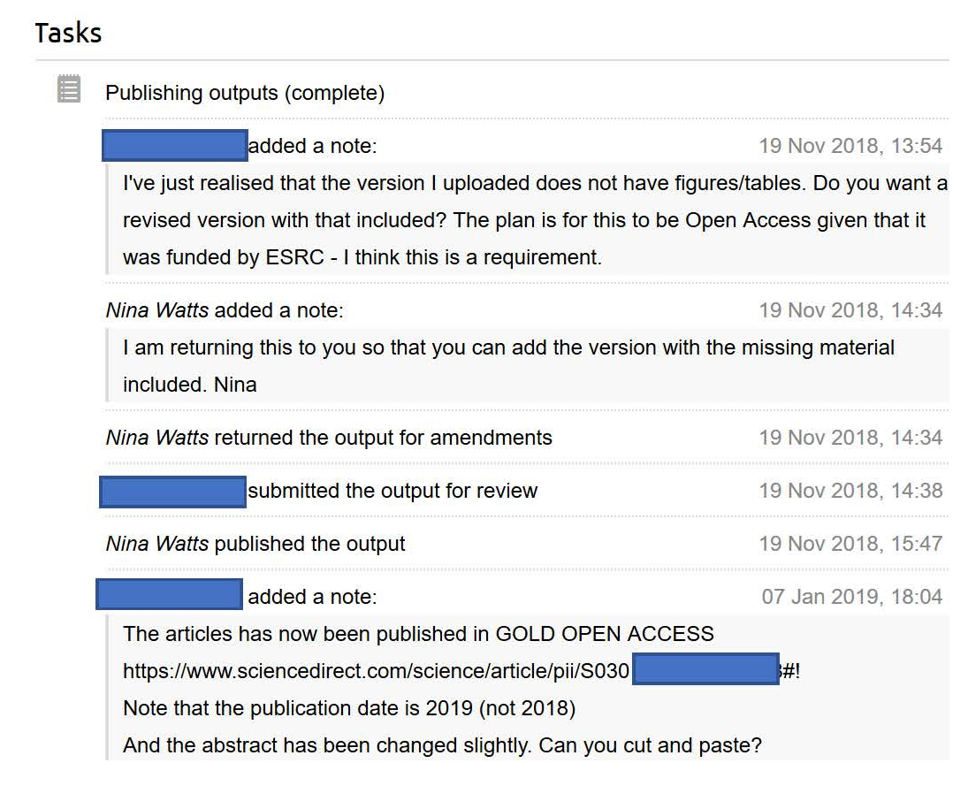
Workflow between the Researcher and the Repository Manager

Slide 10
‘All Haplo’ repository
2018 – Collaborated with Haplo
Planned improvements:
Better support for practice / non-text based research outputs
REF2021 submission support
Design overhaul
Rationalisation of author names
Related outputs

Slide 11
Key Strategies for Enabling Engagement
Collaboration between developers, repository team and researchers central to development
Embedding our academic community within governance structures
Understanding their drivers (including REF and time saving)
Understanding how they articulate their research
Involving them in requirements gathering, workflow mapping and testing
Reiterating the significance of terminology to researchers in these disciplines
Formal and informal advocacy and training

Slide 12
1 - Embedding our academic community within governance structures
Virtual Research Environment (VRE) Working Group
Research Data Management (RDM) Working Group

Slide 13
2 - Understanding their drivers
REF2021 output management
REF2021 portfolio creation
The benefits of having a complete record of ALL university research in one place
  Including potential feeds to research groups, and project, websites
  Increased exposure
  Possibility of making more research open (Most previous REF portfolios aren’t open)

Slide 14
3 - Involving them in requirements gathering, workflow mapping and testing
Start with research leads
1 to 1’s with ‘friendly academics’
Using existing contacts
Using the REF as the driver to get to more people

Slide 15
4 - Reiterating the significance of terminology to researchers in these disciplines
What is research data? Much wider than many first believe
Creators not authors
Descriptions instead of abstracts
Text based / Non-text based outputs
Collaborators with defined roles
Actor | Animator | Author of Screenplay | Calligrapher | Choreographer | Cinematographer
Composer | Conductor | Conference Organizer | Costume designer | Curator | Dancer
Designer | Director | Exhibitor | Film editor | Illustrator | Instrumentalist
Librettist | Film editor | Illustrator | Musician | Performer | Photographer
Printmaker | Producer | Production personnel | Programmer | Recording engineer | Researcher
Set designer | Singer | Translator | Videographer | Vocalist

Slide 16
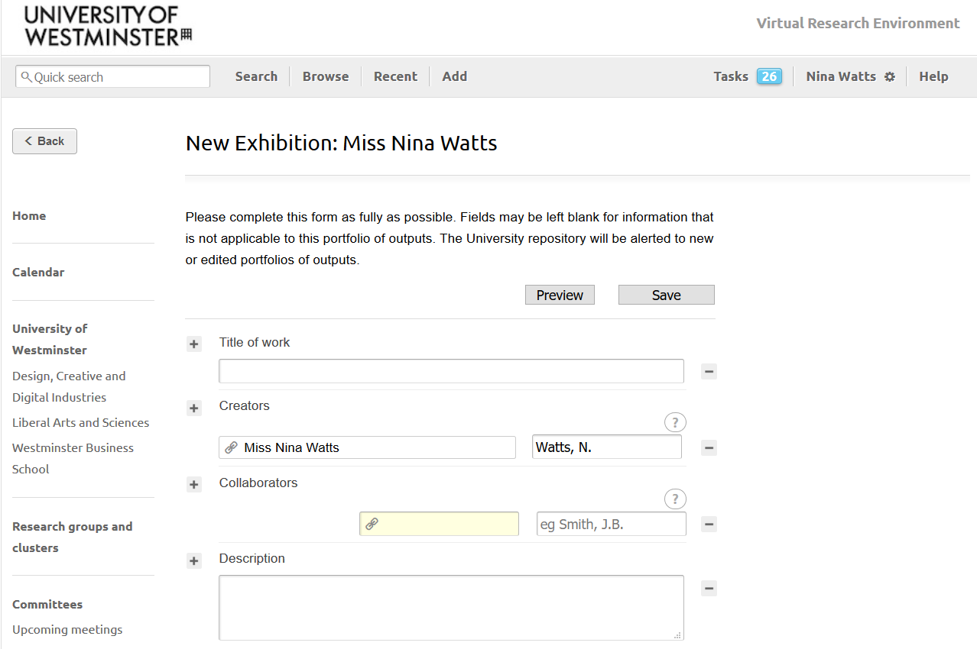

Slide 17
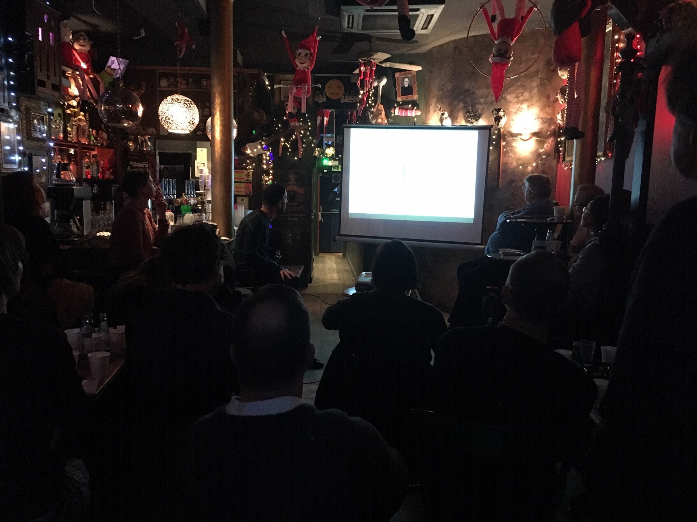
5 - Formal and informal advocacy and training

Slide 18
Challenges / Lessons learned
Changes and improvements have to work within existing standards to ensure interoperability
Changing goals / things got tangled up (scope creep)
Too reactive
Gathering requirements very early on in the life of repository
Diverse stakeholder group
Funder mandates focus on text-based outputs
High level of engagement has seen lots of feedback (too much at times)

Slide 19
Summary of Benefits
Current:
Metadata fields which more accurately record research
Massive increase in self-deposit
Increase in practice-based research outputs:
  261% from 2014 to September 2019
Portfolio/Collections functionality used to collate evidence for REF submission
Internal REF review same for all

Slide 20
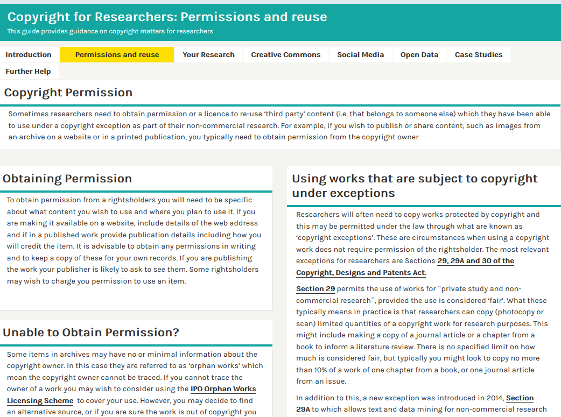
Summary of Benefits
Copyright for Researchers libguide, created for us by Jane Secker. (CC-BY)
https://libguides.westminster.ac.uk/copyrightresearchers/copyrightpermission

Slide 21
Summary of Benefits
Planned:
More openness to practice based research
How to record research that has a vital link to the space in which it takes place, or has tactile properties, etc. How best to record and share? The repository aims to hold a digital representation of the work, which is as rich as possible.
  EXAMPLE: Dr Julie Marsh’s work on Muslim prayer spaces
File access levels – data repository
Training on RDM and copyright aspects

Slide 22
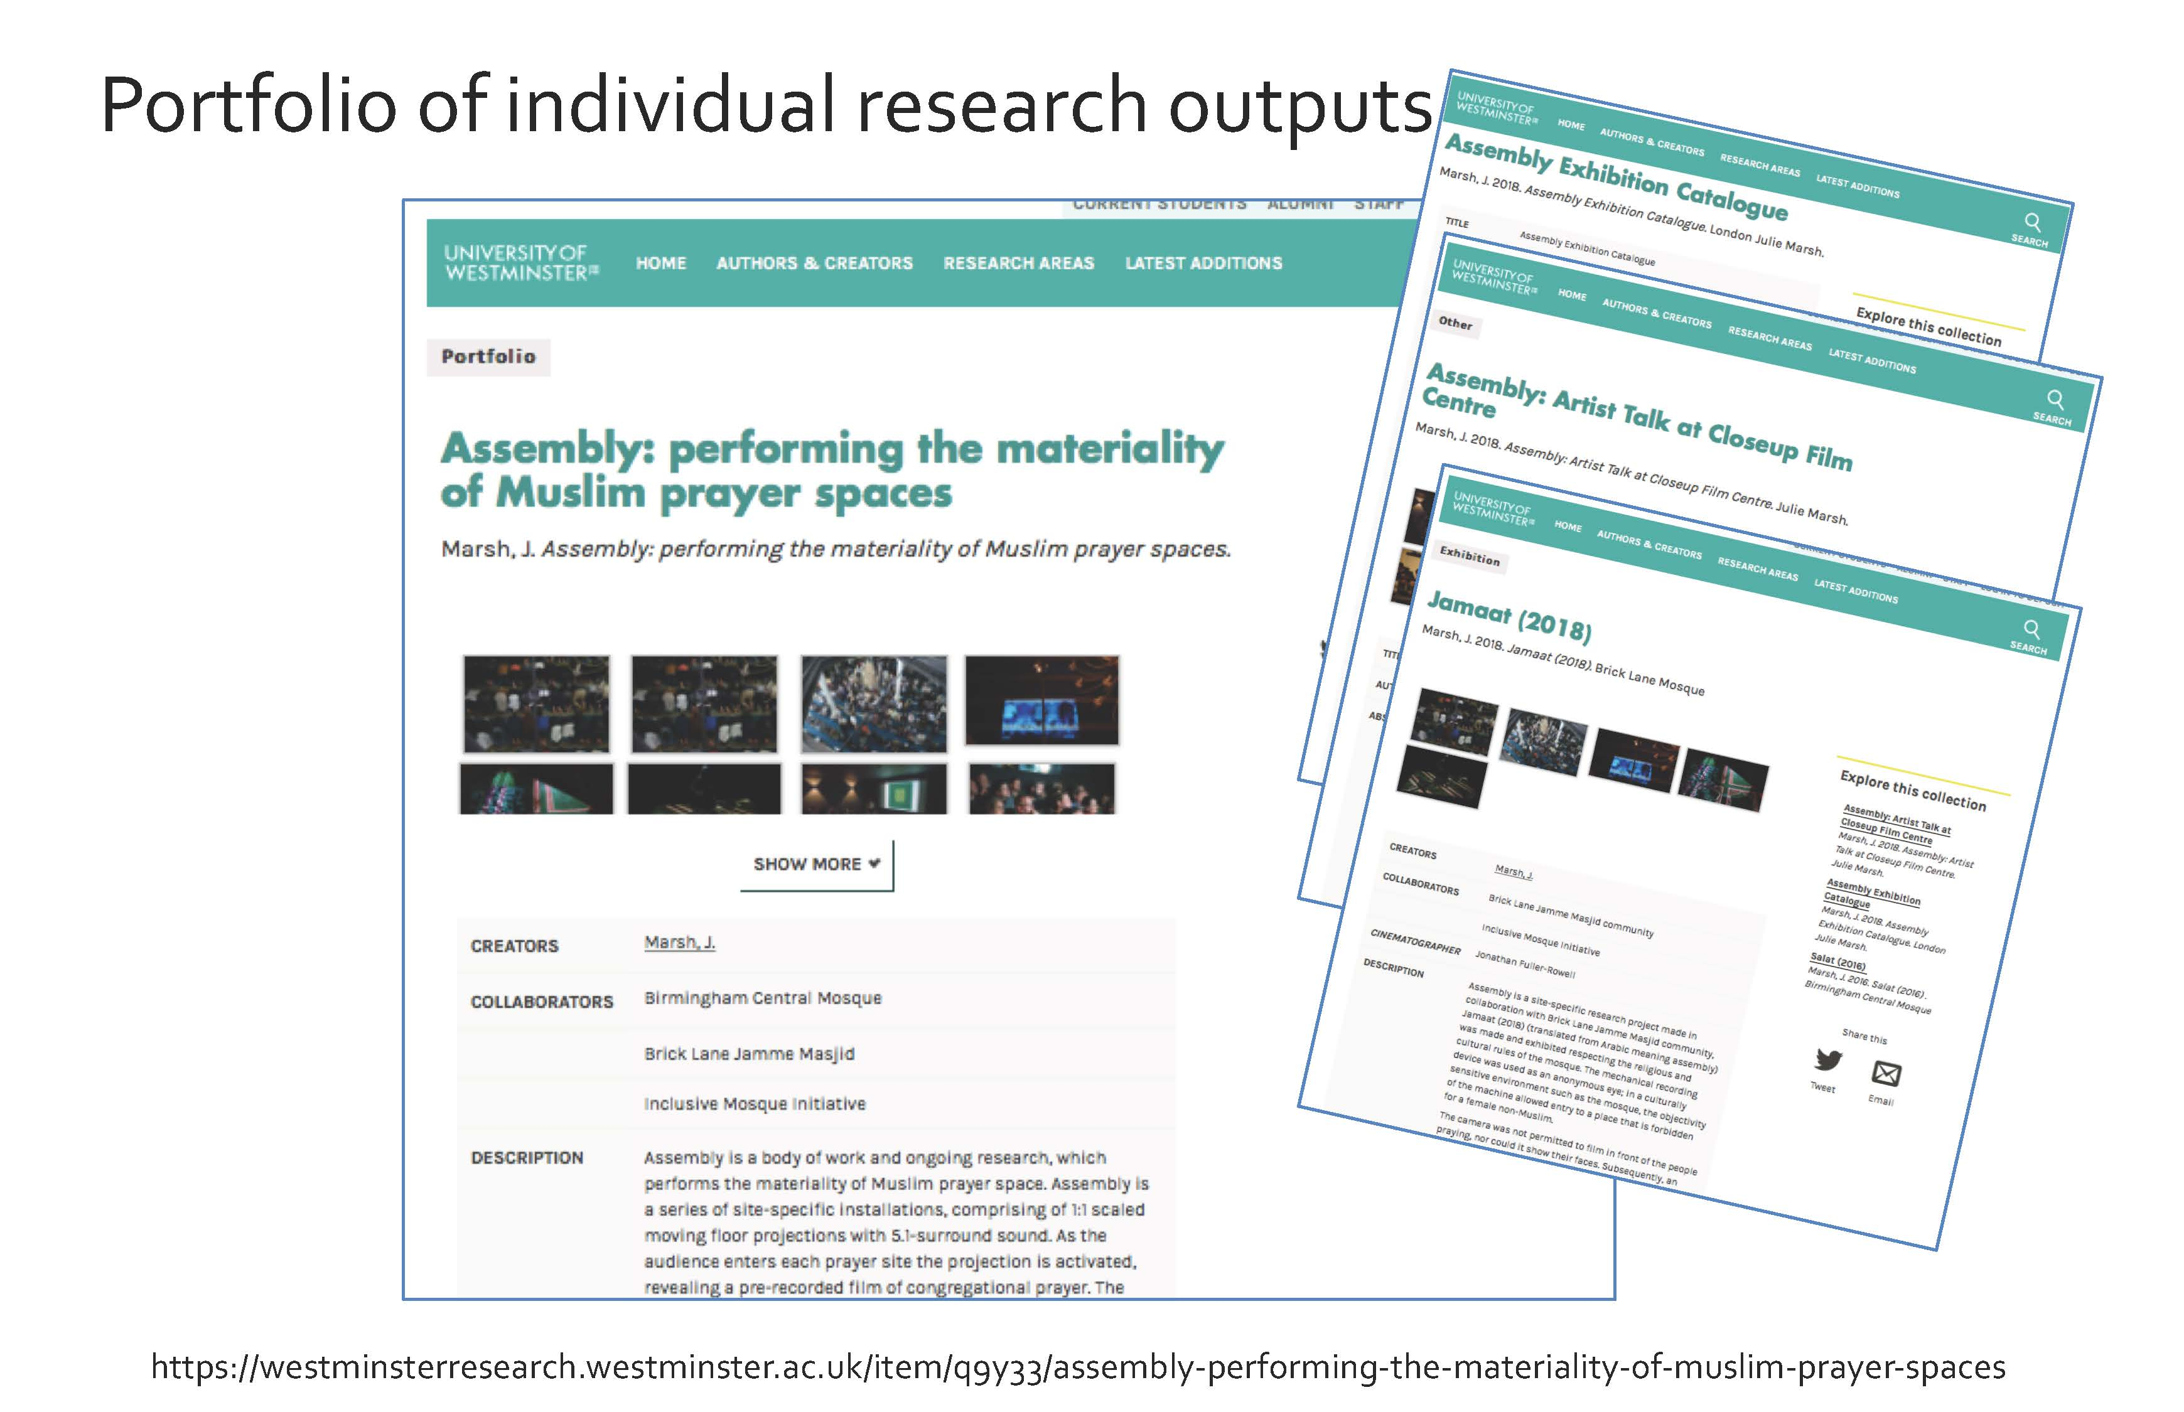

Slide 23
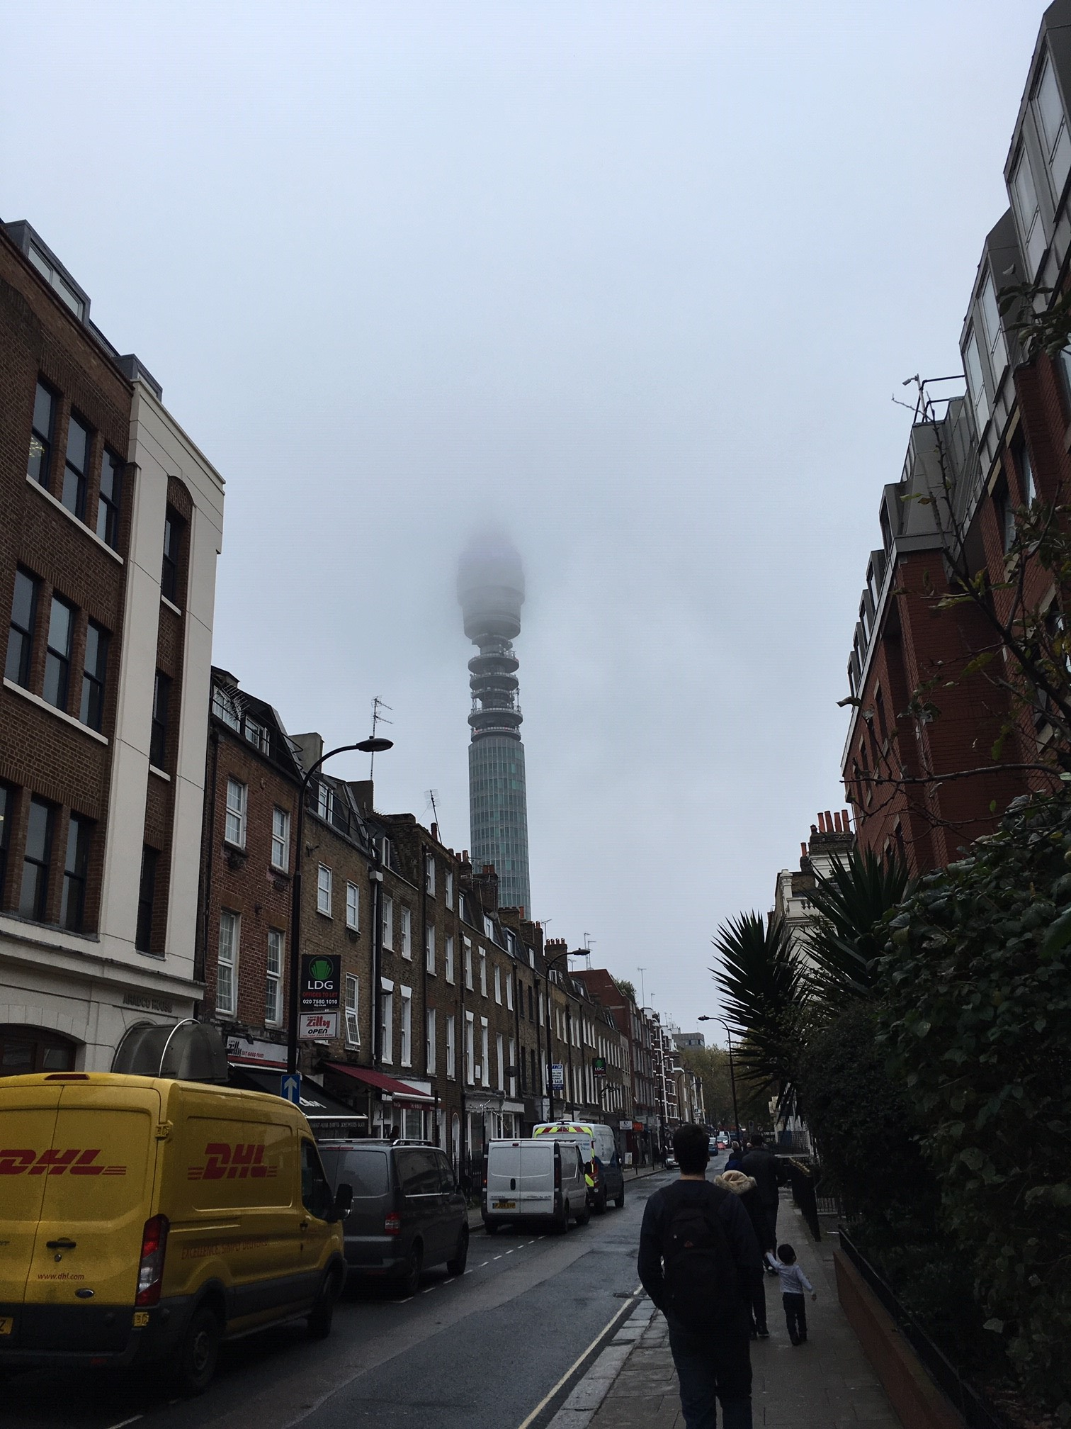
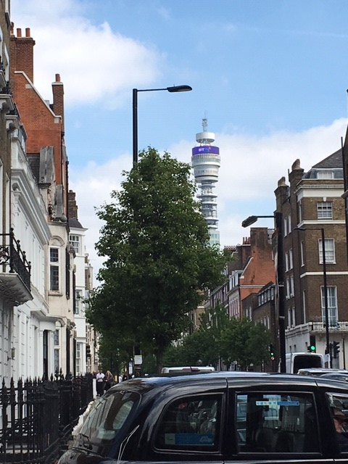
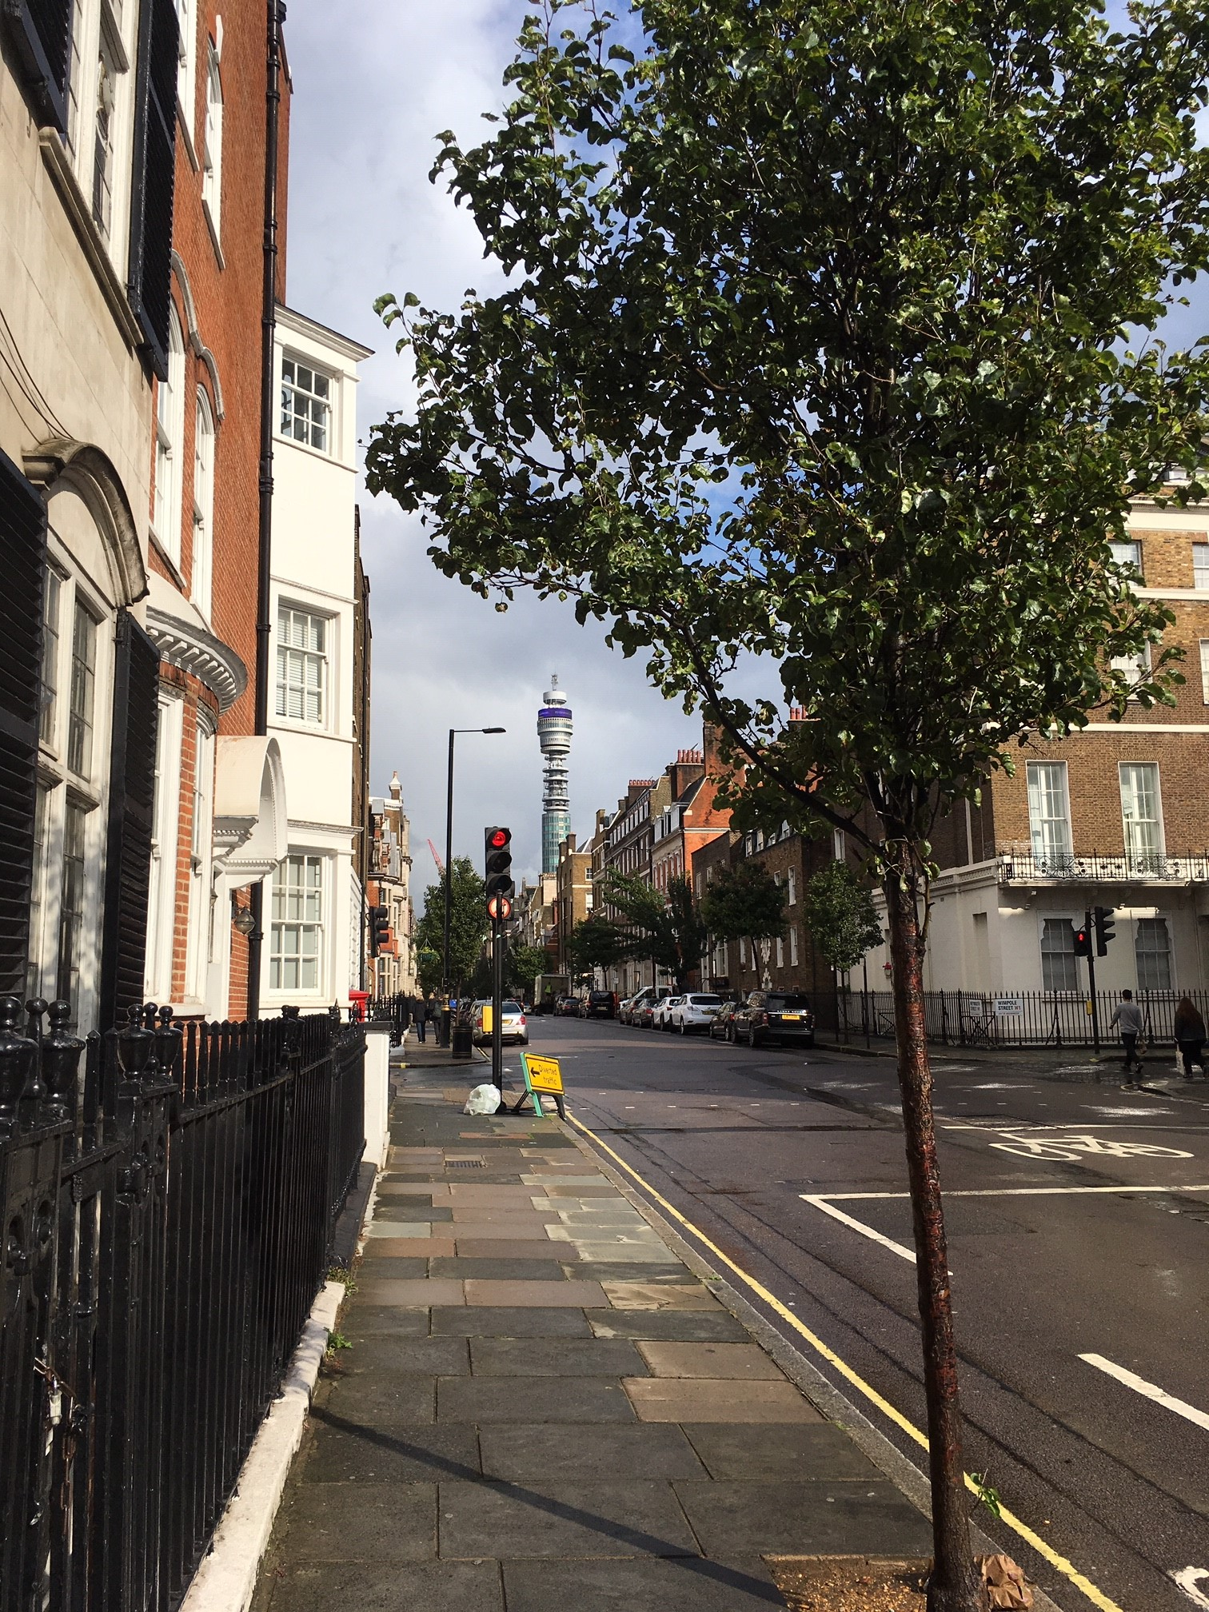
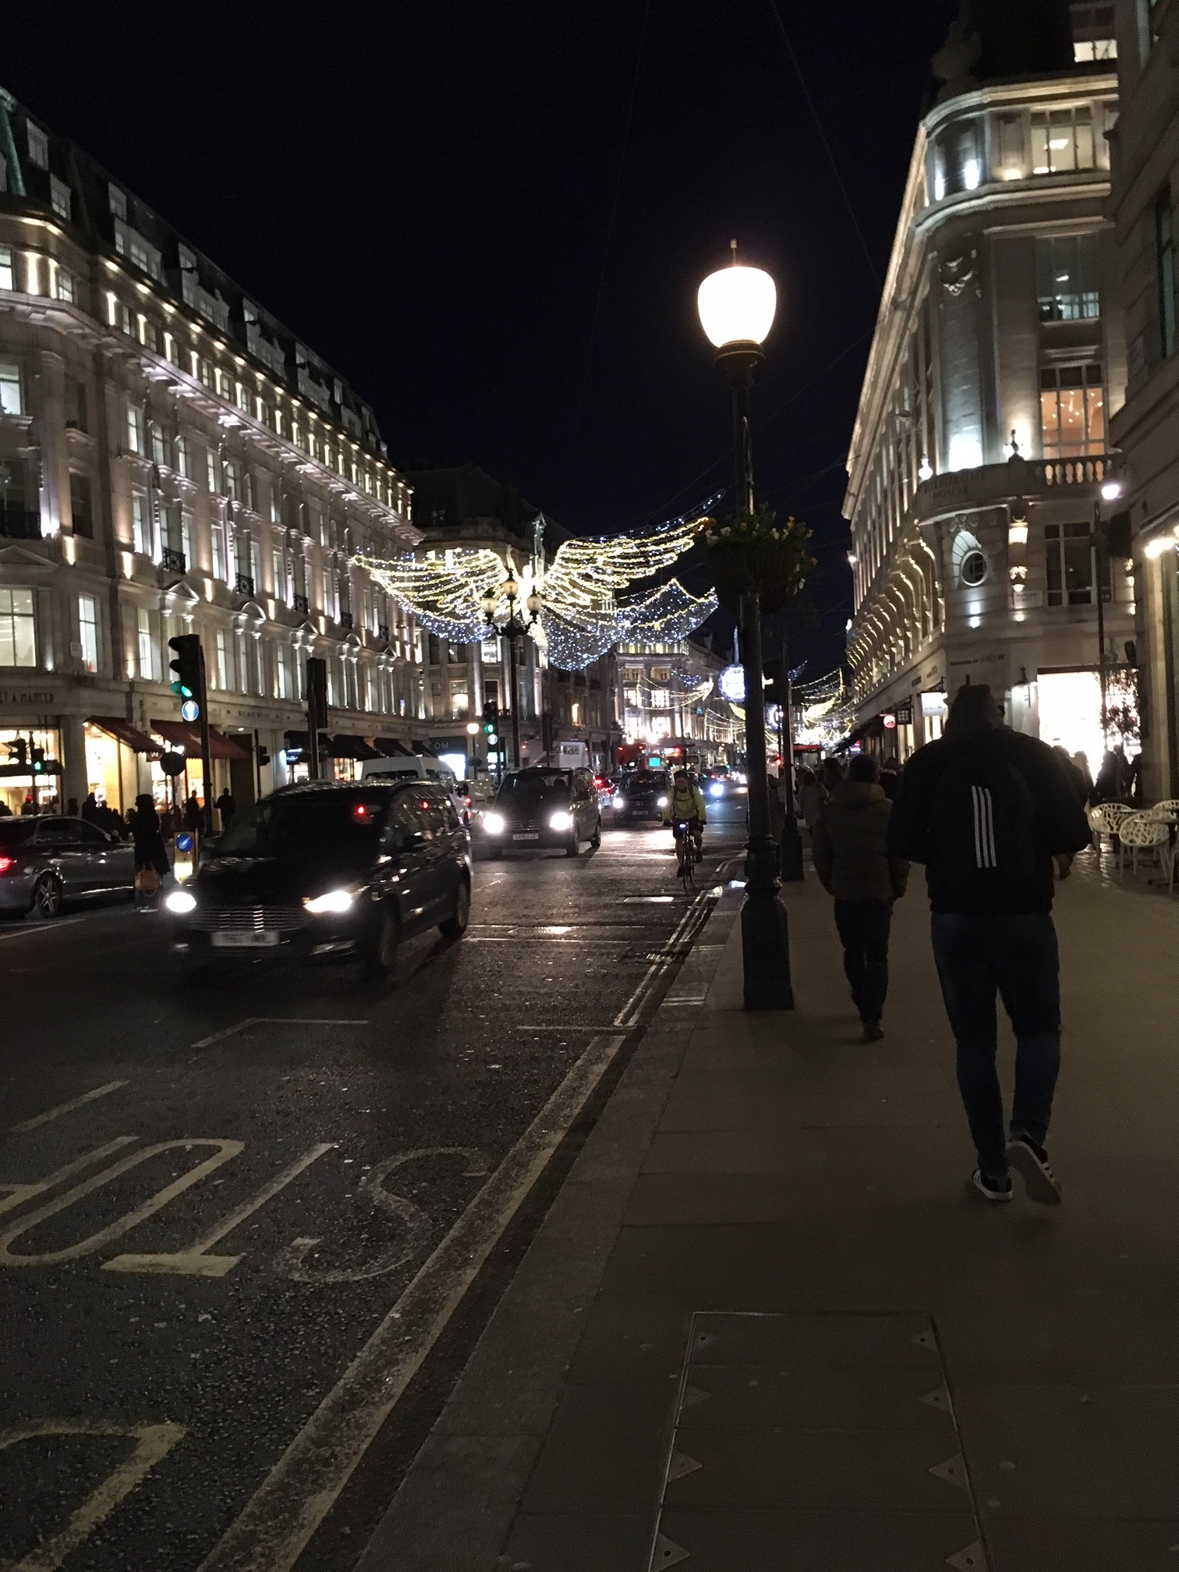
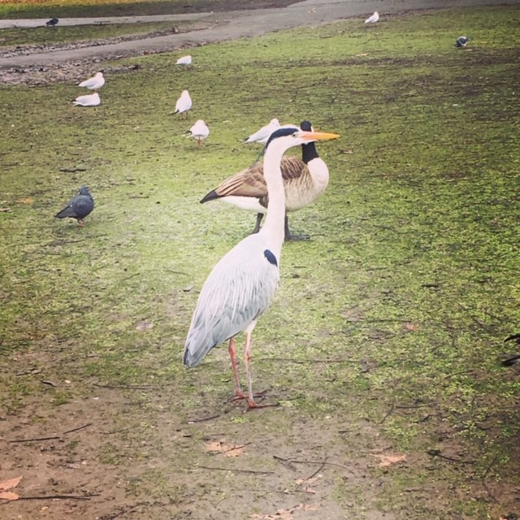
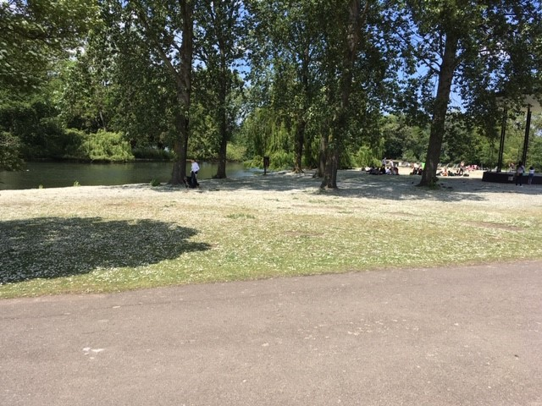
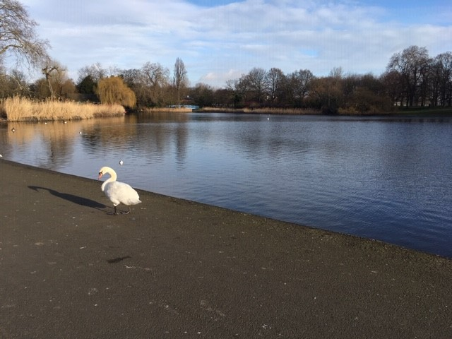
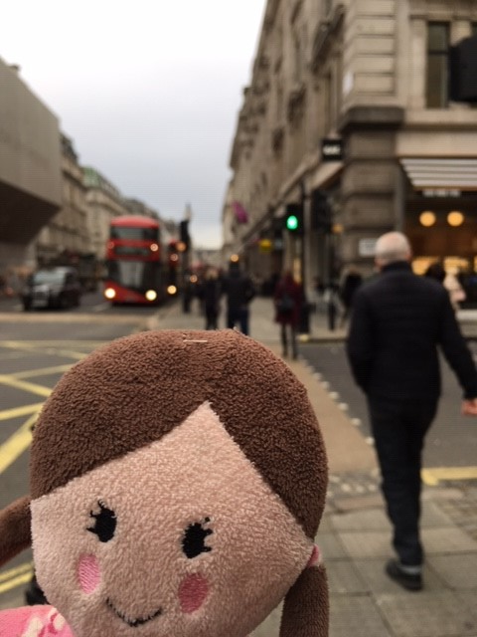

Slide 24
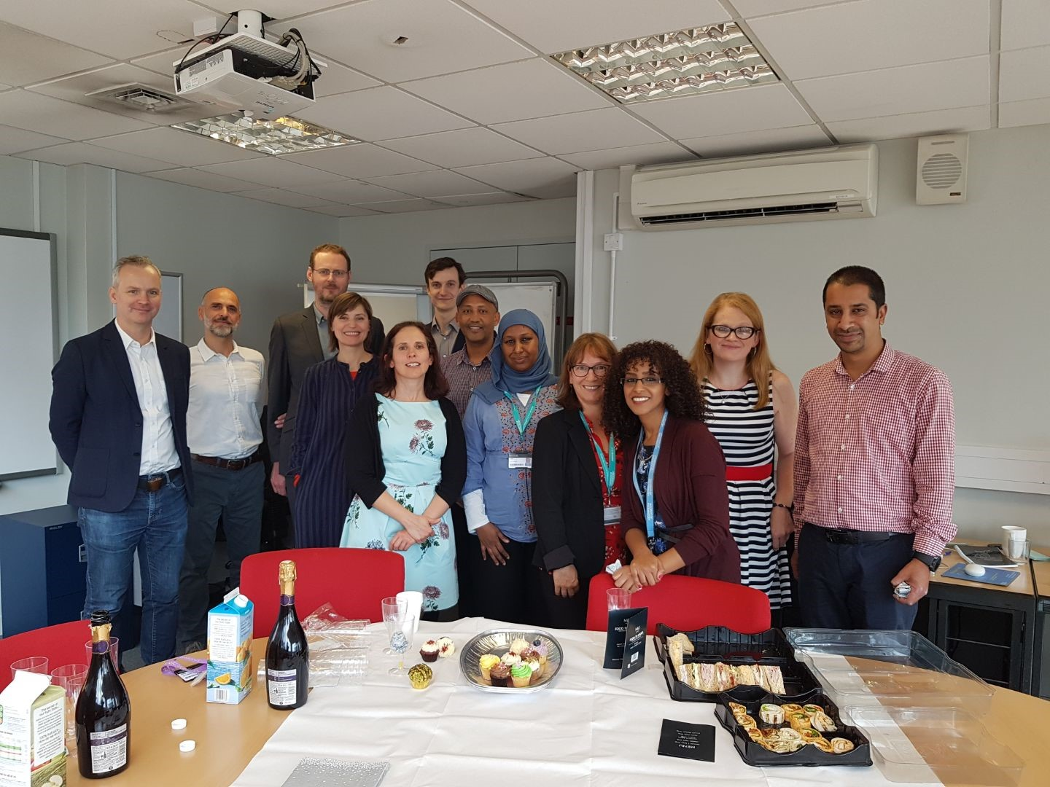

Slide 25

Thank you for listening
Nina Watts, Repository & Open Access Manager
Research & Scholarly Communications,
University of Westminster
E: wattsn@westminster.ac.uk

