Slide 1
University of Westminster 13th Learning and Teaching Symposium
Towards True Equality:
Engaging with LGBTI Students at Westminster
Dr Steven Cranfield (LGBT Staff Network)
Dr Francis Ray White (LGBT Staff Network)
Matthew Follows (UWSU LGBTI Student Society)
Jamie Wareham (UWSU LGBTI Student Society)

Slide 2
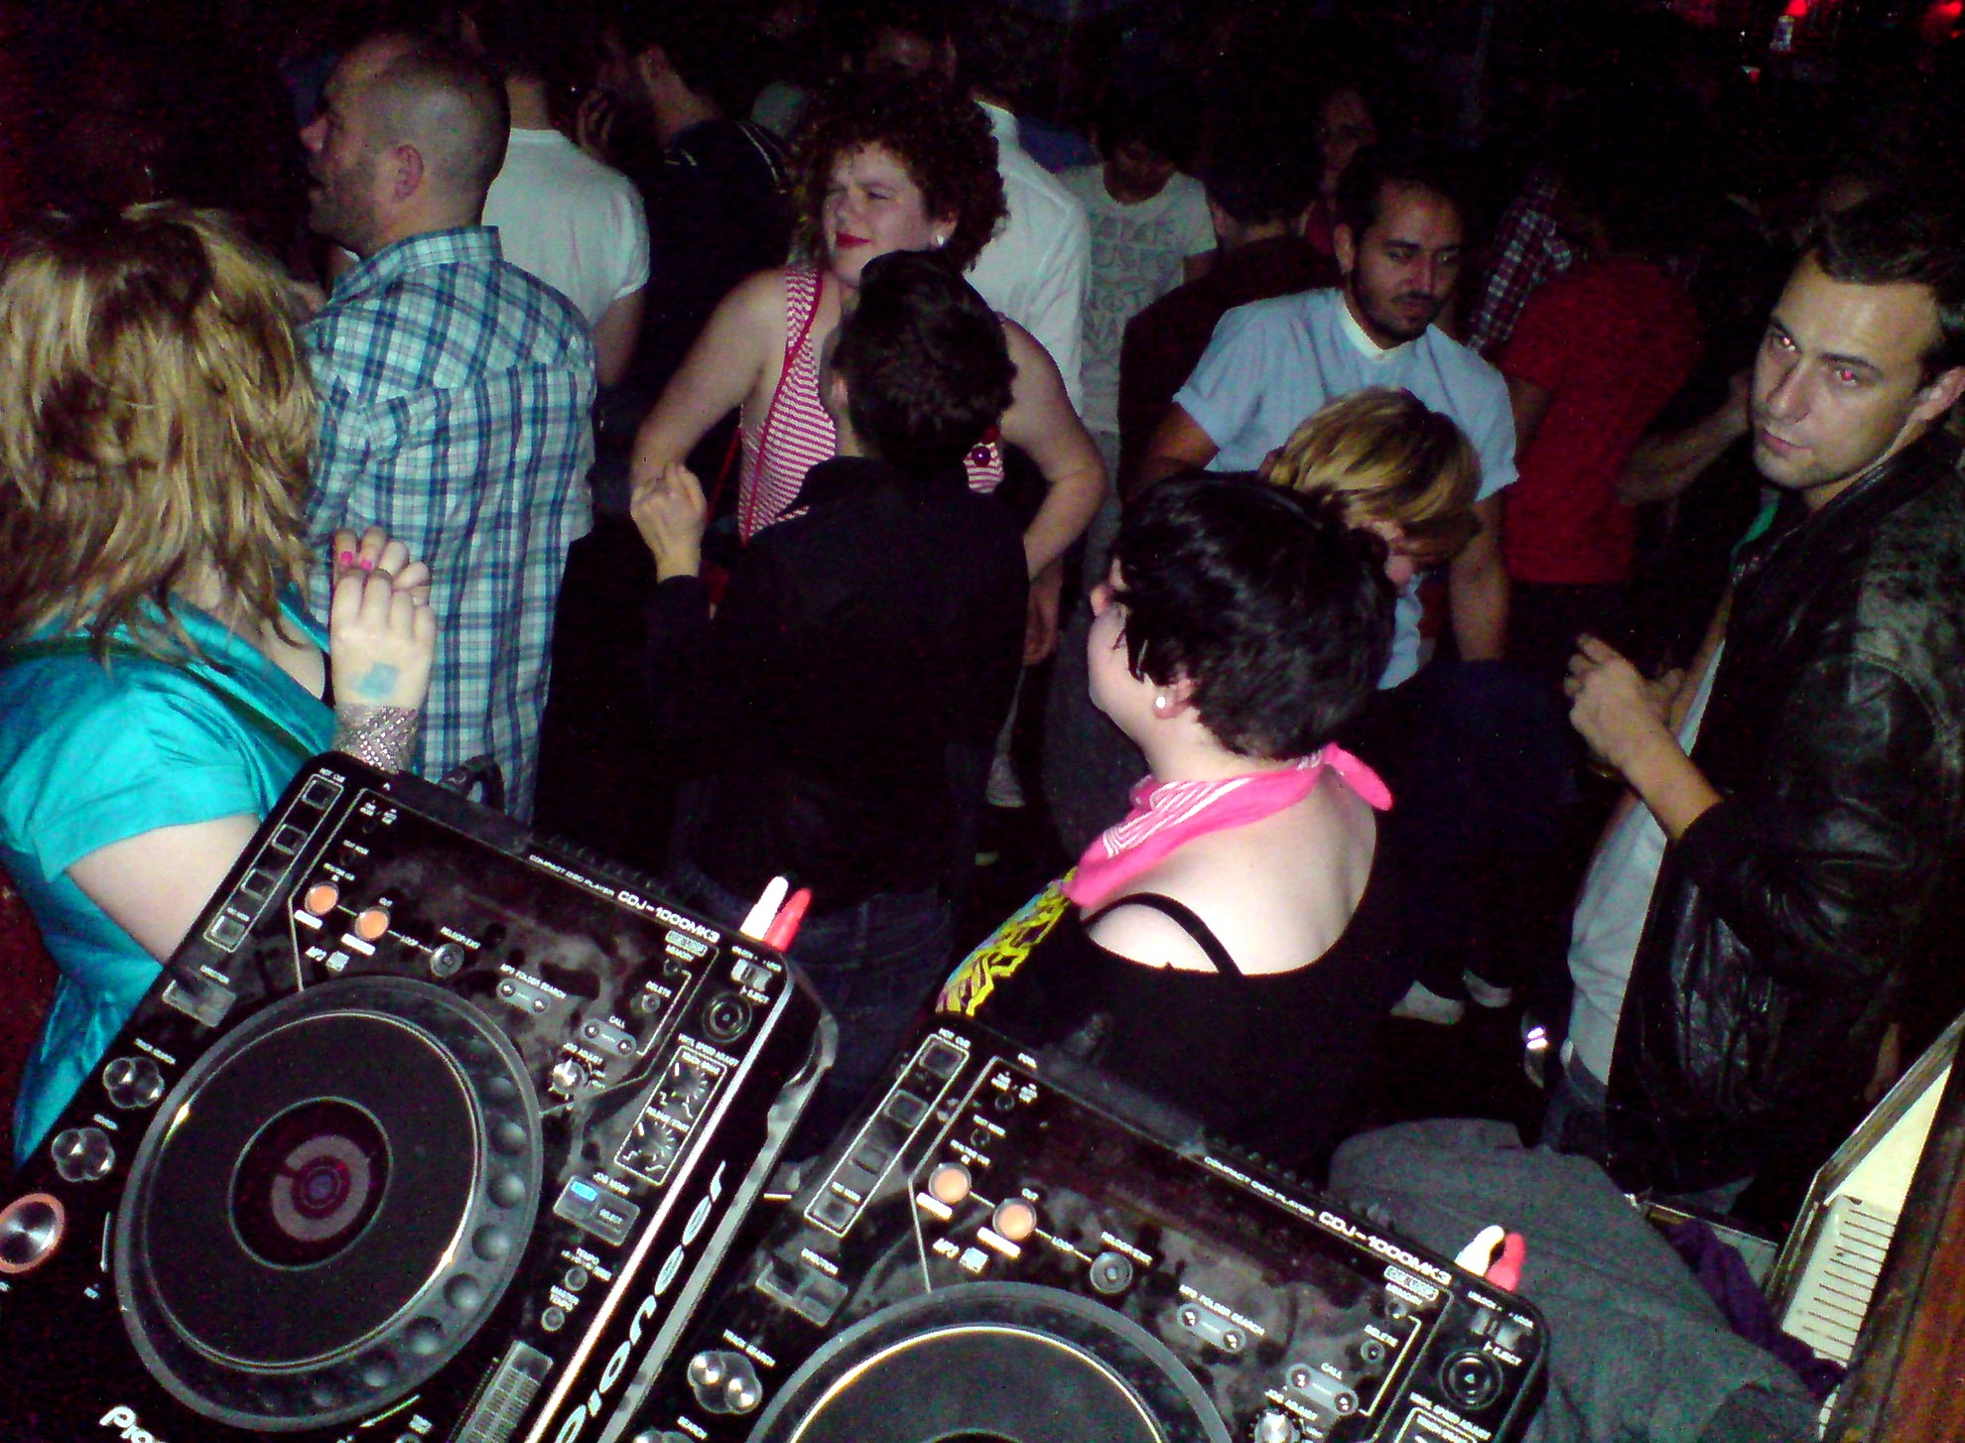

Slide 3
References
Gunn, V. (2010) Academic Development Discussion Briefing: Lesbian, Gay, Bisexual and Transgender (LGBT) Perspectives and Learning at University. University of Glasgow Learning and Teaching Centre.
NUS (2014) Education Beyond the Straight and Narrow: LGBT Students’ Experience in Higher Education. Available at: http://www.nus.org.uk/Global/LGBT-research.pdf
UWSU LGBT Society (2014) How Safe Do You Feel?: LGBT Students on Campus at the University of Westminster. Available at: http://punkandpolitics.co.uk/wp-content/uploads/2014/03/How-Safe-do-you-feel-UWSU-LGBT-Report-.pdf
Valentine, G., Wood, N. and Plummer, P. (2009) The Experience of Lesbian, Gay, Bisexual and Trans Staff and Students in Higher Education. Equality Challenge Unit Research Report.

