Slide 1

Twitter in Teaching Languages: Students' Perspectives
Mahammed Bouabdallah
Lecturer in Arabic
University of Westminster
@mahammedb

Slide 2
About Myself and my Courses
Lecturer of Arabic
General Arabic
Arabic for Specific purposes
Arabic for Media
Arabic for Business

Slide 3
The purpose of this presentation
Twitter can be best used for students’ learning.
To take away something practical with you and try it with your students/learners.
to share my experience with you, and get your opinion about it

Slide 4
The Rational
Will Twitter improve the learning experience?
Will be good for all/some students?
How it defer from VLE?
It would be difficult for any educator now to argue against the fact that the vast majority of students use SNT of some fashion.
Twitter is helpful for students in pursuing immediate feedback. Dunlap & Lowenthal (2009)
Twitter is helpful as an aid for peer tutoring and social interaction that revolved around academic issues. List & Brynat (2009).

Slide 5

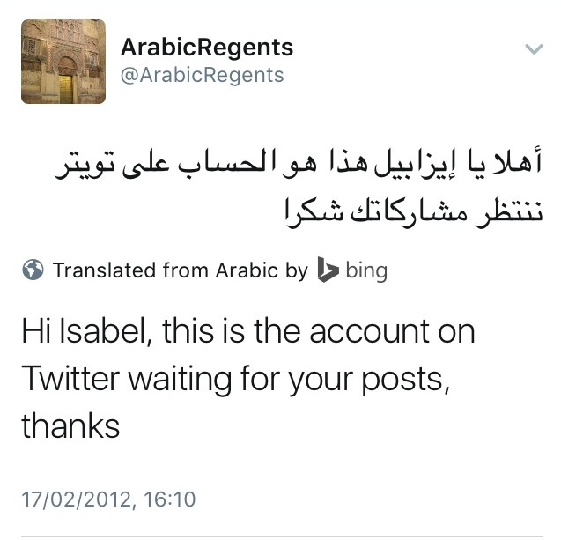
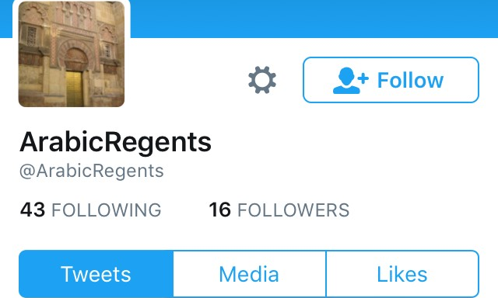
How I started Twitter in my Arabic classes?
A trip to the British Museum

Slide 6
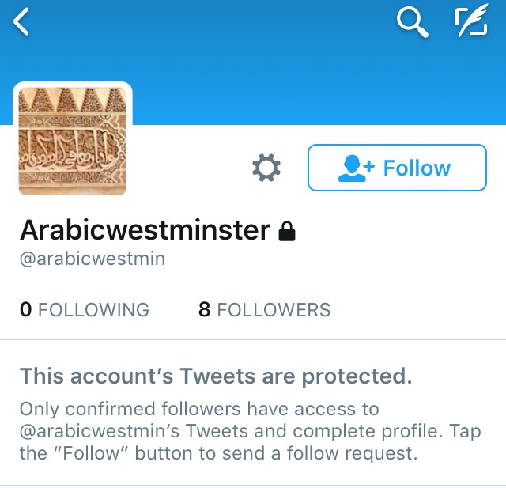
Our Twitter Account
Arabicwestminster @arabicwestmin
Protected account
At the end of the year, students will be blocked
We don’t delete the tweets.

Slide 7
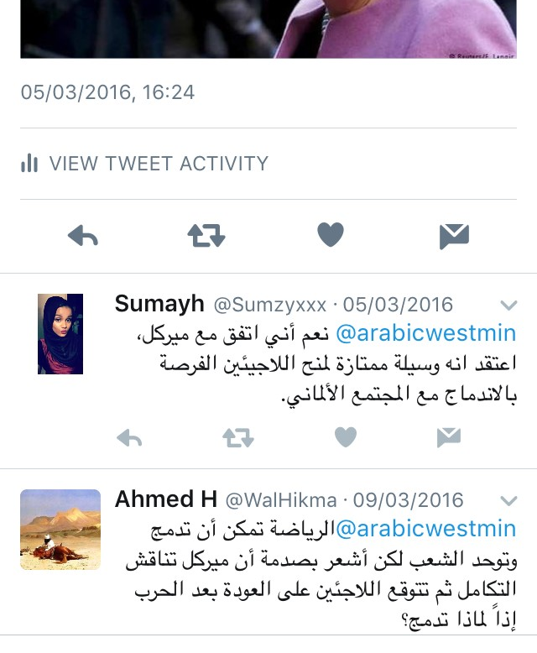
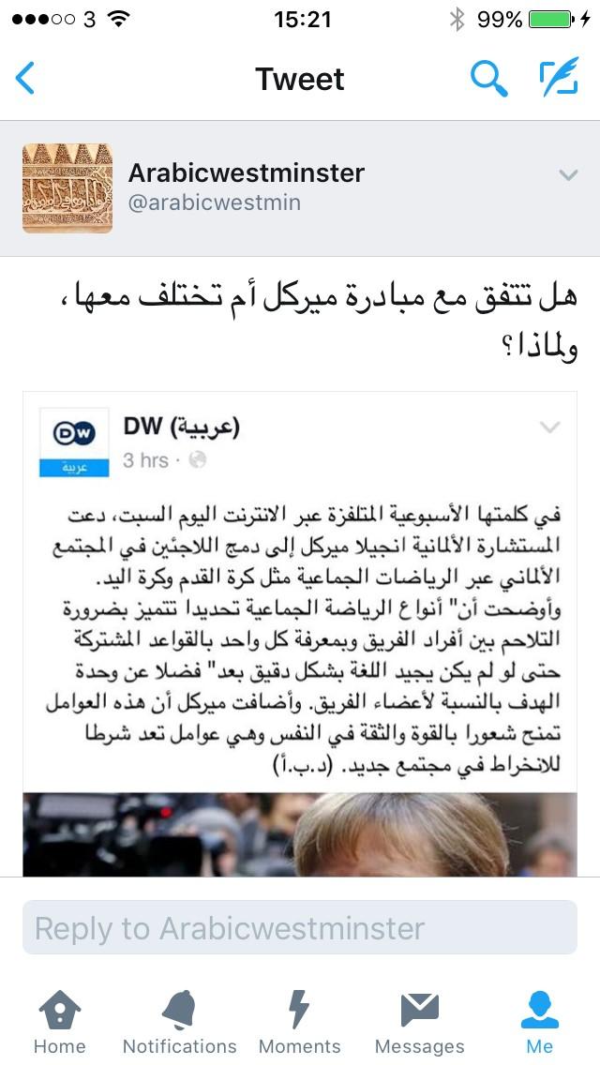
The activities
Comment on a statement/piece of news

Slide 8
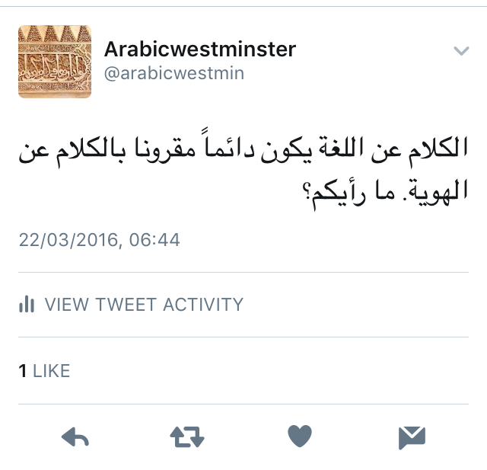
The Activities
Your opinion about something (related to the topics of the syllabus)

Slide 9
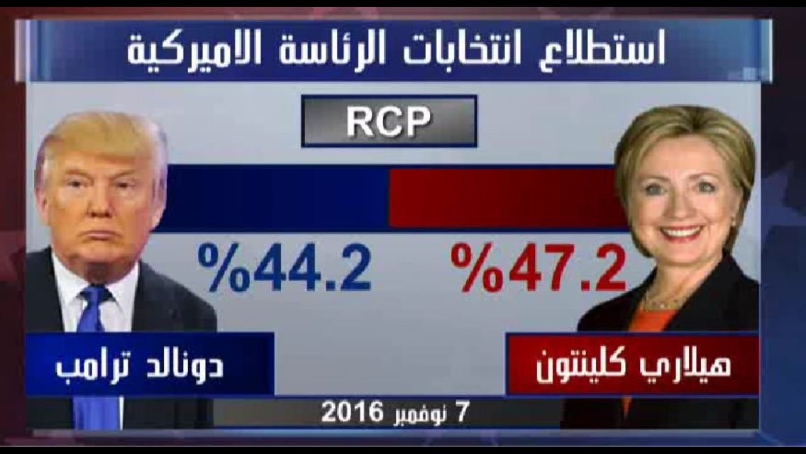
The Activities
Comment on a picture

Slide 10
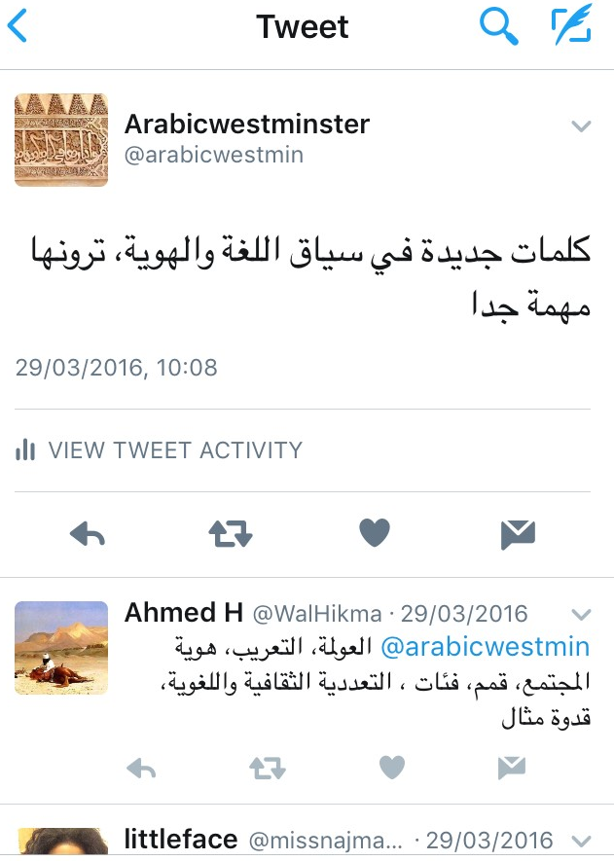
The activities
Writing a list of vocabulary of a given topic

Slide 11
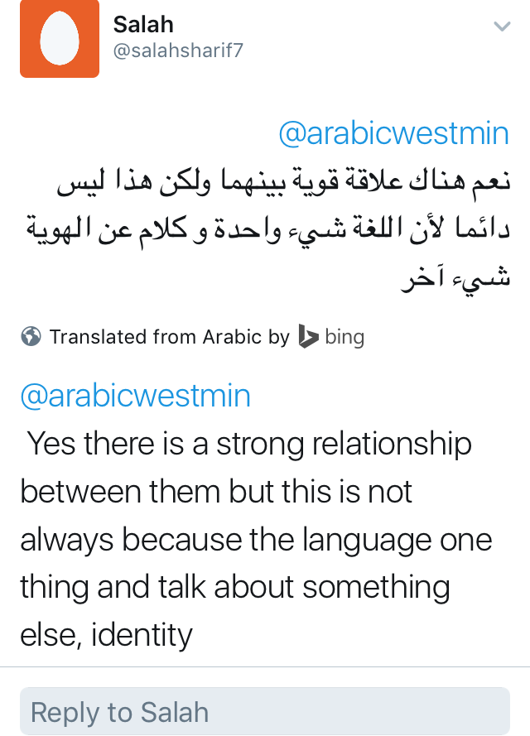
The activities
Comment/correct the auto translation

Slide 12
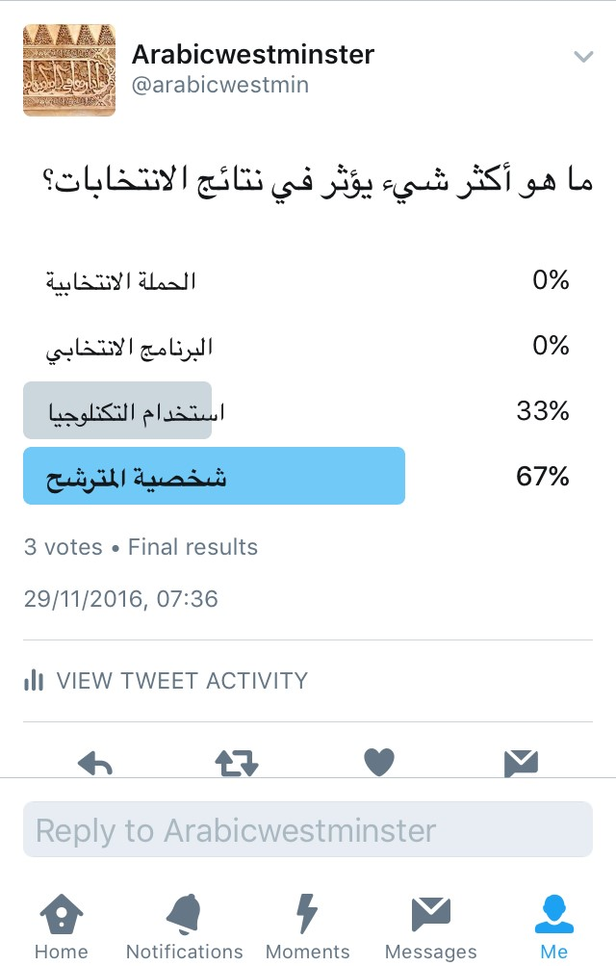
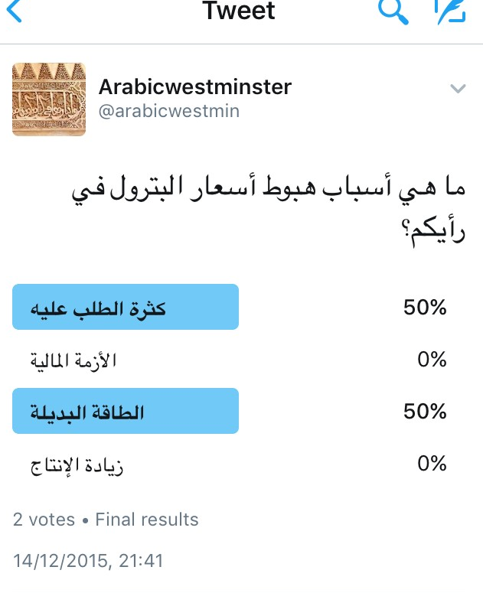
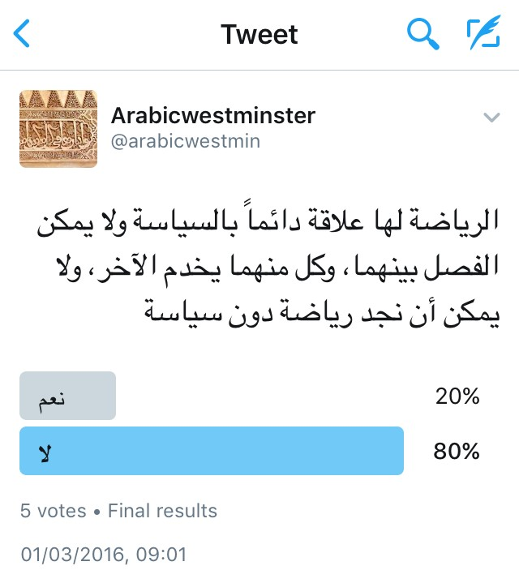
The activities
Twitter polls (discussion)

Slide 13
Students’ Perceptions

Slide 14
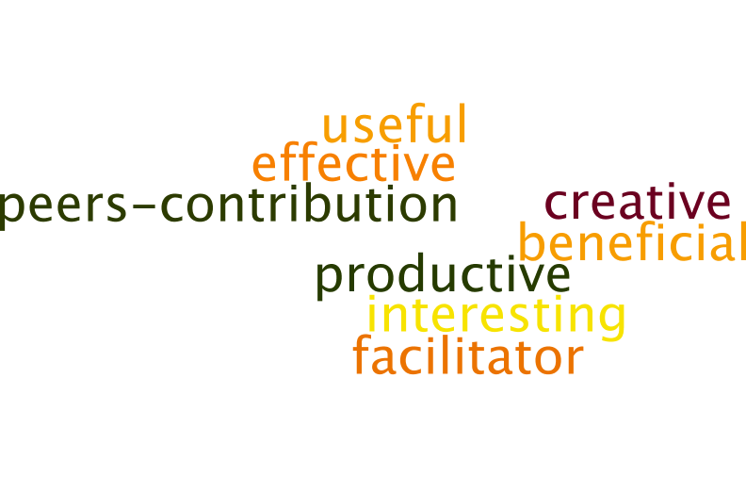
What do you think of the way how Twitter has been used in class?

Slide 15
Did Twitter helped you to learn more in class? How?
Yes, weekly questions/responses which would traditionally have been written on paper and unseen by the rest of the class are now available online. This really improves student engagement as they can instantly compare and contrast their work with colleagues. This improves grammar, boosts vocabulary and encourages creativity (especially in the small word count). “Student’s answer)

Slide 16
In your opinion, what are the advantages of using Twitter in Arabic class?
Useful for digital native students such as myself, making use of technology was advantageous in learning Arabic especially because most of the media is read through apps such as Twitter. Also I did not know about the auto translation, this was helpful in gaining an overall idea of the tweet. “Student’s answer”

Slide 17
In your opinion, what are the disadvantages of using Twitter in Arabic class?
Can be distract
Could take long time to write something 2
Very limited in what to say 2
Typing in Arabic takes me a long
I don’t know how to use the application
I have enough SN platforms, and I don’t want new one.

Slide 18
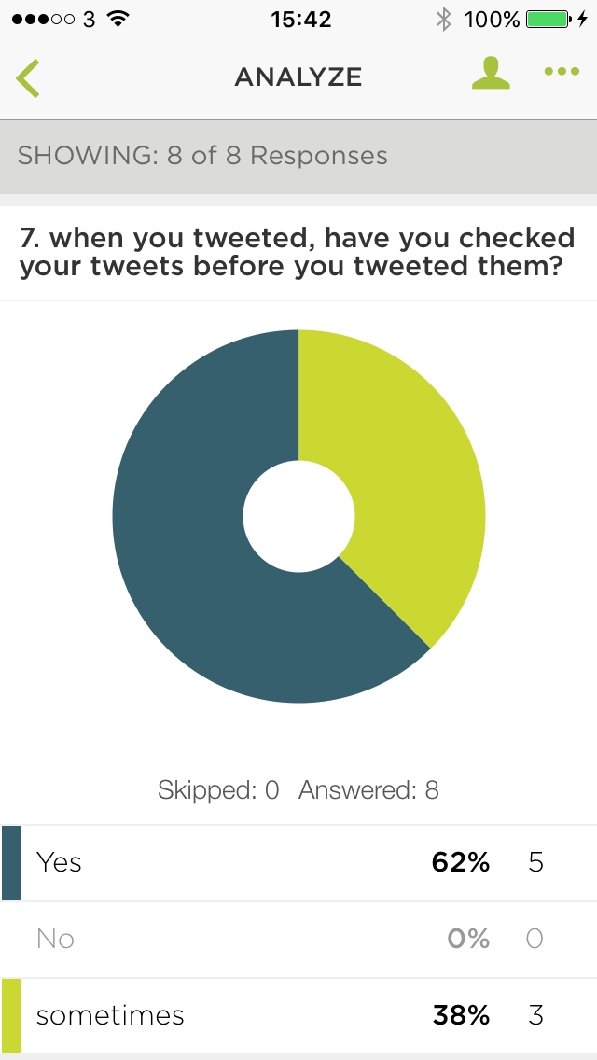
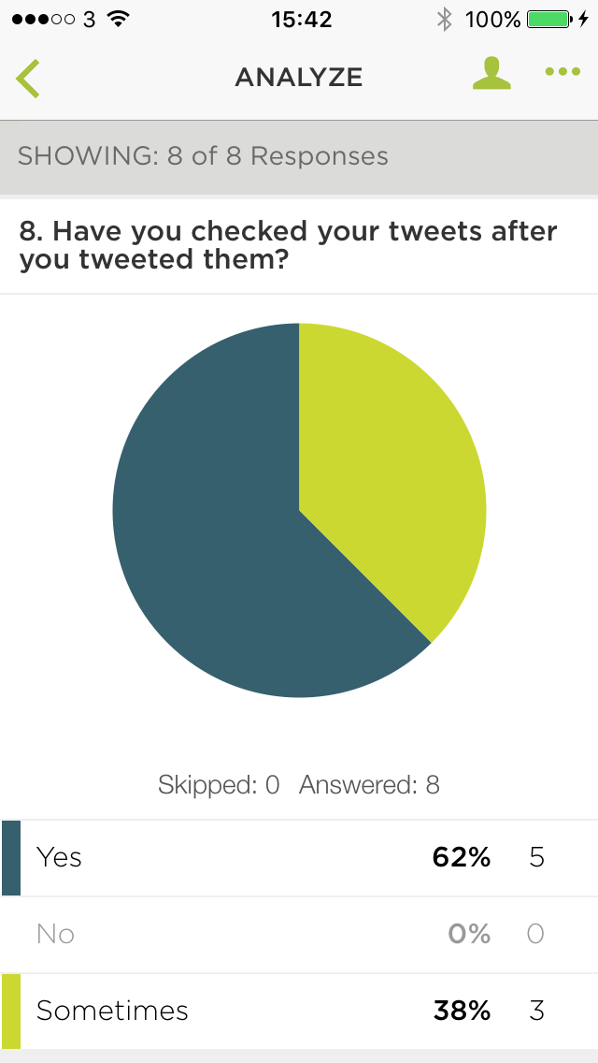
Correction of tweets
Before tweeting
After tweeting

Slide 19
Self correction/ Peer correction
write
Check
Tweet
Check

Slide 20
Which activity helped you more?

Slide 21
Is it worth doing it?
Bridge the gap between formal and informal learning
It can be used as “writing” portfolio
Blended learning community
Practice the language through guided activities
Allow more shy students to learn

Slide 22
Students’ suggestions
A tool of communication
Tweets needs to be corrected
Using the feature “Moments” in Twitter
Have at least one class using Twitter only (to create an entire session around the use of social media, with Twitter being the primary focus).

Slide 23
Shukran, Thank you
Any questions or comments?

