Slide 1
Credit-based mechanisms for user-driven prioritisation during ATFM regulations
BEACON project
University of Westminster
Gérald Gurtner

Slide 2
BEACON – a SESAR ER4 project

Slide 3
ATFM regulations

Slide 4
ATFM delays – typical situation in Europe
ATFM delays occur when flights cannot cross (or use) a section of airspace (of system infrastructure) due to congestion.
ATFM delays are computed by the Network Manager, and issued before the flights take off (CTOT).
Flights are then “regulated”, i.e., they have a 15-minutes slot in which they need to depart.
The delay is assigned by “ration-by-schedule” (first plan first served, FPFS) and irrelevantly of the flight’s characteristics: size, passengers, company, etc.

Slide 5
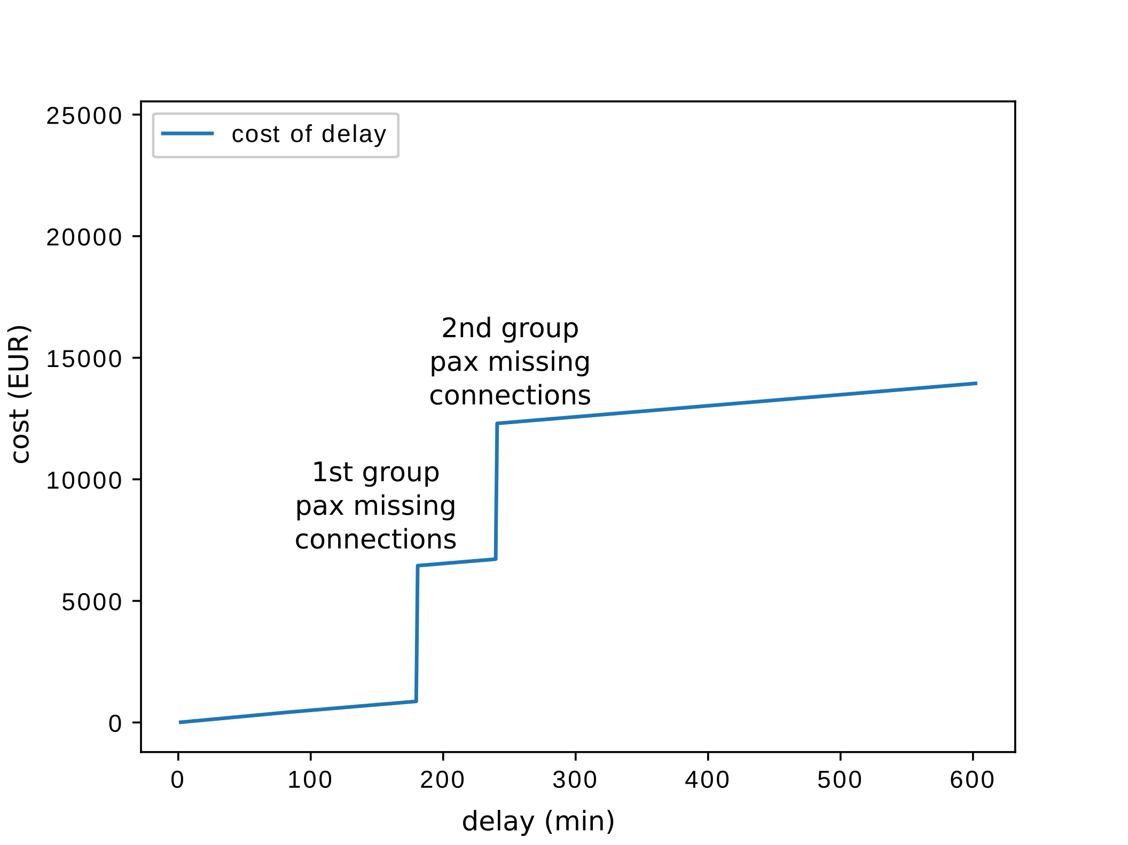
Airspace user costs
The delay has an impact on AU’s cost because of missed connections, curfews, etc.
Different flights have different cost due to different characteristics (e.g., #pax)

Slide 6
Concept – UDPP
User-Driven Prioritisation Process:
Allows ATFM slots to be exchanged between flights of the same airline in same regulation at arrival airports
Goal: protect their most important flights!
Crucial for AUs because of non-linearity of cost.
Different flavours:
Enhanced Slot Swapping
Fleet Delay Reordering
Selective Flight Protection
Margins
Drawback: low-volume airlines cannot do anything…
What about allowing different airlines to swap slots?

Slide 7
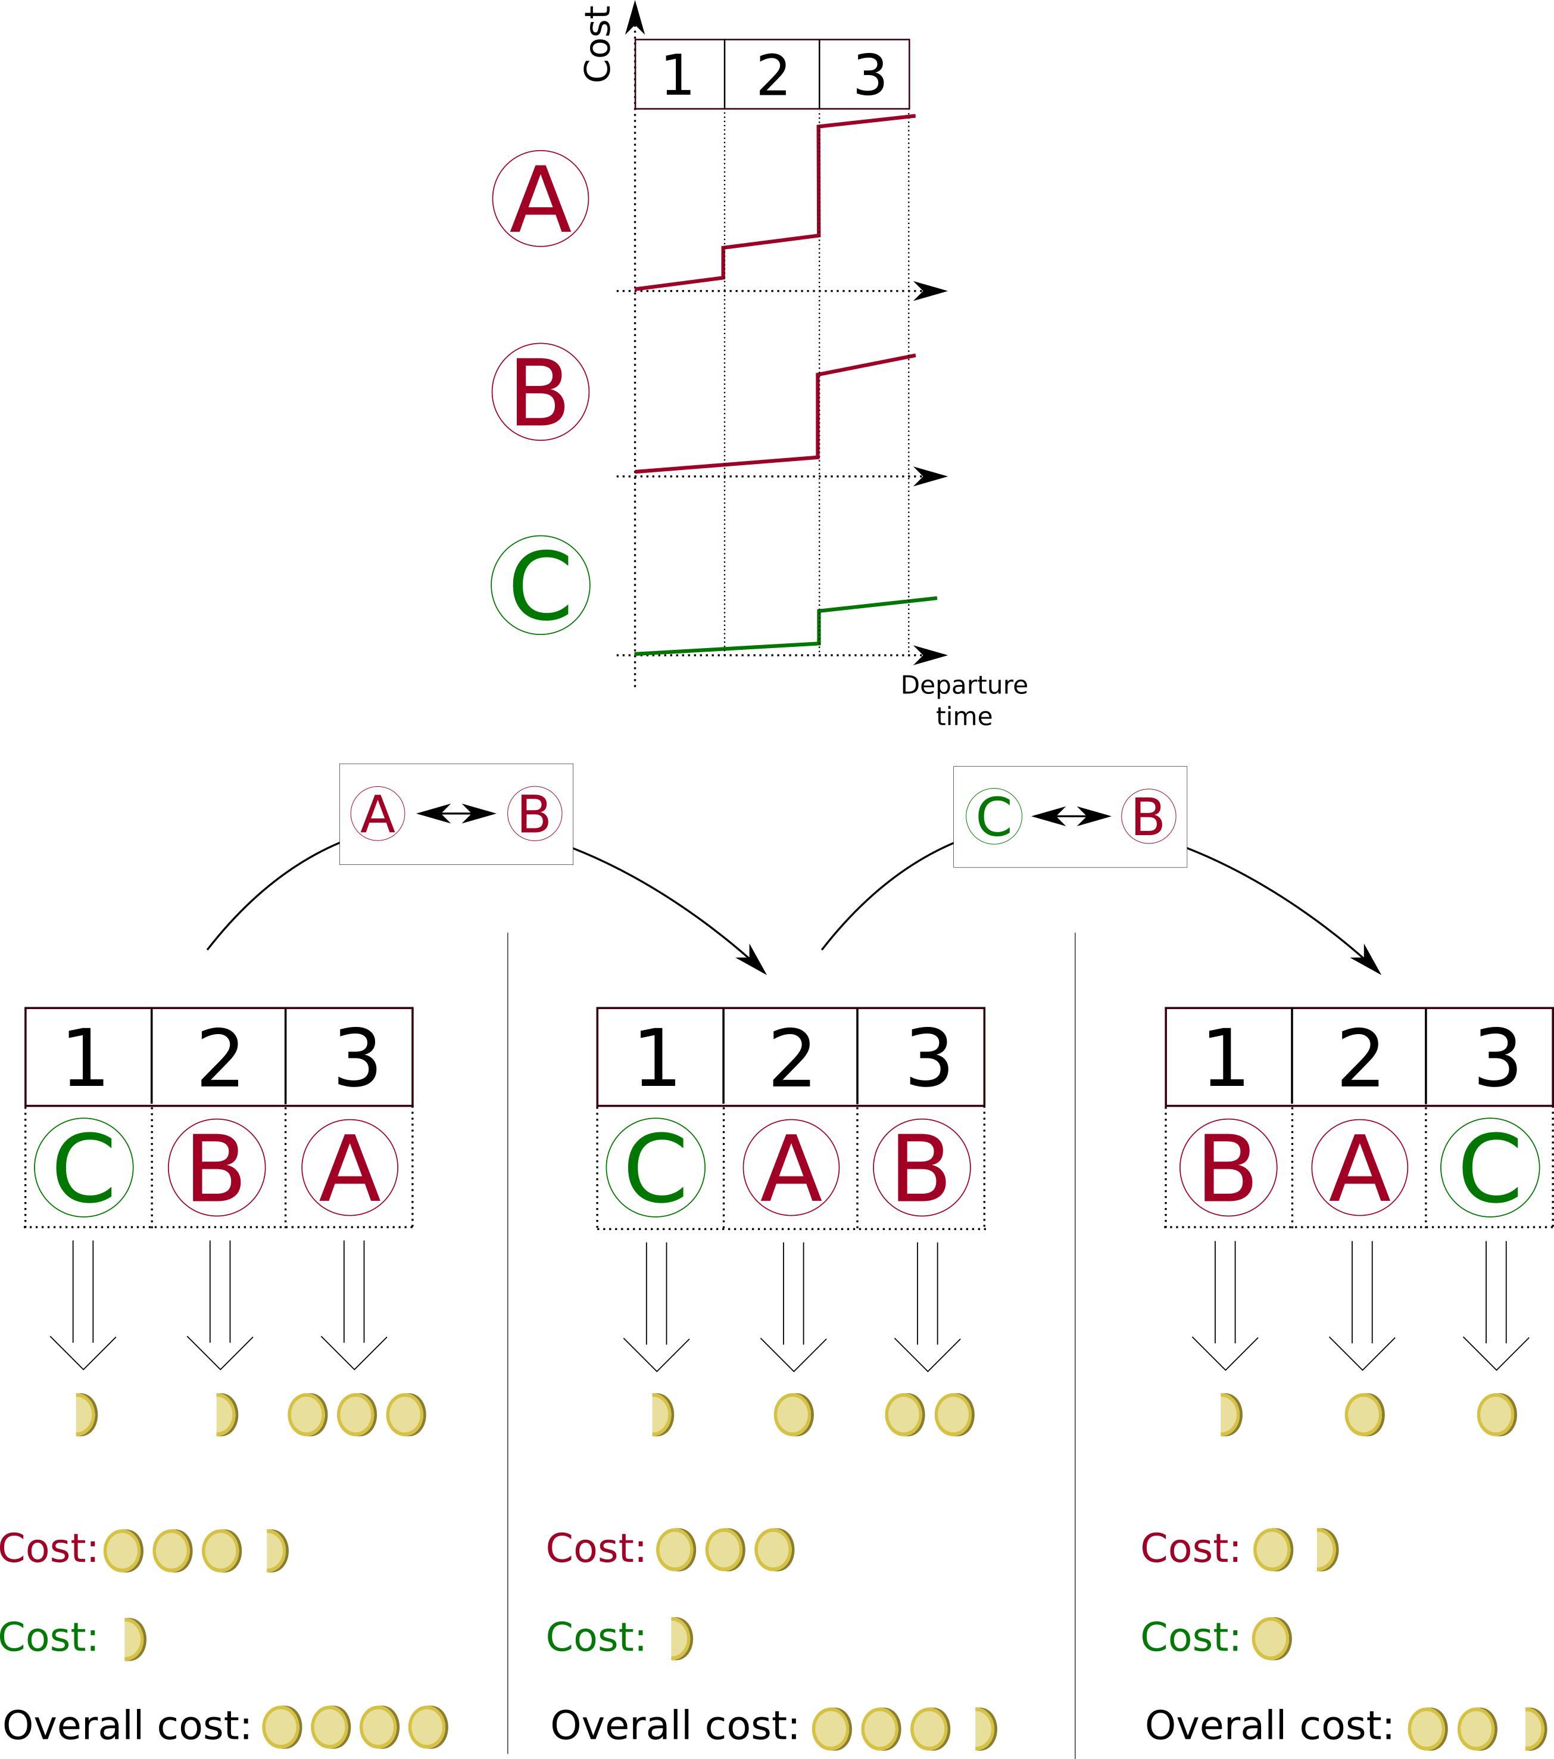
Concept – BEACON UDPP
What kind of mechanism would allow this kind of exchange?
Goal of BEACON: design and test exchange new mechanisms

Slide 8
New mechanisms

Slide 9
Scope
Mechanisms should:
Be as efficient as possible (lowest total cost in average)
Be easy to use operationally
Be Extendable to the en-route airspace
Keep a balance between airlines (equity: to be defined…)
Be Compatible or foreshadowing other concepts like business/4D trajectory.
Along the way, consideration about behavioural economics (see next part) and automation should be done, as well as network stability, constraint management for other stakeholders (airports) etc.

Slide 10
Problem statement
If the NM knew the cost functions of all airlines, it could easily solve for minimum cost (+equity constraints).
Problem: cost functions are unknown:
Because airlines do not really compute them in this form,
Because airlines may be reluctant to share sensitive information (see also SESAR ER4 project SlotMachine about this issue),
Because airlines may not communicate their true costs (gaming).
We need to “push” airlines to reveal their costs to help reducing them.
Two possible paradigms:
airlines communicate costs only
or airlines choose (bid for) slots

Slide 11
New mechanisms to be tested in BEACON
Mechanism | Concept
A | UDPP Automation Centralised slot assignment
B | UDPP Automation Flexible credit mechanism
C | Primary Auction

Slide 12
Mechanisms A and B
Sequencing of the flights in the identified slots based on two principles:
First Plan First Served, FPFS
UDPP Automation (FDR, SFP or FM)
Final slot allocation:
A ➔ Centralised assignment via automatic estimation of cost functions (ISTOP)
B ➔ Centralised assignment via credit-based estimation of cost functions

Slide 13
Mechanism A (ISTOP): automatic estimation of cost function
Principle:
Airlines communicate some simple parameters (priorities, margins), similar to what they give to UDPP
NM uses some rescaling trick to build surrogate cost functions.
Then two flavours:
NM finds the best allocation, with or without “non-negative” constraints, i.e. nobody loses from the allocation.
Or NM finds suitable slot swapping propositions and airlines can accept them of not
Potential issue: is rebuilding the cost function in this way good enough?

Slide 14
Mechanism B : credit-based mechanism
Principle:
Airlines communicate some simple parameters (priorities, margins), similar to what they give to UDPP (idem mechanism A)
Airlines pay (in credits) for non-default parameters: e.g. if margin <15 minutes ➔ pay 10 credits.
Then NM finds the best allocation overall.
Potential issue: gaming from airlines? Calibration (“price” of parameters)? Initial credit endowment (related to equity…)?

Slide 15
Mechanism C: Auction
No initial endowment of slots (not based on FPFS).
Each airline puts a bid (in credits) on each slot for each of its flights.
The sum of all the bids for a flights needs to be equal to 0.
The highest bidder for each slot gets it.
The excess in credits spent by all the airlines are redistributed equally among airlines, to ensure that the volume of credits remain constant in the system.

Slide 16
Mechanism C: Auction
Bets:
 | Slot 1 | Slot 2 | Slot 3 | Slot 4
A1 (F001) | 10 | 5 | 0 | -15
A1 (F010) | 5 | 4 | 1 | -10
A2 (F002) | 9 | 1 | -3 | -5
A3 (F008) | 3 | 1 | -1 | -3
Final allocation:
Slot 1 | Slot 2 | Slot 3 | Slot 4 | Total Credits spent
A1 (F001) 10 | A1 (F010) 4 | A3 (F008) -1 | A2 (F002) -5 | 8
We then redistribute excess credits to have a constant number of credits in the system:
Slot 1 | Slot 2 | Slot 3 | Slot 4 | Total Credits spent
A1 (F001) 8 | A1 (F010) 2 | A3 (F008) -3 | A2 (F002) -7 | 0

Slide 17
Other issues
Credits vs money. Feedback from airlines: no ‘real’ money, for operational reasons.
Dynamic nature of slot allocation: how to deal with evolving situations, for instance when airlines have already paid something in credits?
How to deal with constraints in other sectors?

Slide 18
Behavioural economics

Slide 19
Deviations from rationality
BEACON will test deviations from rationality in the context of UDPP
“Rationality” loosely means that an agent makes the best available decision with the available information to maximise its (self-)declared objective function (e.g. profit).
Apparent deviations: the observer does not have the same information that the agent or does not know exactly the objectives of the agent.
Real deviations: the agent makes sub-optimal decisions.
Companies are made of humans:
Agent problem: the objective of the human may not be aligned with the entity.
Humans have cognitive biases.
=> Use of prospect theory & intertemporal choice

Slide 20
Classical Economics
Assumes fully rational agent
Full utility maximisation with stable and consistent preferences
Prescriptive normative models
Objective weighing-up of costs and benefits of choices across lifetime
Unlimited cognitive ability and act accordingly
Well-formulated mathematical models with convenient properties

Slide 21
Number of decisions an adult makes per day.
35,000

Slide 22
Behavioural Economics
Based around real (not fully rational) agent
As assumptions about human rationality, utility maximisation and preferences are often violated in reality
Studies deviations from rationality to explain and mitigate their impact in a systematic way
Descriptive models to capture actual behaviour
Limited cognitive capacity:
We make many decisions each day, and therefore have to take mental shortcuts and use heuristics because cognitive resources are scarce
Resulting biases can impair judgement, lead to suboptimal decision-making
Often not possible to mathematically formulate
Exceptions include prospect theory and hyperbolic discounting

Slide 23
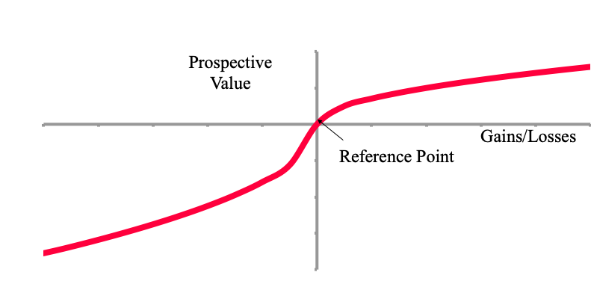
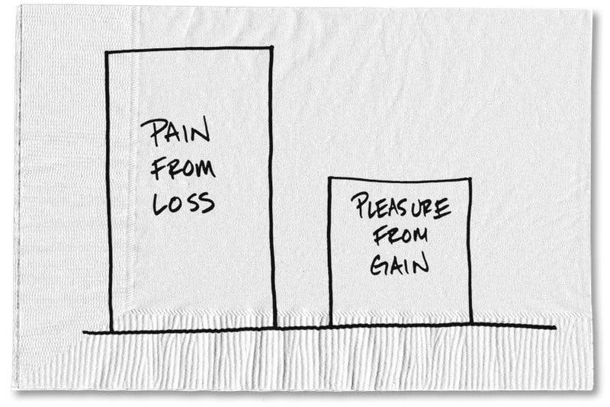
Prospect Theory
Prospect Theory was developed by Kahneman and Tversky (1979) to describe decision-making under uncertainty
Some distinguishing features compared to standard utility theory are:
Losses loom much larger than gains – about twice as much (loss-aversion)
Diminishing sensitivity in the loss as well as the gain domain
Reference point dependent - often the status quo
Related biases include:
Loss-aversion
Endowment effect
Disposition effect

Slide 24
Simulations

Slide 25
Methodology
5 steps:
Problem definition and high-level modelling requirements
Definition of KPIs, mechanisms, scenarios
Small-scale behavioural modelling
Inference of behavioural parameters through small experiments
Mechanisms testing.
Large-scale simulations at ATM network level
Use of European-wide microscopic ABM Mercury.
Human-in-the-loop simulations.
Analysis of modelling results
Statistical effects, differential effects
Computation of KPIs, non-rationality
Conclusions, guidelines and recommendations
Importance of non-rationality, recommendations for further studies (e.g. B.E. used at the design stage)
Concept assessment (in particular regarding new mechanisms).

Slide 26
Models
First model:
Small scale, stylised airspace, reduced number of airports, reduced number of flights. Includes passenger connections.
Focused on some behavioural assessments and a rough estimation of the UDPP parameters.
Second model (Mercury):
Large scale, real airspace, historical data (traffic, regulations, passenger itineraries), more detailed processed (turn-around, curfew etc).
Produces the final KPI assessment.
Will be used for human-in-the-loop simulations.

Slide 27
Summary
UDPP allows to “relax” the rigidity of FPFS by considering airline costs
Airline costs can be “revealed” by different mechanisms
Mechanisms may have various degree of efficiency, operationally easiness, equity, etc.
Mechanisms should be tested taking into account potential cognitive/algorithmic biases ➔ behavioural economics.
Agent-based simulations are particularly suited to this problem and allow a network-wide assessment of the mechanisms.
Website: www.beacon-sesar.eu
Twitter: @H2020Beacon
Linkedin: beacon-project

Slide 28
Thank you very much for your attention!

Slide 29
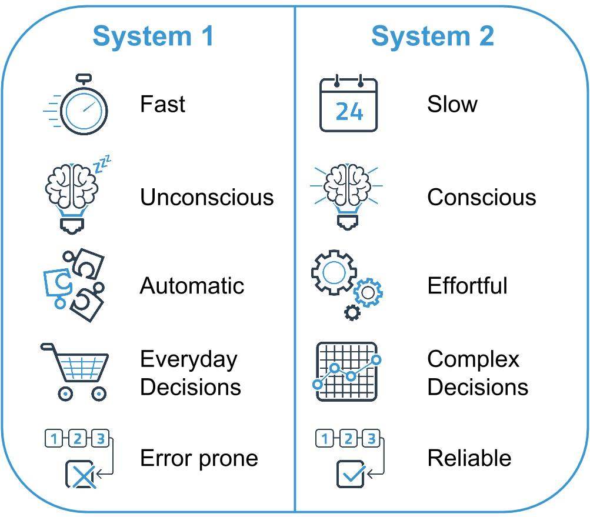
Cognitive Capacity
The human mind is very complex. Dual-process theory helps us to better understand the decision making process
Our cognitive capacity is limited and we make use of two interrelated ‘systems’ often called System 1 and System 2 to make decisions
As a result we do not fully weigh up our choices at all times, we take mental shortcuts, are prone to biases and act non-rationally

Slide 30
Objectives
BEACON's general goal is to explore the role of AUs' complex behaviours, such as bounded rationality, in the design of new management procedures.
More specifically, BEACON will:
Propose a set of improved flight prioritisation mechanisms that expand current UDPP capabilities.
Define new metrics to evaluate the fairness and equity of flight prioritisation mechanisms and validate them.
Quantify the impact of ‘non-rational’ behaviours of AUs on the outcome of the proposed mechanisms, using behavioural economics.
Integrate the insights into an agent-based microsimulation model of the full ECAC network able to capture network effects and compute KPIs.
Run a set of simulation experiments to evaluate the impact of the new UDPP mechanisms on the selected KPIs to analyse the advantages and the risks with respect to the current UDPP capabilities.
Derive guidelines and methodological recommendations on the further development, validation and deployment of the new UDPP mechanisms.

Slide 31
Concept – Fairness and equity
New (and existing) mechanisms need to be monitored.
BEACON is not interested (only) in a system-wide perfect optimum, but will look at how different AUs are impacted.
Different KPIs in Equity and Fairness will be considered.
BEACON will start from existing metrics (e.g. SESAR) and define new ones.
These KPAs are crucial, they condition the acceptance of new mechanisms.

Slide 32
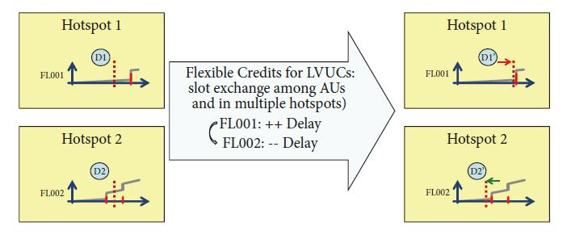
Flexible Credits for LVUCs (FCL)
Considered as an extension or a complementary mechanism to other UDPP features -> SFP + Flexible credits
Use credits in other Hotspot
Suspend flight
Earn credits
Use credits
Protect flight
The potential advantage of FCL is the ability to provide flexibility also to AUs with a low number of flights involved in a regulation, thus increasing the equity of the system.

