Slide 1


Slide 2
History
The Construction Halls at Sub-Podium levels 1 – 4 were built for use by the School of the Built Environment and were completed in 1969.
Between 1984 and 1996 Professor Paul Regan, a highly respected international expert in the subject of concrete lead teams which undertook the testing of concrete used in many Department of Transport projects such as Spaghetti Junction, bridges on the M6 motorway and the Channel Tunnel.
The discipline of Civil Engineering and the related research, was closed in 1997 and the space was converted by Katharine Heron, Professor of Architecture and Michael Maziere, Reader in Film and Video.

Slide 3
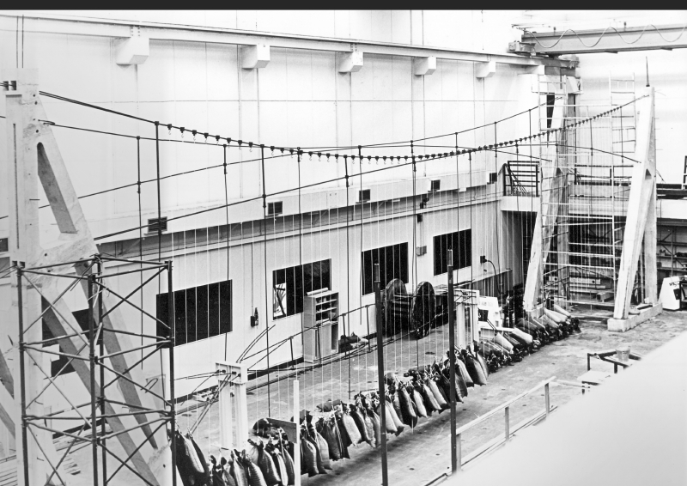

Slide 4
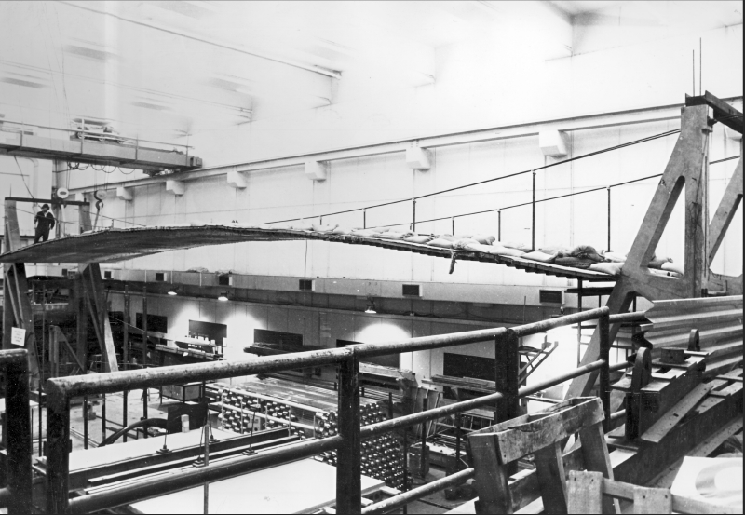

Slide 5
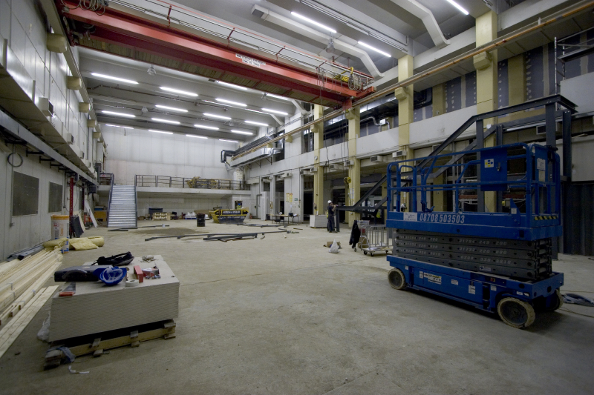

Slide 6
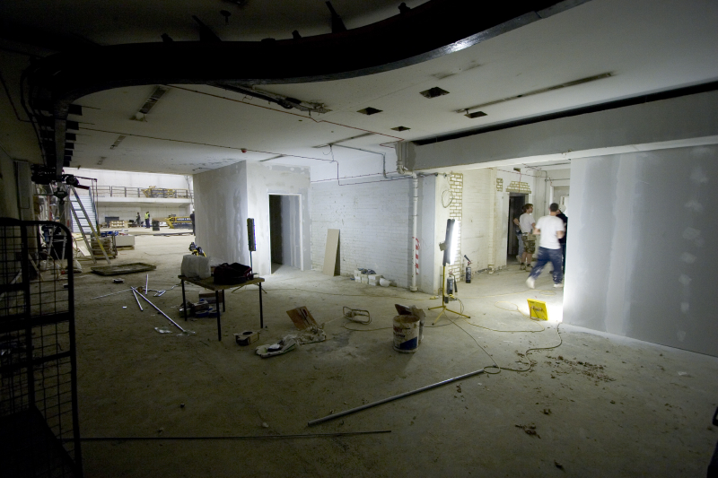

Slide 7
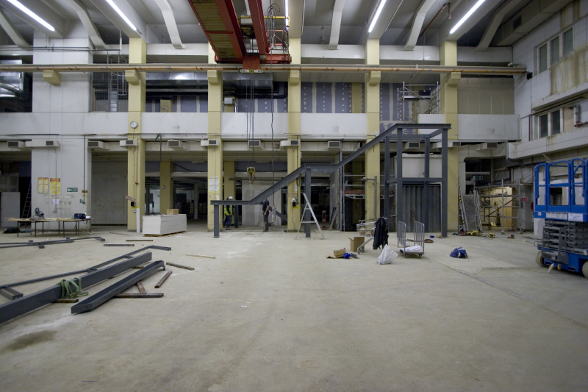

Slide 8
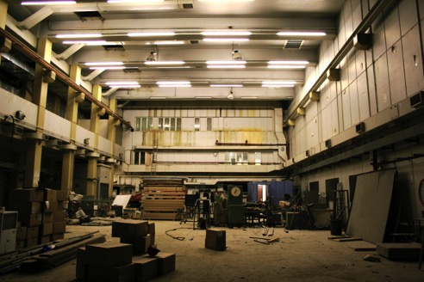
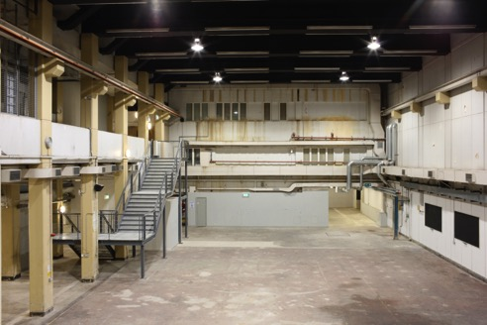

Slide 9
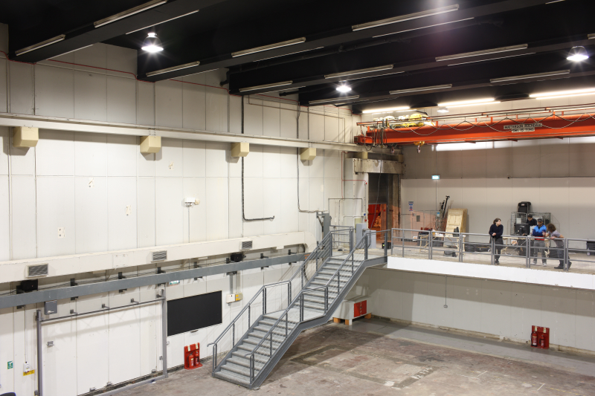

Slide 10
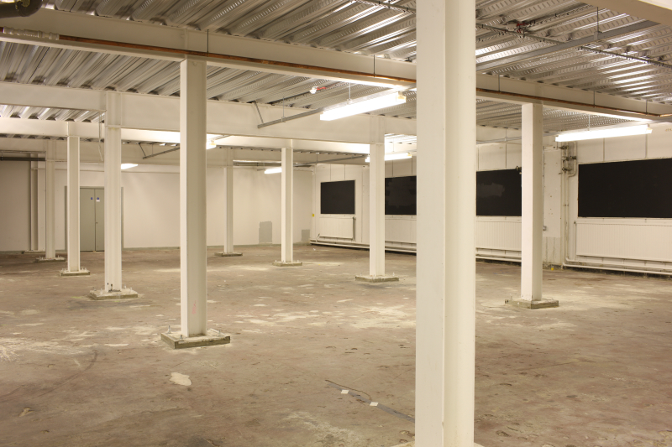

Slide 11
David Ward: Rink
David Ward transforms the floor of Ambika P3 into a huge light drawing. Linear drawings from sources including ice skating will be digitally projected from the high ceiling of P3 on to the expansive floor.
Viewers will see the constantly changing work unfolding from the mezzanines in the space and can also take to the floor, walking amongst the lines, arcs and spirals which move and layer over the surface like the paths of skaters or stars.

Slide 12
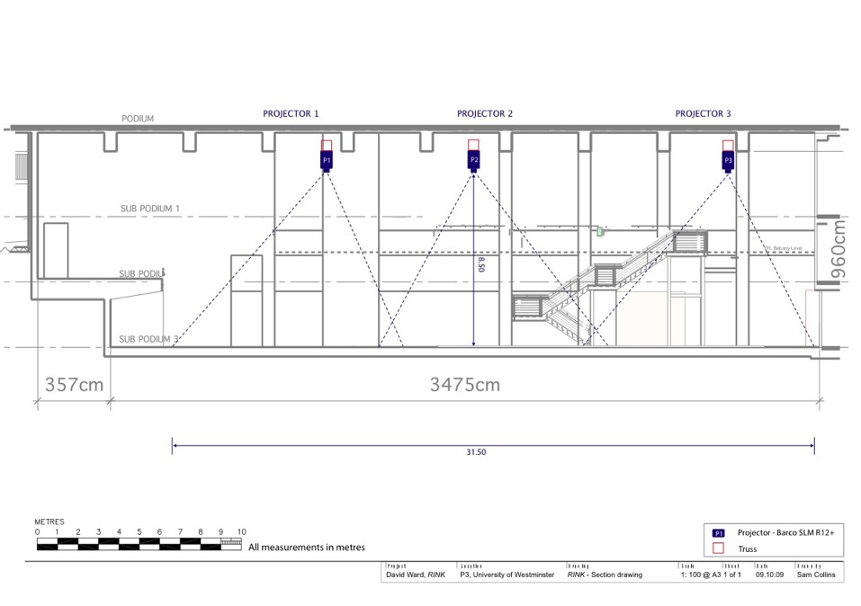

Slide 13
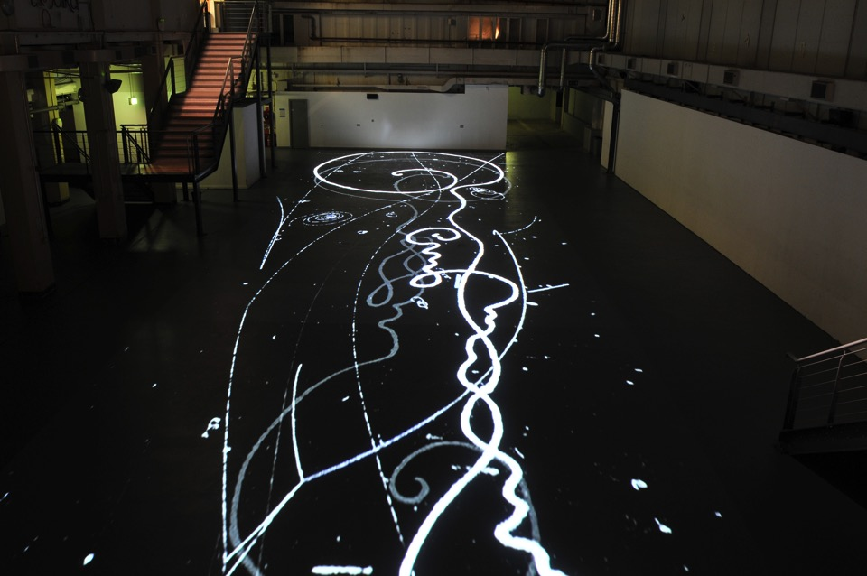

Slide 14
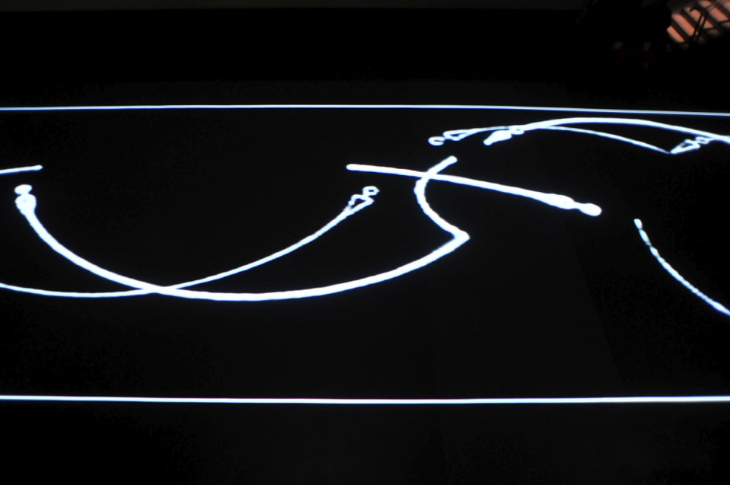

Slide 15
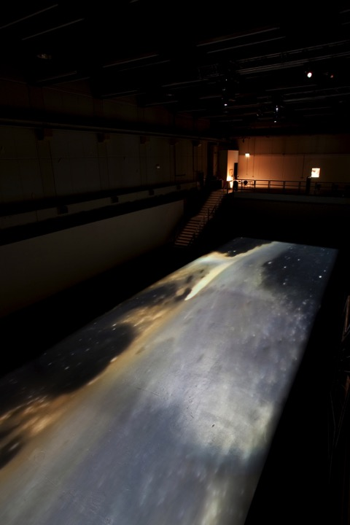

Slide 16


Slide 17
Anthony McCall Vertical Works
Works in the exhibition: Vertical Works; Breath (2004), Breath III (2005), Meeting You Halfway (2009) and You (2010).
Four video projectors, computer, QuickTime Movie file, Four haze machines, two audio speakers.

Slide 18
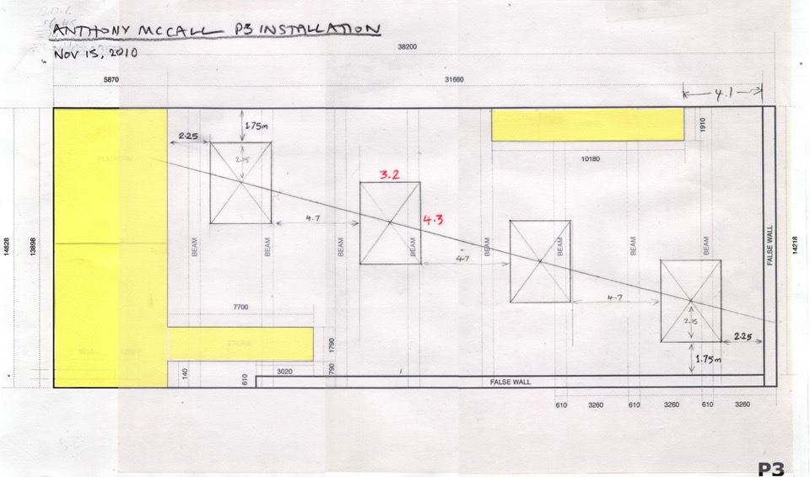

Slide 19
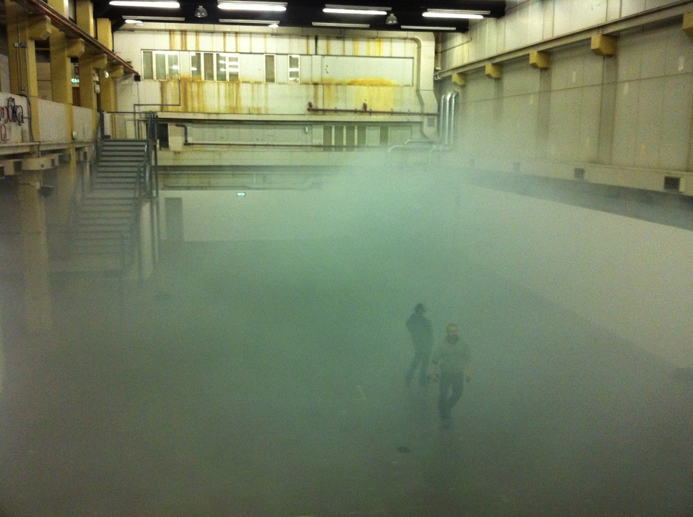

Slide 20
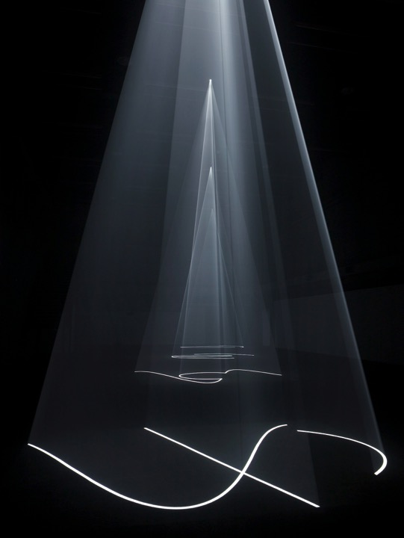

Slide 21
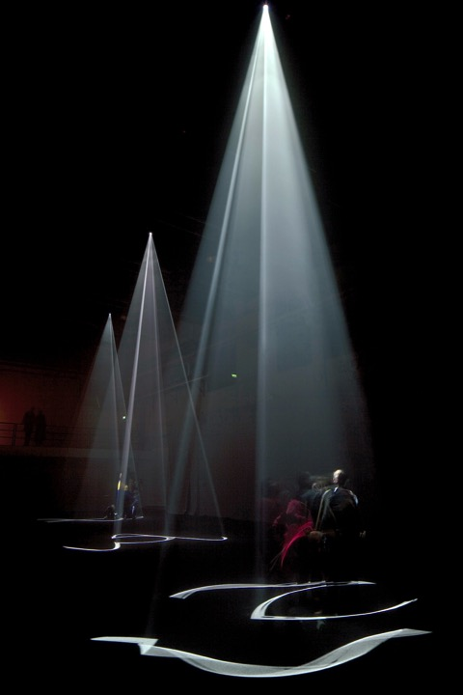

Slide 22
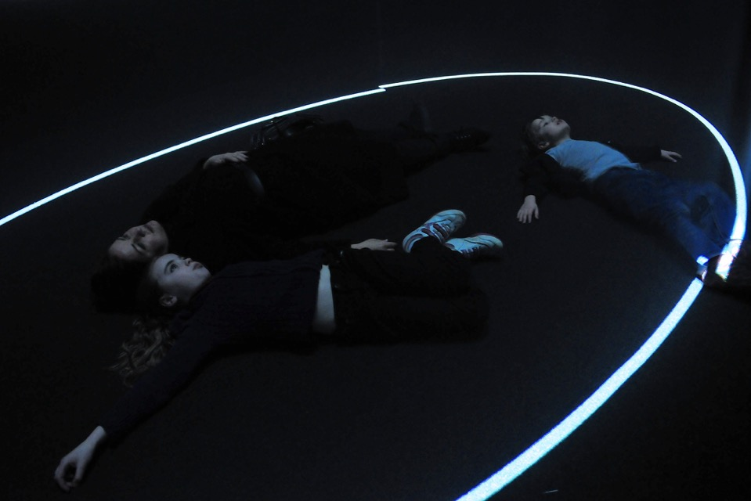

Slide 24
Ilya and Emilia Kabakov: The Happiest Man
A major installation by Russian artists Ilya and Emilia Kabakov, influential pioneers of installation art. The Happiest Man, features a room within a specially created cinema showing clips from Russian propaganda films of the 40s and 50s.
The visitor can escape to the room and become ‘The Happiest Man’ or enjoy the films in the classic cinema setting. The work explores the fragile boundaries between reality and imagination, fact and fiction, art and life.

Slide 25
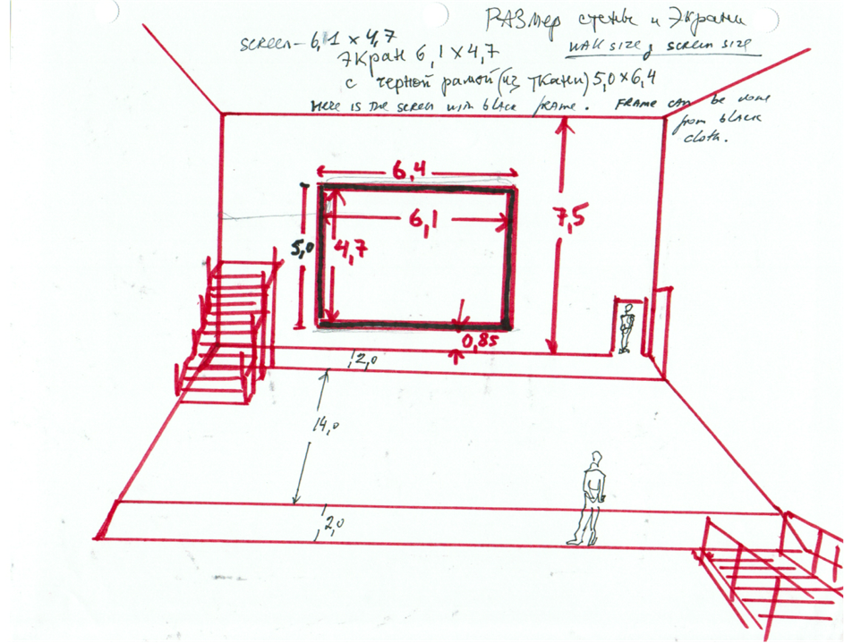

Slide 26
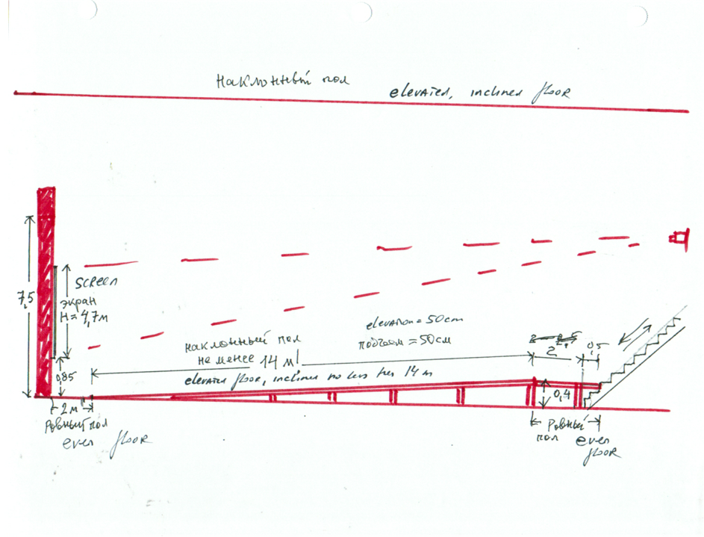

Slide 27
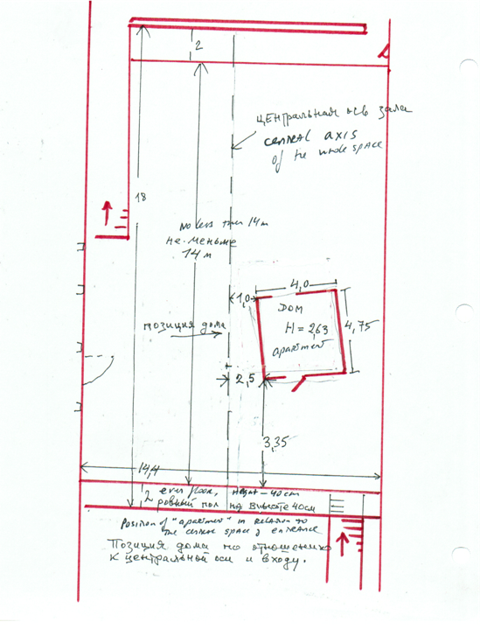

Slide 28
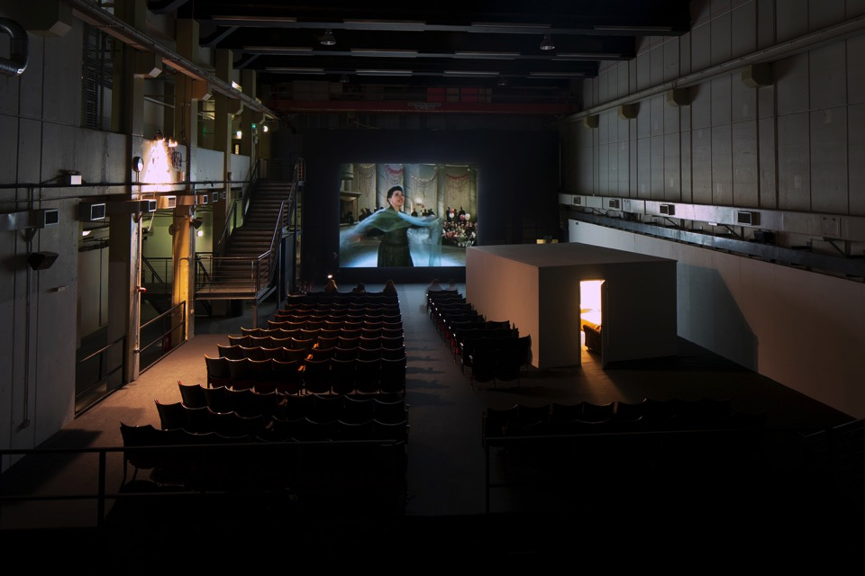

Slide 29
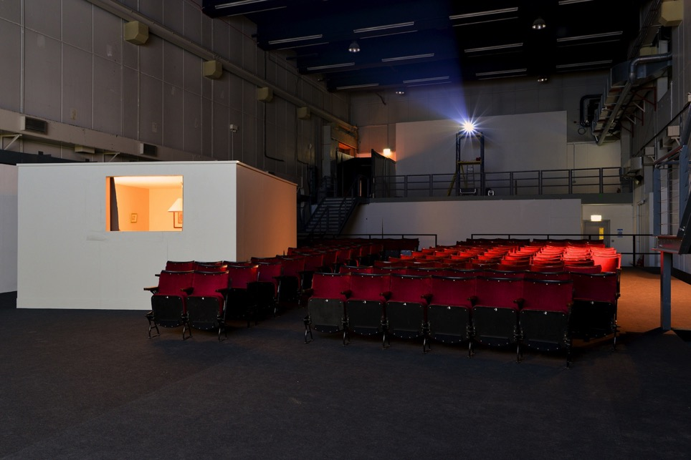

Slide 30
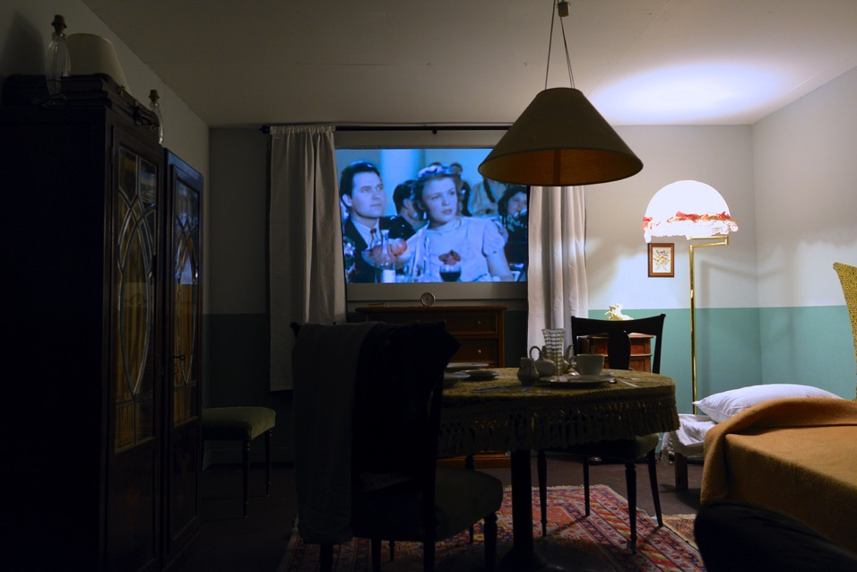

Slide 31
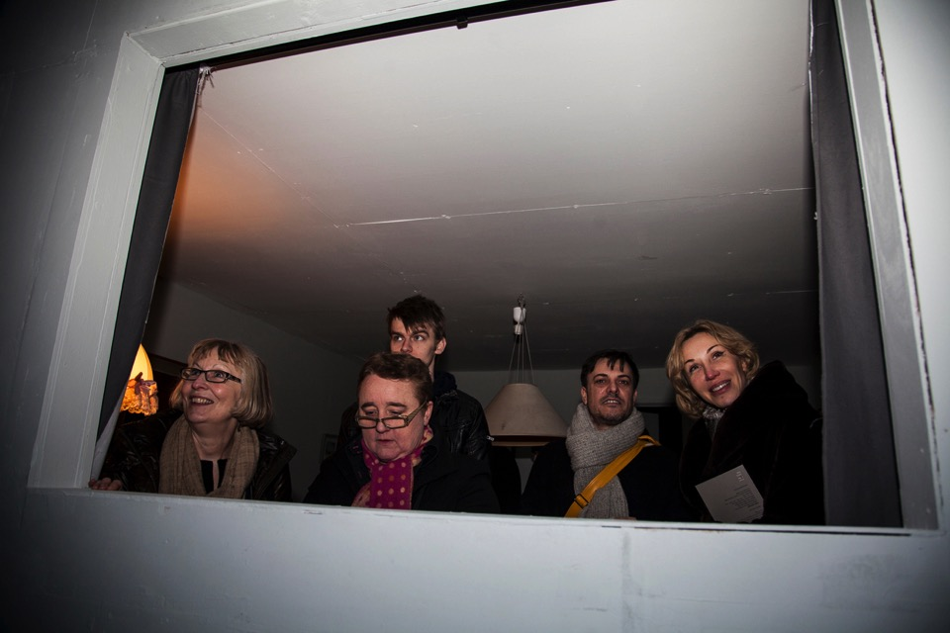

Slide 32
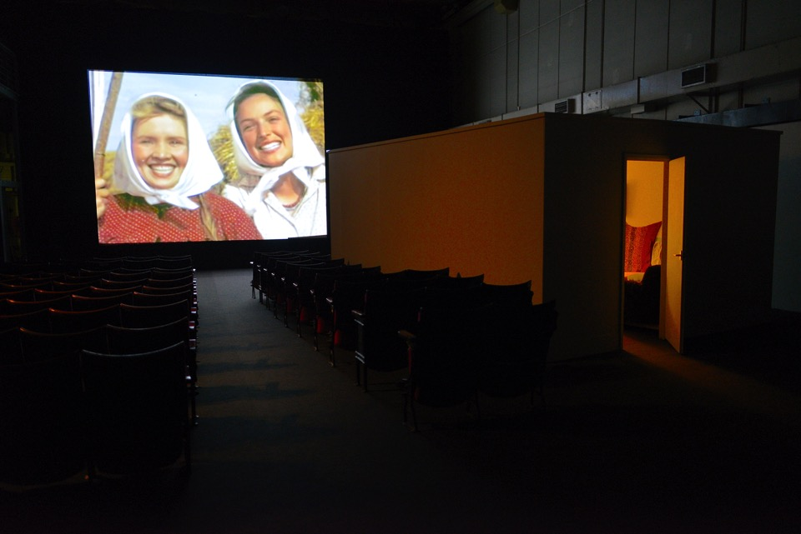

Slide 34
David Hall End Piece…
'1001 TV Sets (End Piece)' 1972-2012
‘Progressive Recession’1974
‘TV Interruptions (7 TV Pieces): the Installation' 1971/2006.
1001 CRT analogue televisions, Steel Scaffold, Cabling, Netting, and 16 CRT monitors, 9 Cameras.

Slide 35
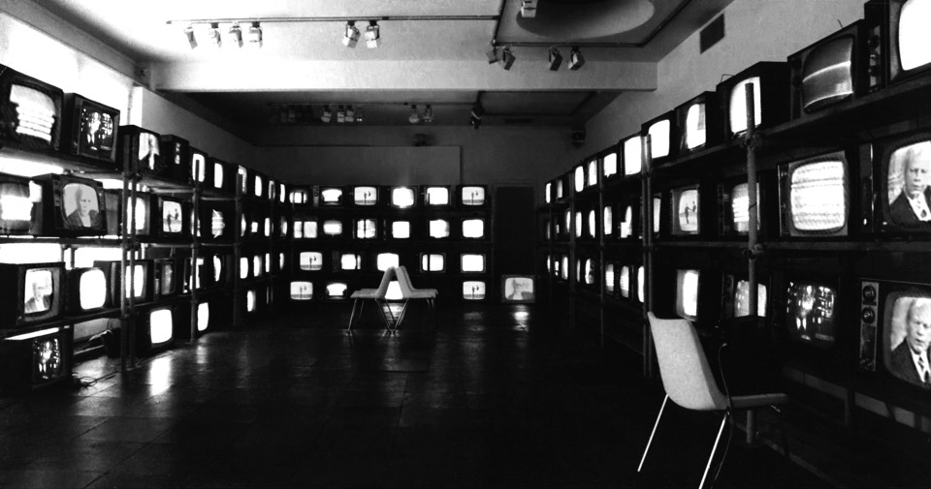

Slide 36
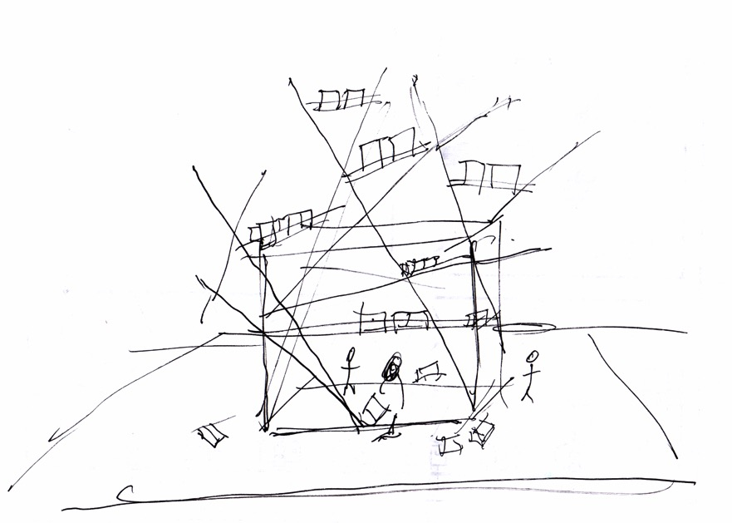

Slide 37
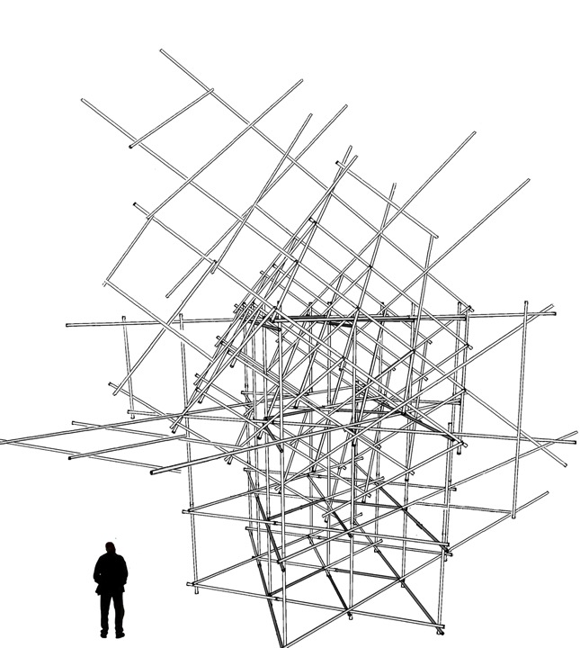

Slide 38
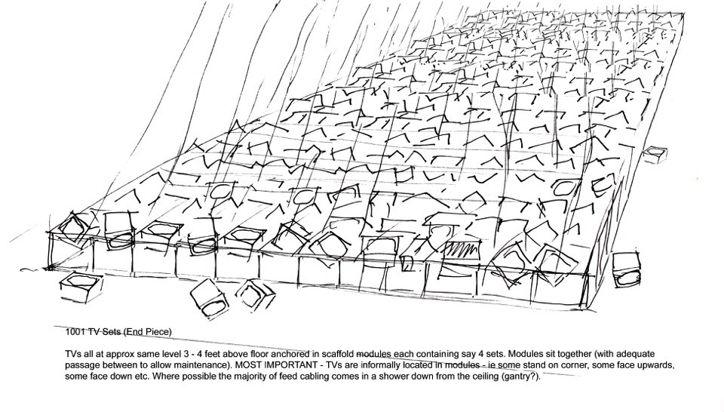

Slide 39
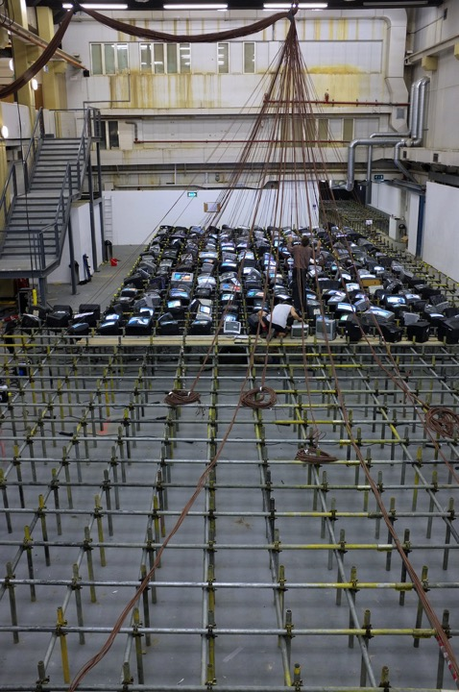

Slide 40
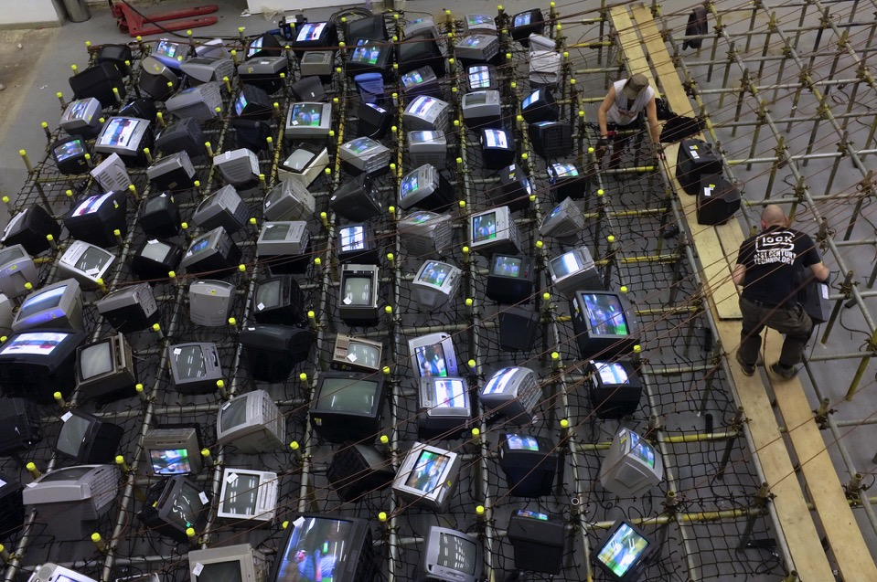

Slide 41
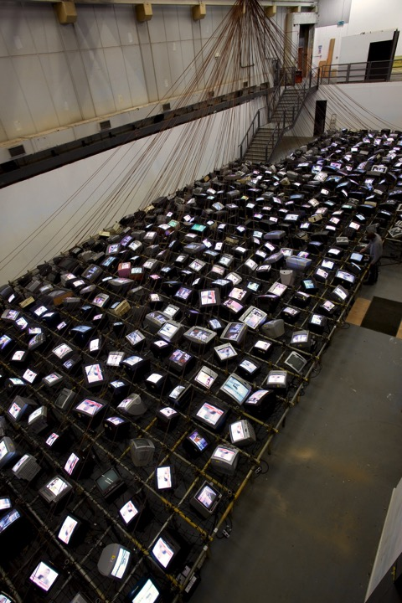

Slide 42
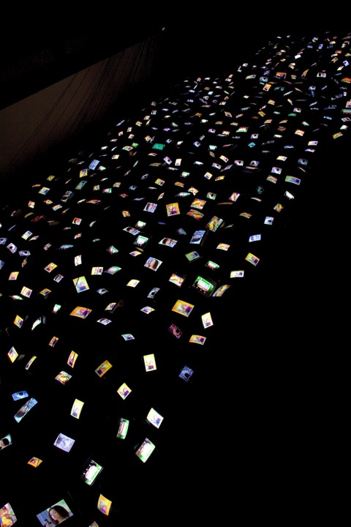

Slide 43
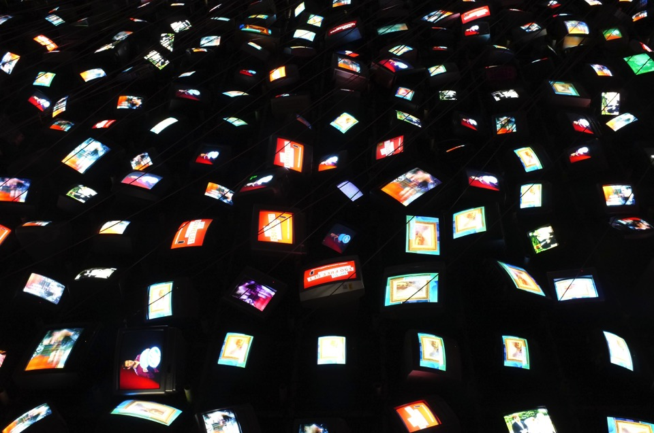

Slide 44
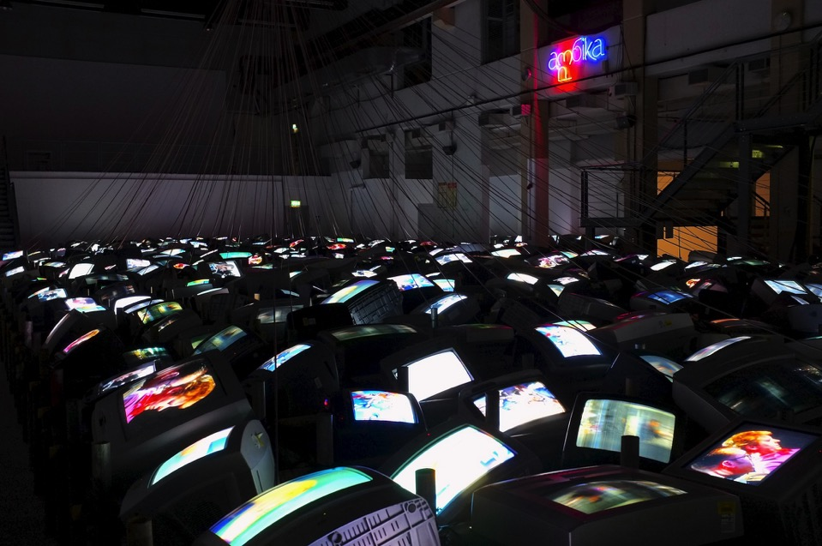

Slide 45


Slide 46
Victor Burgin, A Sense of Place
Videoworks :
Voyage to Italy - (Basilica I & II) 2006; Olympia, 1982; Solito Posto (2008); The Little House (2005); Mirror Lake (2013); A Place to Read (2010)
Photoworks :
UK76, 1976; Zoo78, 1978 ;Portia, 1984; In Grenoble, 1982; Hotel Latone, 1983, Gradiva, 1982

Slide 48
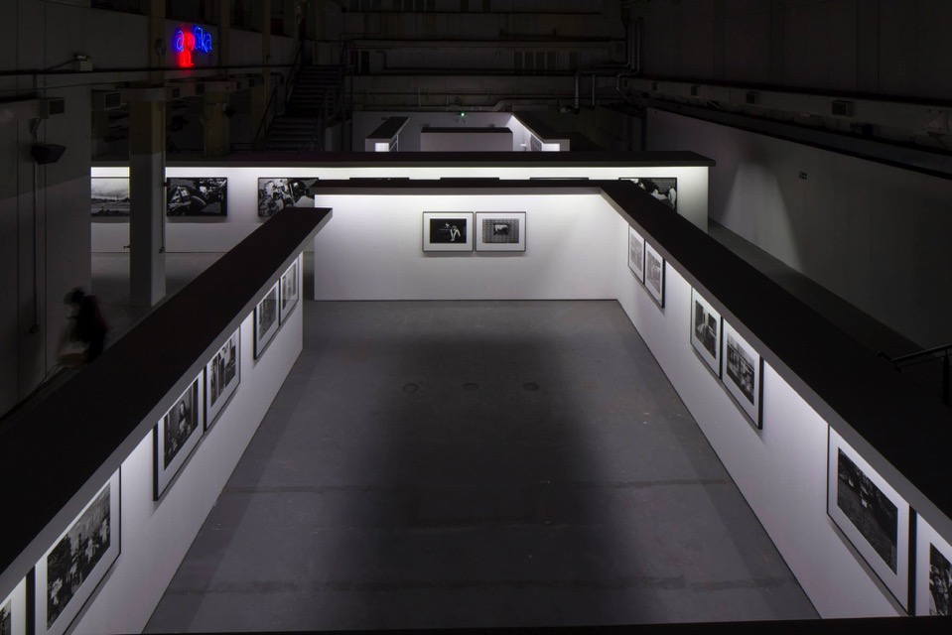

Slide 49
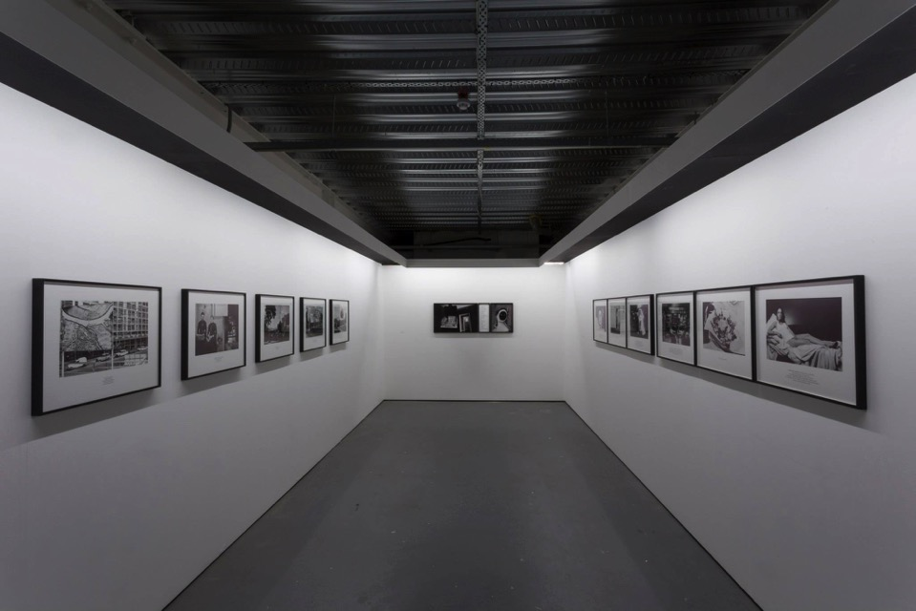

Slide 50
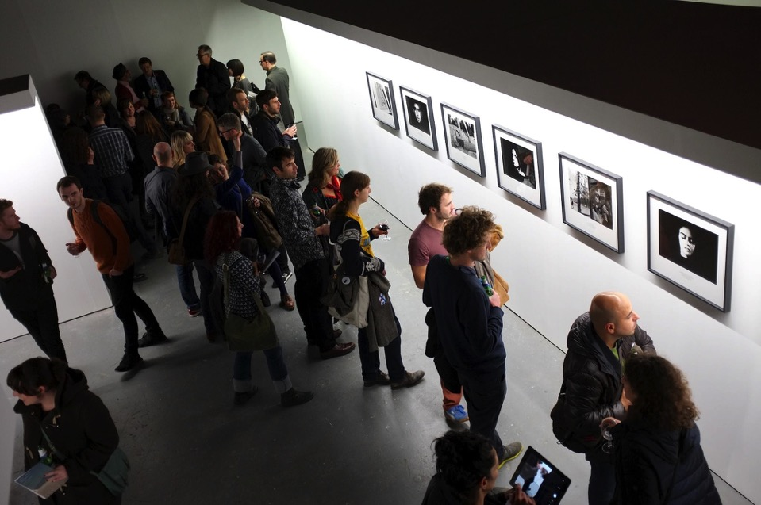

Slide 51
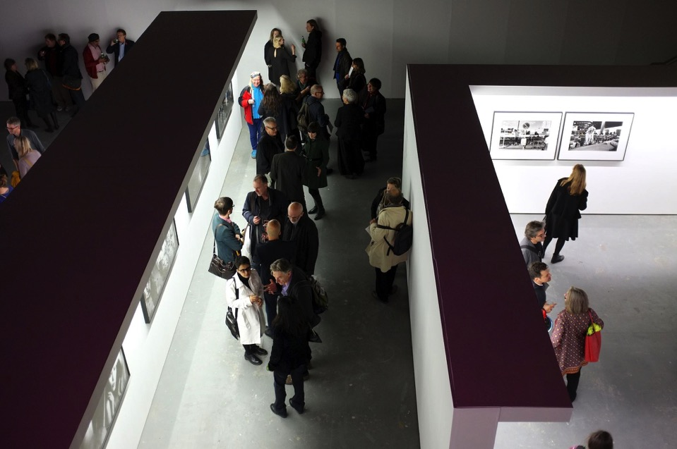

Slide 52
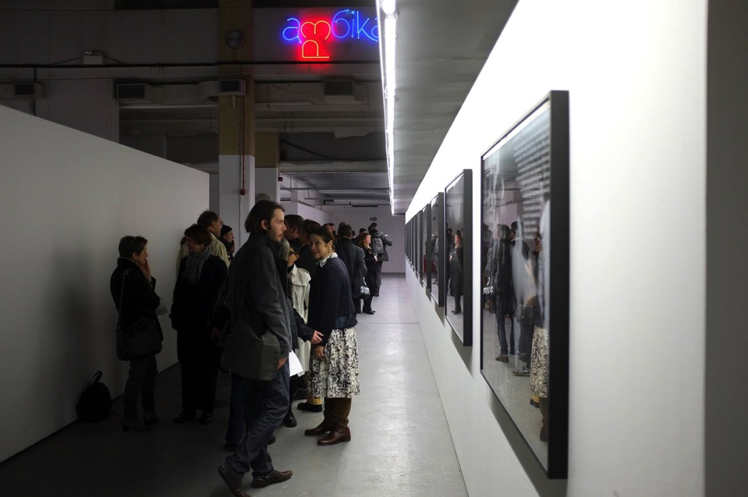

Slide 54
Elizabeth Ogilvie, Out of Ice
Scottish environmental artist Elizabeth Ogilvie brings the Polar Regions to Ambika P3 for Out of Ice, her investigation of the psychological, physical and poetic dimensions of ice and water.
Fusing art, architecture and science in an experiential installation comprising ice, water, video projections and film.
Out of Ice is also Ogilvie’s homage to the indigenous people of the Far North, in five films reflecting on their deep, sustaining relationship with ice and its significance in their cultural and intellectual identity.

Slide 55
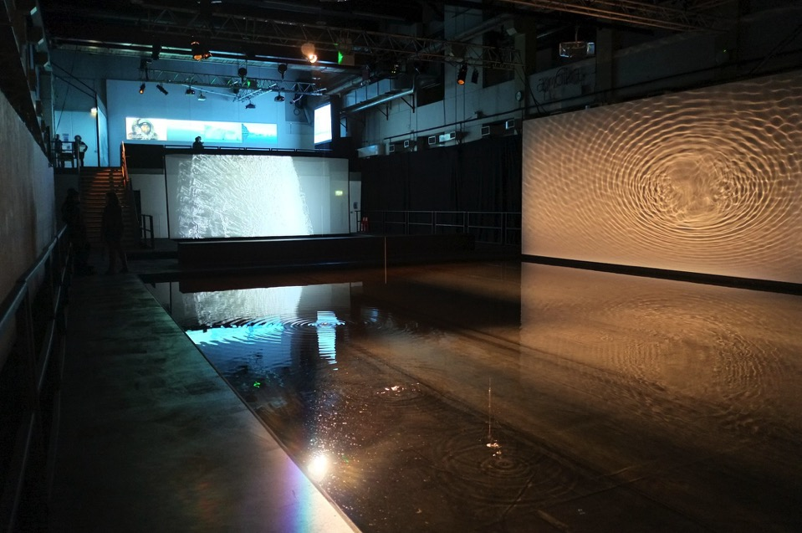

Slide 56
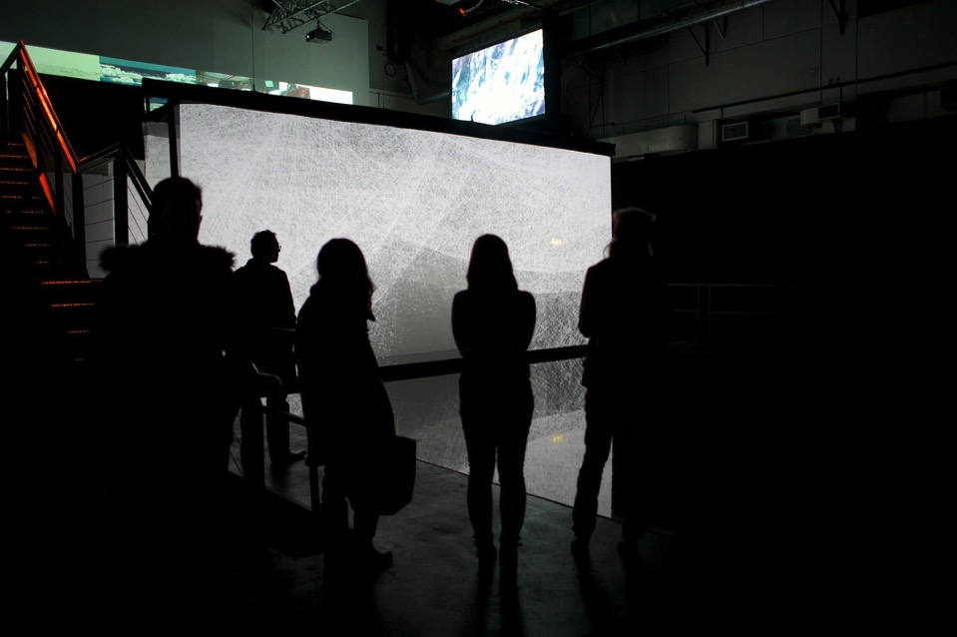

Slide 57
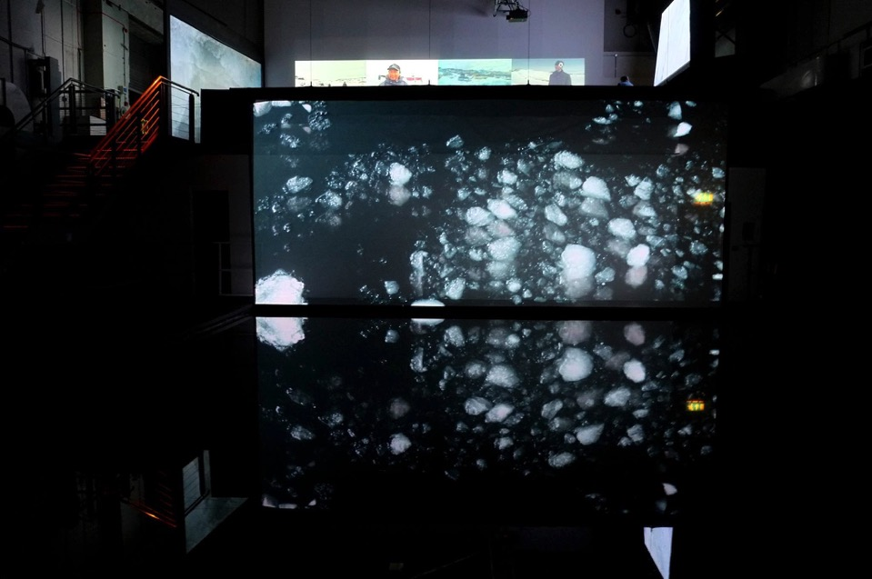

Slide 58
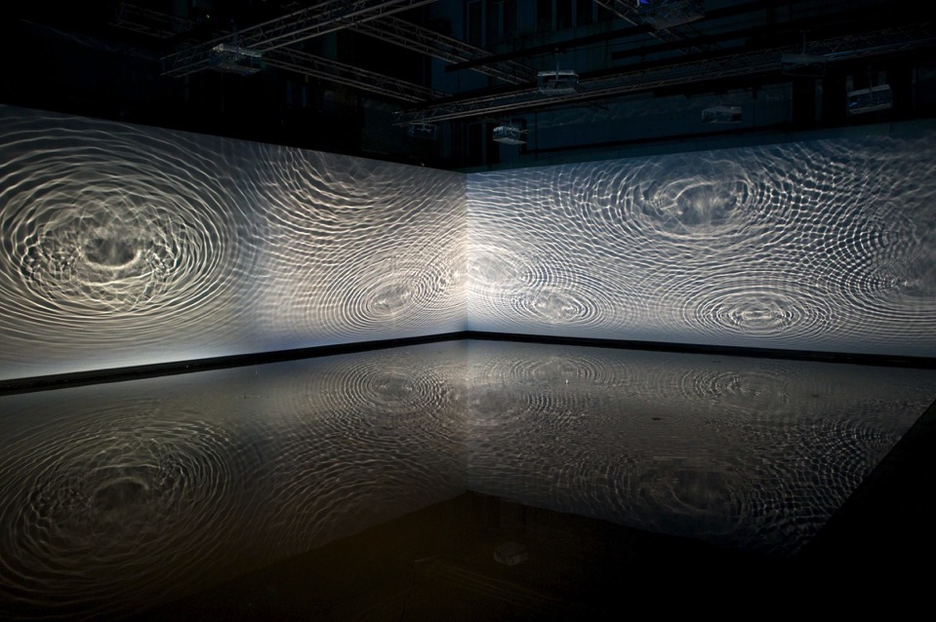

Slide 60
Martina Amati, Under
UNDER 2015
One suspended video screen
One projected video screen
One two sided hanging screen with headphones

Slide 61
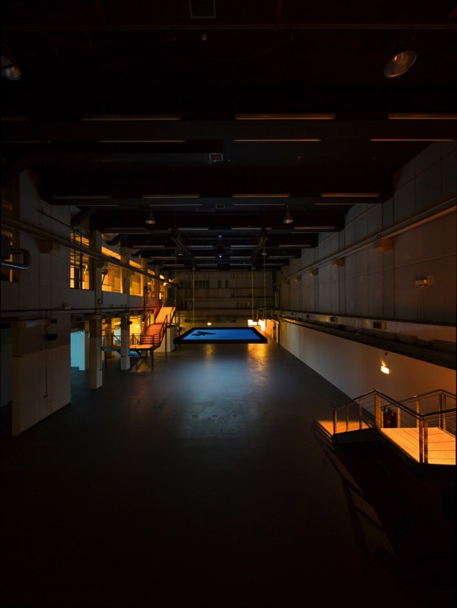

Slide 62
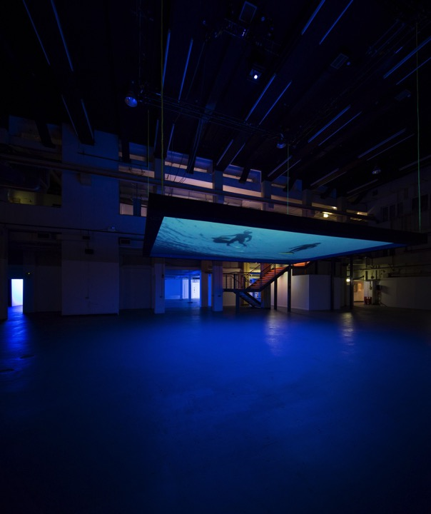

Slide 63
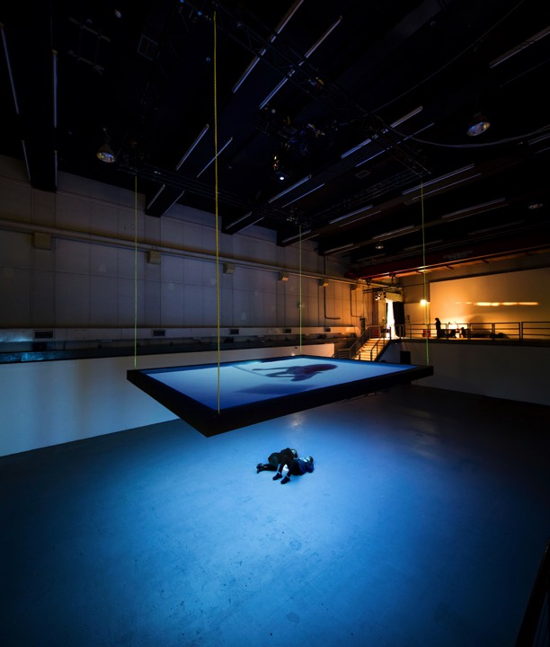

Slide 64
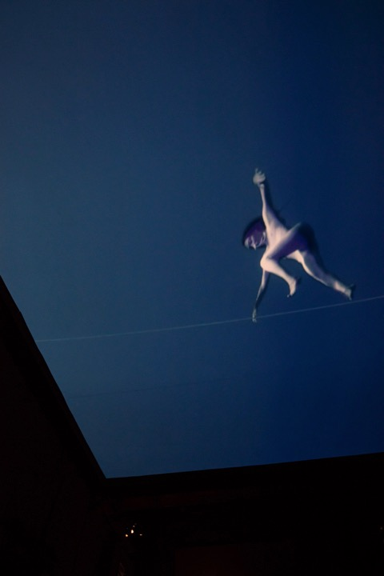

Slide 65
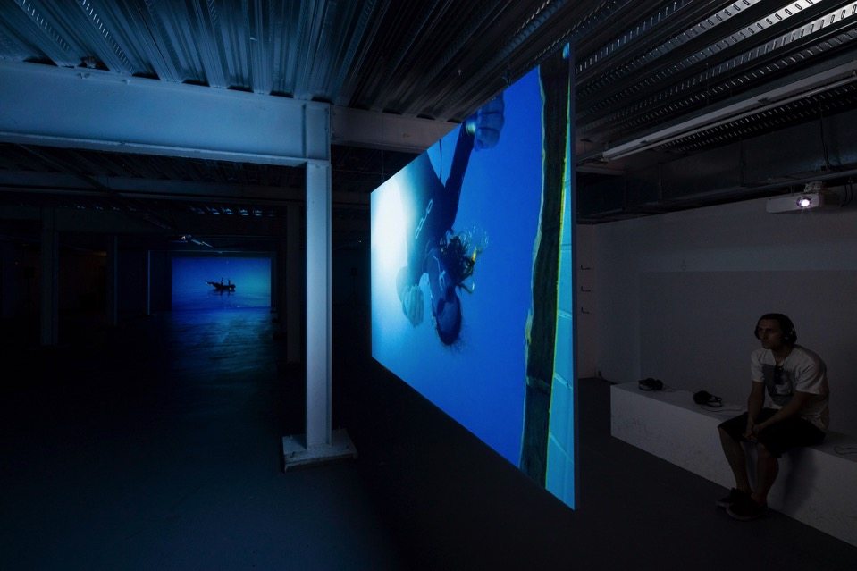

Slide 67
Chantal Akerman, NOW
In the Mirror (1971/2007)
A Voice in the Desert (2002)
Maniac Summer (2009)
Maniac Shadows (2013)
Tombée de nuit sur Shanghaï (2007)
D’est: au bord de la fiction (1995)
NOW (2015)

Slide 69


Slide 70


Slide 71


Slide 72


Slide 73


Slide 74


Slide 75


Slide 76


Slide 77


Slide 78


Slide 79


Slide 80


Slide 81


