Slide 1
29 November 2023
Tatjana Bolic
Roadmap for a European open science alliance for
ATM research

Slide 2
Authors
Tatjana Bolić, Andrew Cook
Rainer Koelle, Enrico Spinielli, Quinten Goens
Martin Strohmeier

Slide 3
Agenda
Background
Barriers and opportunities
Roadmap towards an ‘open science alliance’

Slide 4
Background
Open science
Open science practices involve:
open access (to publications)
open data (sharing research data)
open source/code (sharing software)
open methodology (sharing models, methods, etc.)
open peer review and
open educational resources
Why?
greater efficiency in research through increased collaboration
higher levels of verification/validation
reduced duplication
collaborations broaden the user community
improve methods and code testing, and enable more reproducible research

Slide 5
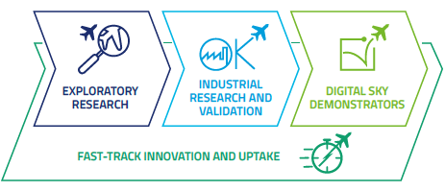
Background
Open science in the EU ATM research
Majority of EU ATM research under SESAR
Exploratory
Industrial
Demonstrators
Covid-19 impact “shows that we need an ATM system that is sustainable, scalable, and resilient, which does call for the envisioned transformation” and faster innovation cycles
The openness, transparency and reproducibility of research under open science practices can enable faster innovation cycles
Especially within current shape of innovation pipeline
TRL*0-2
TRL3-6
TRL6-8?
Source: SESAR Innovation pipeline, 2022 highlights
* Technology readiness level

Slide 6
Background
Reproducibility in the EU ATM research

Slide 7
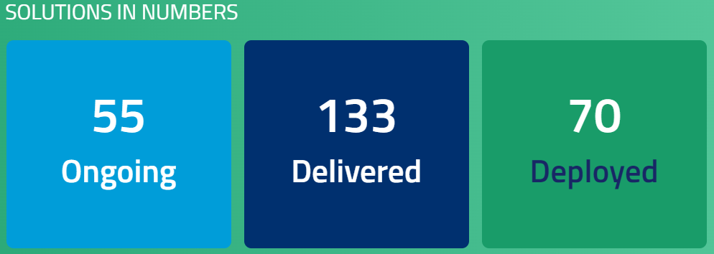
Background
Data needs
To reach TRL8, need to complete regulatory and standardisation requirements
SESAR Solutions
The need for open access to data for faster turnaround of ideas
ER often hampered
Engage KTN
An example of open data (and code) community
OpenSky Network

Slide 8
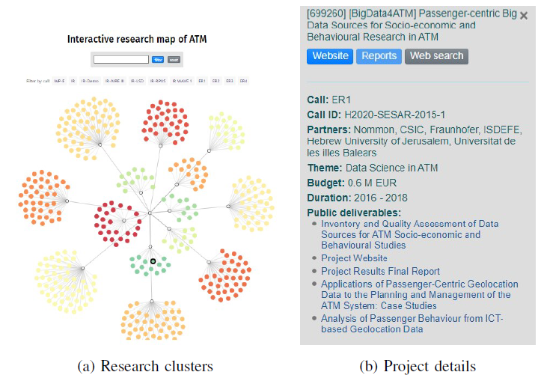
Background
Engage KTN
Open data most-cited issue
6-12 months to obtain data
Licensing and non-disclosure agreements prevent data sharing
Creation and application of non-disclosure agreements regarding the acceptable form of sharing of confidential (or subject to GDPR) information by the data owners
Creation of a framework to share ATM-relevant data (including MET and multimodal data), to afford easier access without having multiple agreements in place
https://wikiengagektn.com/EngageWiki

Slide 9
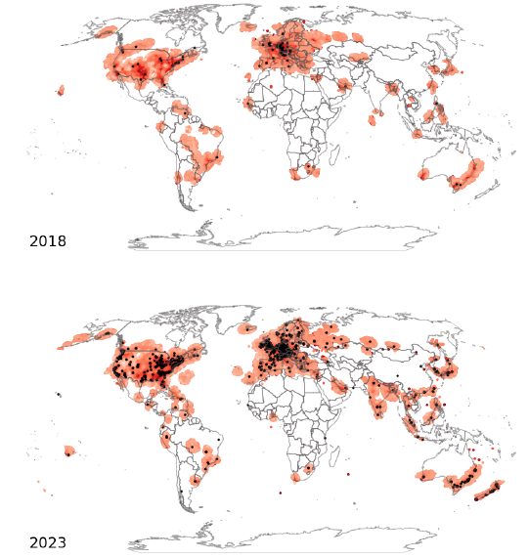
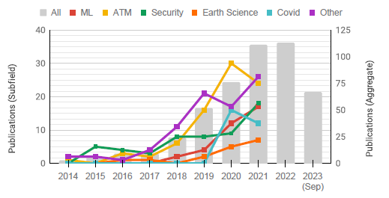
Background
OpenSky Network
Collaborative sensor network, collecting surveillance data for air traffic control purposes
to grant the general public access to real-world air traffic control data and
promote advancement of ATC technologies and processes
Open access to data for research purposes
Extensive tooling for easy data access, processing and visualisation
Publications numbers growing

Slide 10
Barriers and opportunities

Slide 11
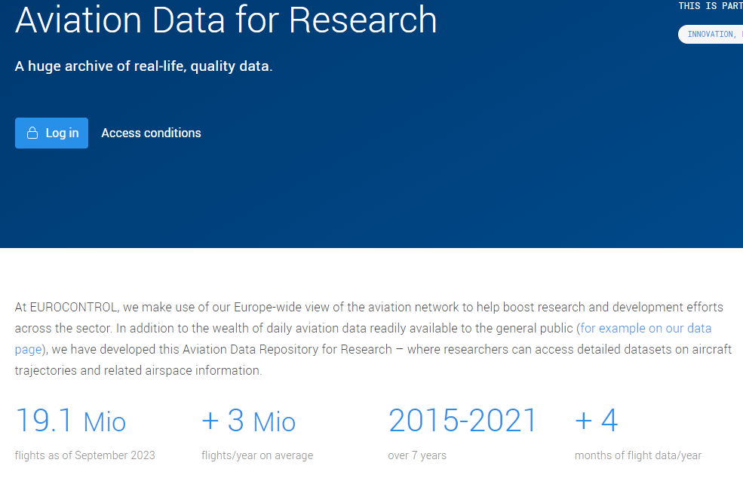
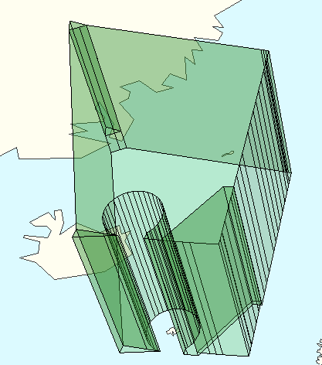
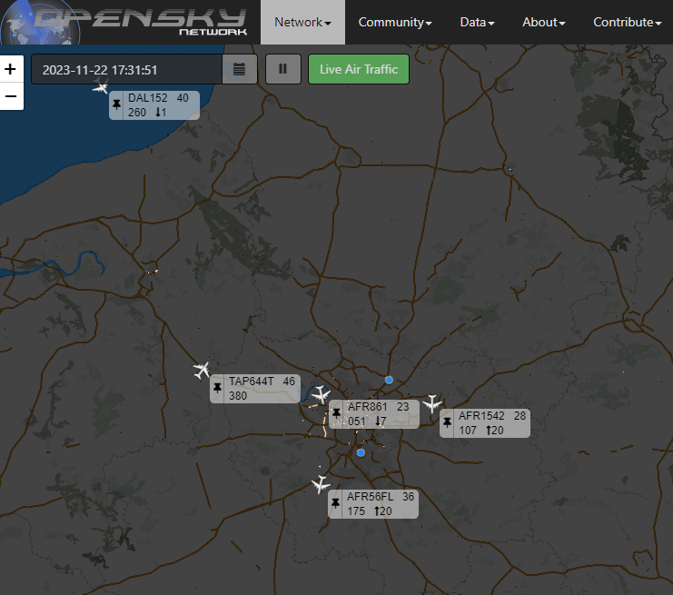
Barriers and opportunities
General ATM data availability
Flight data
Airspace and airport capacity
Source: visualisation with NEST

Slide 12
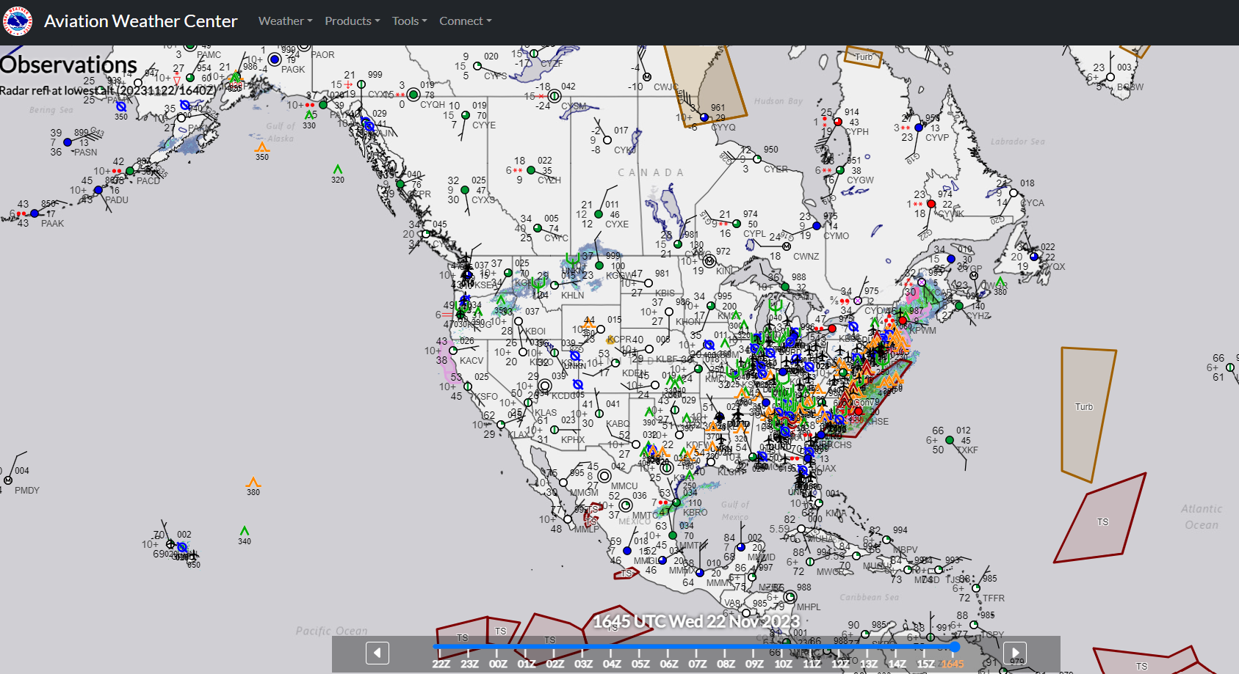
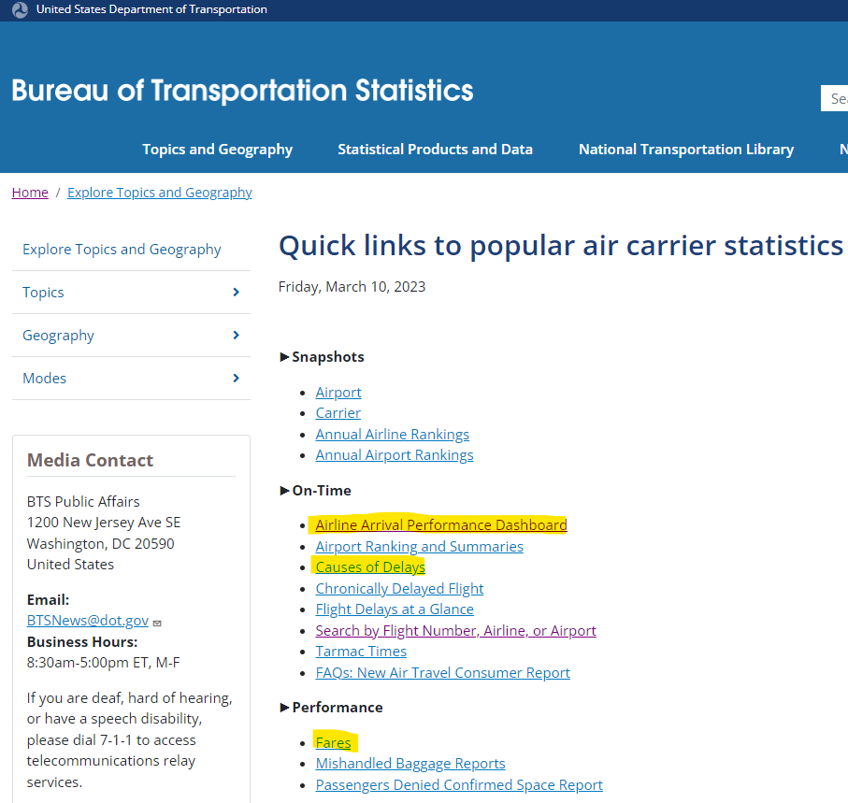
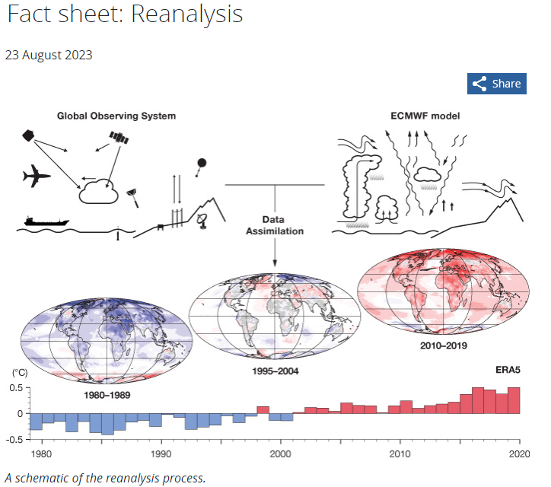
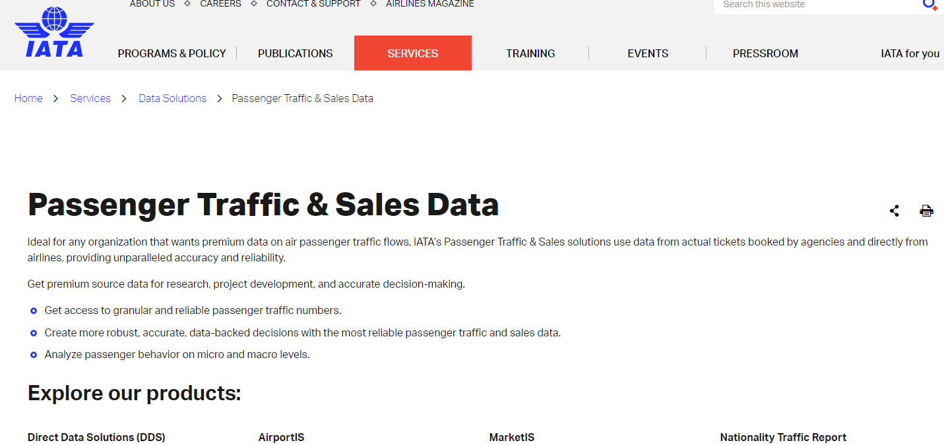
Barriers and opportunities
General ATM data availability
Schedules and fares
MET data

Slide 13
Barriers and opportunities
Barriers
Cultural change to embrace transparency and reproducibility
Barriers:
Reputational repercussions
Privacy considerations
Business considerations
National security and defence issues
Costs
Data ownership (licensing)
Need for opening to address environment and digitalisation

Slide 14
Barriers and opportunities
Opportunities
Continuously growing number of initiatives to crowd-collect/acquire data (and code) and share it
Political goals for future of air transportation and the discussion of aviation’s impact on climate change, call for higher levels of transparency
Open data would enable:
Easier application of the Performance Assessment Framework within SESAR
Transparency and reproducibility
Ability to COMPARE the outcome of different solutions from a continuation of the same project or an alternative piece of research/approach
Higher research ranking on the global stage

Slide 15
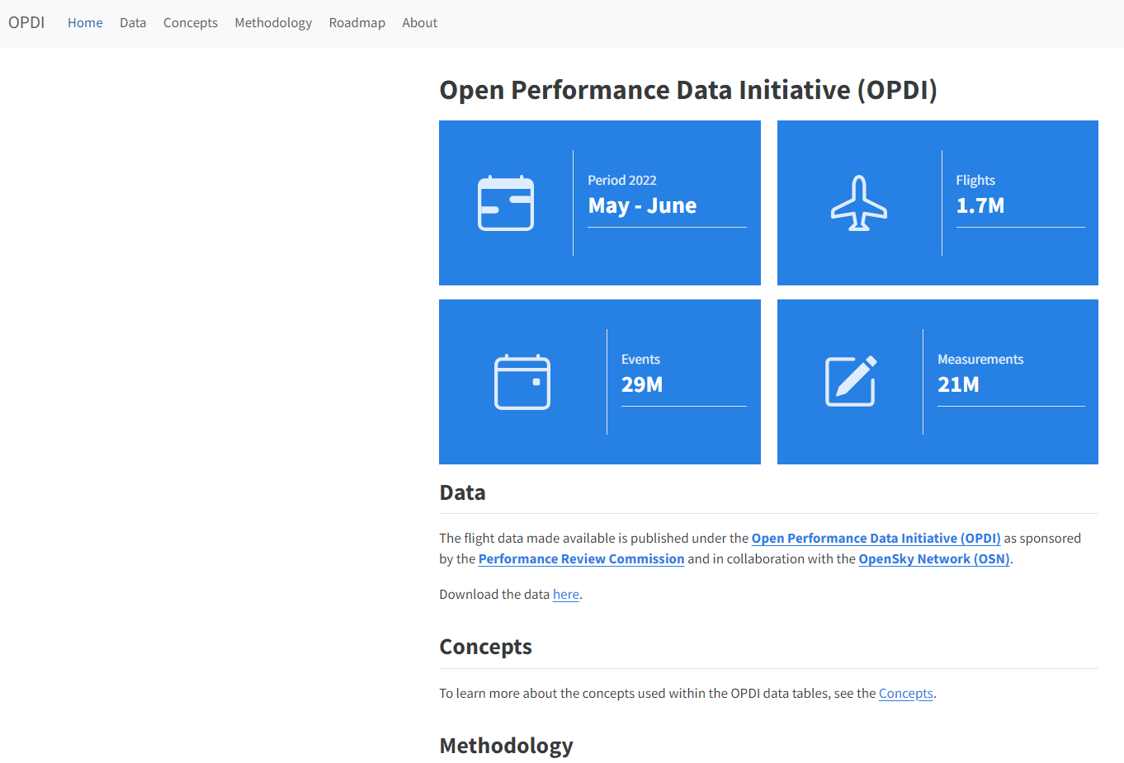
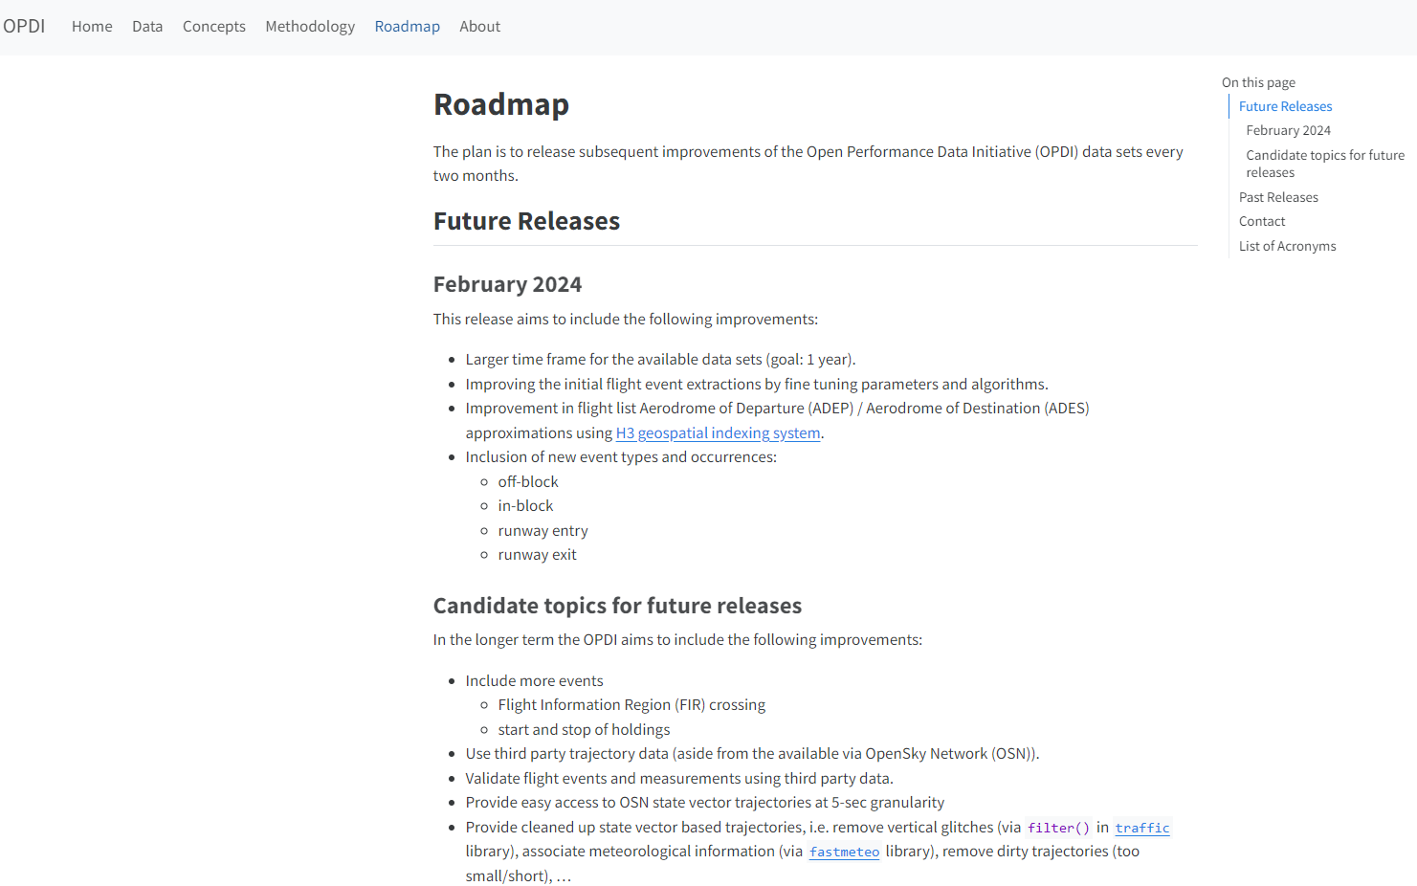
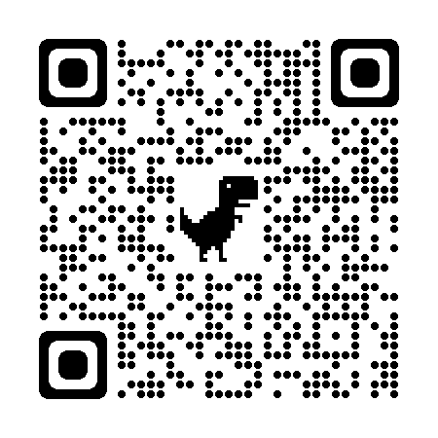
Roadmap towards an ‘open science alliance’
Open performance data initiative
https://www.opdi.aero/

Slide 16
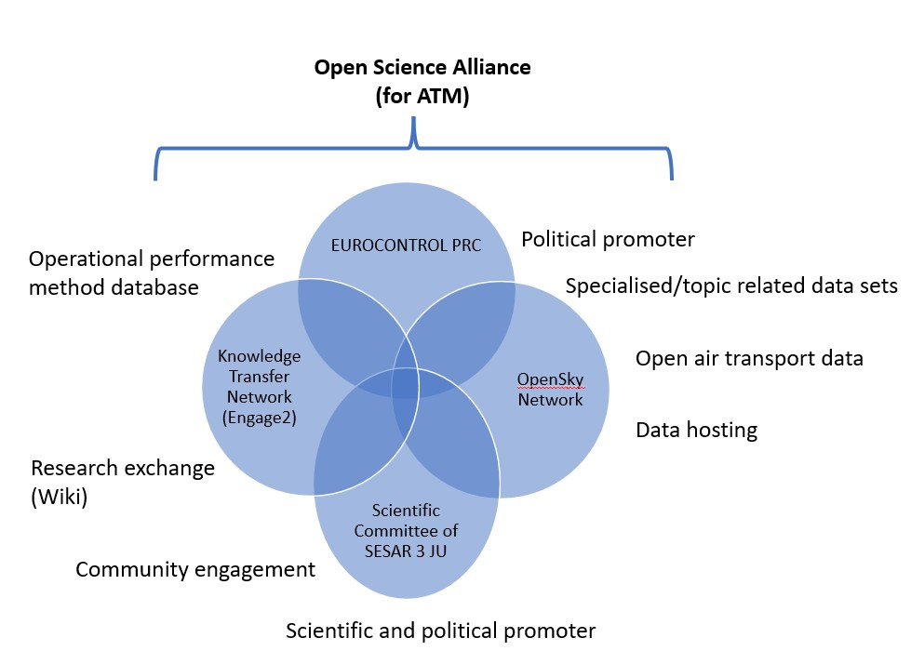
Roadmap towards an ‘open science alliance’
Existing collaborations

Slide 17
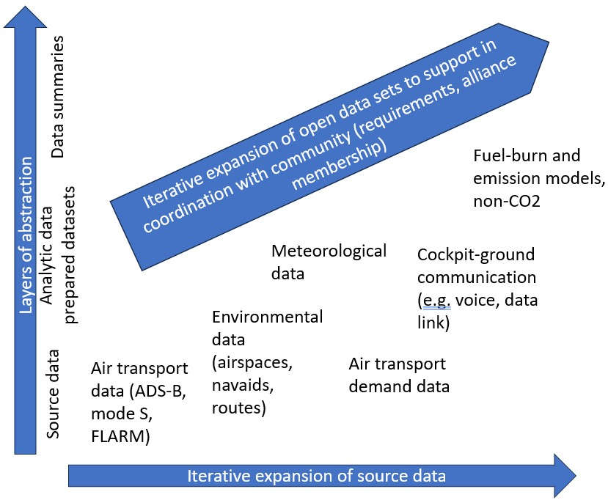
Roadmap towards an ‘open science alliance’
Expansion

Slide 18
Roadmap towards an ‘open science alliance’
Join us
USE the open data (and software, and results,…) and HIGHLIGHT (cite) the importance of it
CONTRIBUTE to the open data and open science:
Tell us about your open data needs
Join the ‘open science alliance’ collaboration
Comprehensive survey on open data/science by
Coming in March 2024
Click for ‘Open science alliance’
survey

Slide 19
THANK YOU
t.bolic@westminster.ac.uk

