Slide 1
Design Methodology for Rich Web-based Applications
Nalaka R. Dissanayake
Director of studies: Dr Alexander Bolotov
Secondary supervisor: Dr Simon Courtenage

Slide 2
Content
Introduction
Literature Review
Work completed
Future work
Methodology
“

Slide 3
1. Introduction a. Background – Rich Web-based Applications
Type of web-based systems
Rich GUIs
+
Advanced communication model (Delta-Communication)
=
Improved user experience

Slide 4
1. Introduction a. Background – Rich Web-based Applications
Type of web-based systems
Rich GUIs
+
Advanced communication model (Delta-Communication)
=
Improved user experience

Slide 5
1. Introduction a. Background – SE methodology
Software engineering methodology is a framework that governs the engineering project by defining a set of methods selected for a software engineering project based on specific criteria.

Slide 6
1. Introduction a. Background – SE methodology
Software engineering methodology is a framework that governs the engineering project by defining a set of methods selected for a software engineering project based on specific criteria.
Methods
Engineering approaches (model driven engineering, agile SE)
Design and development Approaches (OODD, structured DD)
Modelling languages (syntax and models)
Standards, guidelines, tools, practices, policies, …..

Slide 7
1. Introduction a. Background – Design methodology
high-level/preliminary design (architectural design)
Informal Box-and-Line Drawing
Architectural Description Languages (ADLs)
UML-based Architectural Modelling – SysML, C4 model
low-level/detailed design
Processing/business logic
Communication logic and APIs
GUIs and events
Databases

Slide 8
1. Introduction b. Problem and Motivation
Research problem is the unavailability of a complete design methodology dedicated to catering to the specificity of the RiWAs.

Slide 9
1. Introduction b. Problem and Motivation
Research problem is the unavailability of a complete design methodology dedicated to catering to the specificity of the RiWAs.
Available solutions (low adoptability)
Incomplete – Do not address all the aspects of RiWAs, like
DC related logic and API modelling
Business logic distribution
Complex – Lots of new syntax and models, resulting a higher learning curve

Slide 10
1. Introduction c. Aim and Objectives
Aim of the research is to introduce a novel designing methodology for RiWAs, which is complete and simple.

Slide 11
1. Introduction c. Aim and Objectives
Aim of the research is to introduce a novel designing methodology for RiWAs, which is complete and simple.
Obj 1. Identify the general characteristics of the RiWAs to be addressed by a complete design methodology
Obj 2. Identify a comprehensive abstract architectural style for the RiWAs
Obj 3. Introduce a RiWA design methodology
Obj 4. Demonstrate the utilization of the introduced methodology through a use case
Obj 5. Evaluate the introduced design methodology for the RiWAs

Slide 12
1. Introduction d. Research Hypotheses
H₀1: Models can be introduced to design all the general characteristics of the RiWAs, based on a comprehensive abstract architectural style.
H₀2: A simple UML profile can be introduced to produce the complete set of models introduced while satisfying the H₀1, maintaining lower complexity, thus, incorporating a lower learning curve towards higher adoptability.
H₀3: A complete RiWA design methodology can be produced, utilizing the UML profile and the models of that profile, introduced while satisfying the H₀1 and H₀2.

Slide 13
2. Literature review High-level design methods
Criteria \ Method | Box-and-line | ADLs | UML-based
Completeness (Provide support to include processing and communication-related entities/elements, communication channels and related aspects, additional entities, and additional details) | All the aspects can be designed. | Most of the aspects can be designed. | Most of the aspects can be designed.
Simplicity (Ability to adopt into RiWAs architecture designing, with a lower learning curve) | Can be easily used for RiWAs. Incorporates learning curve per diagram. | Not specialized for RiWAs and a higher learning curve. | Not specialized for RiWAs, but a lower learning curve.

Slide 14
2. Literature review Low-level design methods
Criteria \ Method | UWE-R | OOH4RUA | OOHDM | WebML IFML | RUX-model | ADRIA
Completeness | Standard web | Standard web | Incomplete | Incomplete | Incomplete | Incomplete
Simplicity | Complex | Complex | Complex | Complex | Complex | Complex

Slide 15
3. Work completed a. General characteristics of RiWA [Obj 1]
Client-side Event Handling
Split Business Logic between Client and Server
Required effective Modularization
Required proper DC Handling and Management

Slide 16
3. Work completed b. Comprehensive style for RiWA [Obj 2]

Slide 17
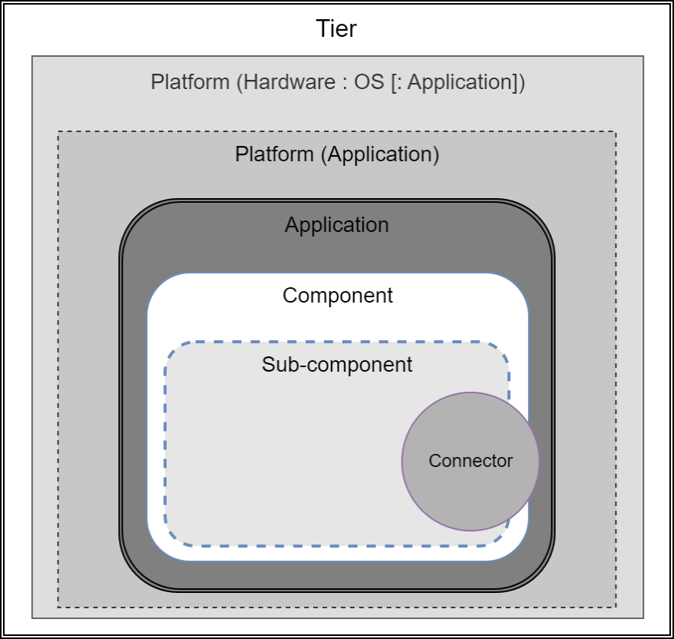
3. Work completed c. Requirements for high-level design
1. Processing elements of RiWAs

Slide 18
3. Work completed c. UML notations for high-level design
1. Naming labels
<< Element : Type : Name >>

Slide 19
3. Work completed c. UML notations for high-level design
1. Naming labels
<< Element : Type : Name >>
<< Tier: Presentation : Users >>

Slide 20
3. Work completed c. UML notations for high-level design
1. Elements

Slide 21
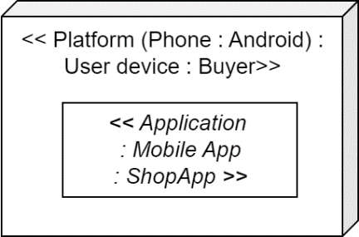
3. Work completed c. UML notations for high-level design
1. Elements

Slide 22
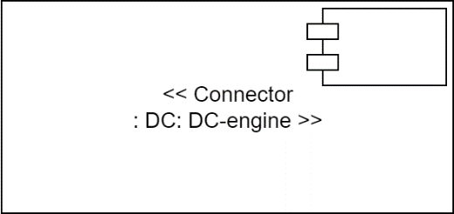
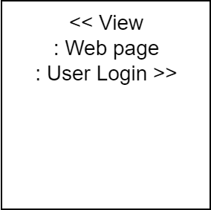
3. Work completed c. UML notations for high-level design
1. Elements

Slide 23
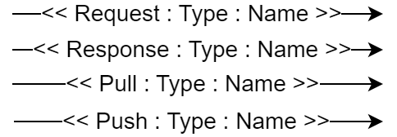
3. Work completed c. UML notations for high-level design
2. Communication channels
Direction, mode (request, response, pull, push), name, and type

Slide 24
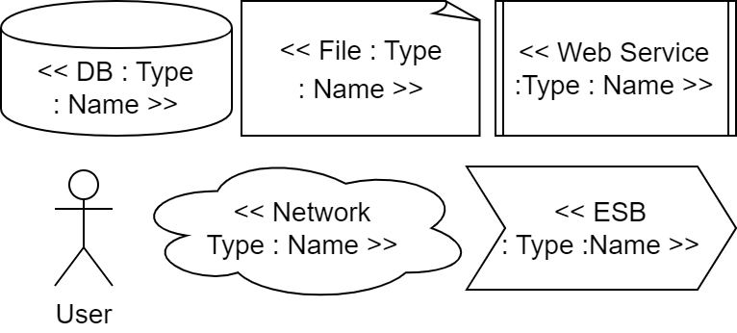
3. Work completed c. UML notations for high-level design
3. Additional entities
User, DB, files, web services, networks

Slide 25
4. Future work a. Tasks to complete [Obj3]
Introduce UML profile/extension for high-level design of RiWAs
Introduce UML profile/extension for the low-level design of RiWAs
Finalize the process, rules, and guidelines for the proposed design methodology
Use case – design a real-world system and demonstrate the application of the proposed methodology
Evaluate the proposed design methodology

Slide 26
4. Future work b. Contributions [Obj3]
A comprehensive set of models
A new UML profile
A new design methodology for the RiWAs
A case study

Slide 27
5. Methodology a. Research methods
Research type
Qualitative research – complexity, completeness, simplicity, and easiness
Conceptual research – Implementing a design methodology

Slide 28
5. Methodology a. Research methods
Research type
Qualitative research – complexity, completeness, simplicity, and easiness
Conceptual research – Implementing a design methodology
Research Framework
Conceptual
Software Engineering Research Methodology (SERM)
Software Engineering = f_{n}(C,F,D)
Formal
Developmental

Slide 29
5. Methodology b. Implementation of the Proposed Design Methodology
Process
Step 1: Set requirements
Identify general characteristics and features of RiWAs to address
Set requirements for high-level design aspects of RiWAs
Set requirements for low-level design aspects of RiWAs
Step 2: Design the language elements
Design architectural design language elements
Design detailed design language elements
Step 3: Implement the methodology
Define the models
Define the rules and guidelines

Slide 30
5. Methodology C. Evaluation
Self-evaluation – to identify the pros and cons of the produces design methodology
Contextualized comparisons – to compare the introduced methodology against the available solutions, to reflect the advancements and limitations
Expert evaluation – To verify the usefulness, based on the opinions of the domain experts
Triangulate the results to derive conclusions.

Slide 31
Thank you Q and A
“

