Slide 1
Creating Inclusive Learning Environments for the 21st Century
Convegno Internazionale Ambienti di apprendimento, Inclusione e Benessere: dentro e fuori la scuola
24 October 2022
Alastair Blyth, Assistant Head , School of Architecture and Cities
University of Westminster

Slide 2
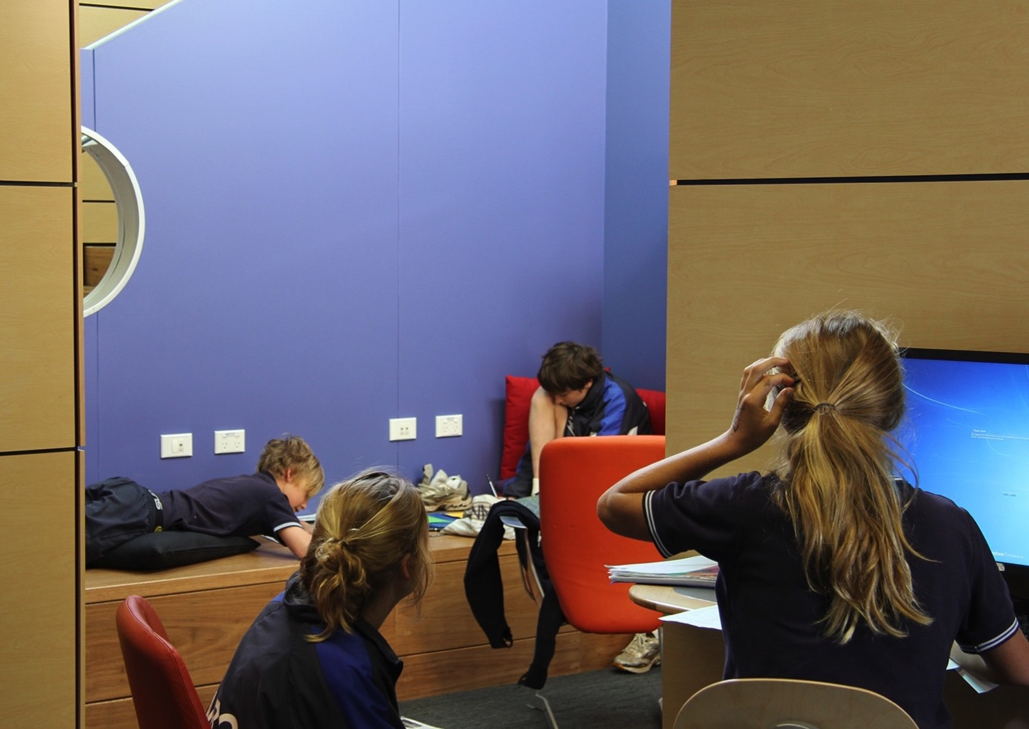
To meet the demands of 21st Century:
Education systems are expected to help students develop:
Ways of thinking: Creativity, Critical thinking, Problem-solving
Ways of working: Collaboration, Teamwork, Adaptability, Leadership
Ways of living together: Curiosity, Empathy, Self-esteem, Resilience
Notes:
So, to meet the demands of 21st century skills education systems are expected to help students develop their ways of thinking, ways of working and ways of living together.

Slide 3
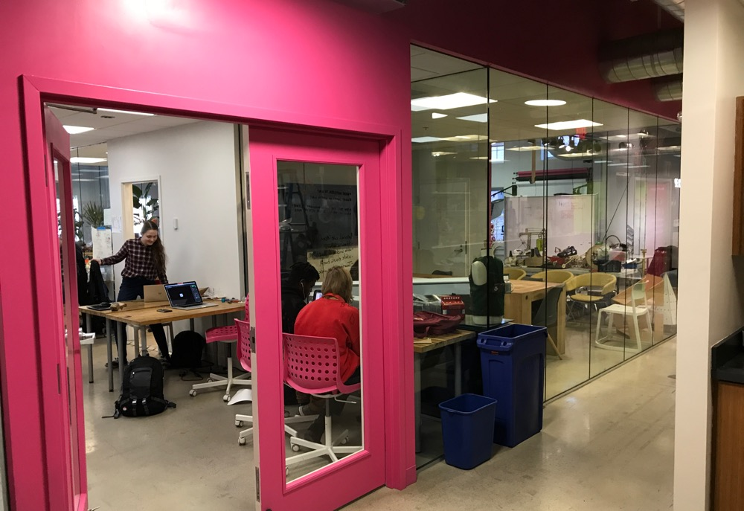
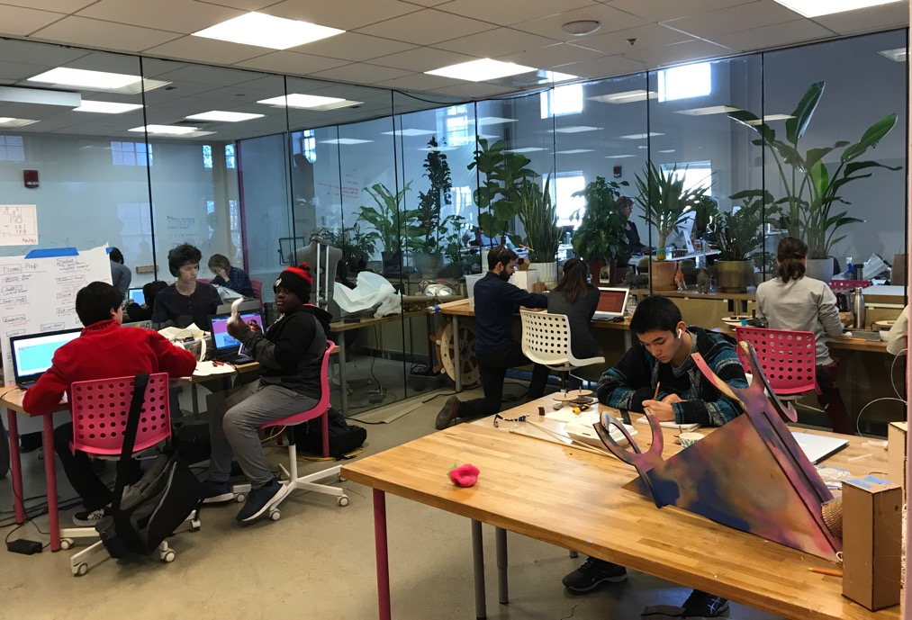
To support teaching and learning, the physical environment needs to respond and support the needs of the users

Slide 4
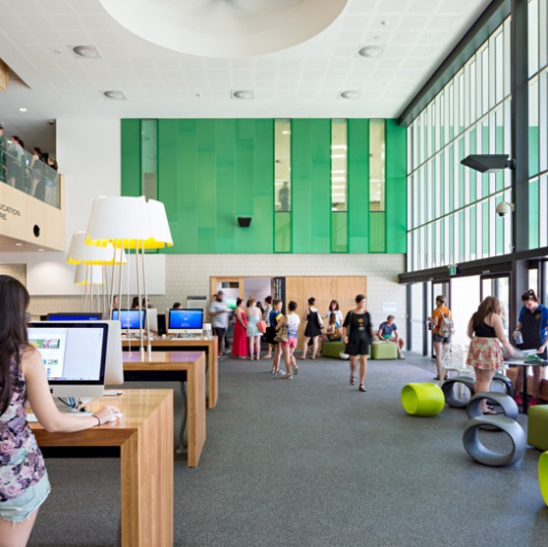
Some questions to ask today:
What is inclusive design and its relationship with learning spaces?
What is the role of design as a process?
What are the areas of concern?

Slide 5
Space is a multi-layered conversation
because space is not just about space ...
people & what they do
time
technology
… and space

Slide 6
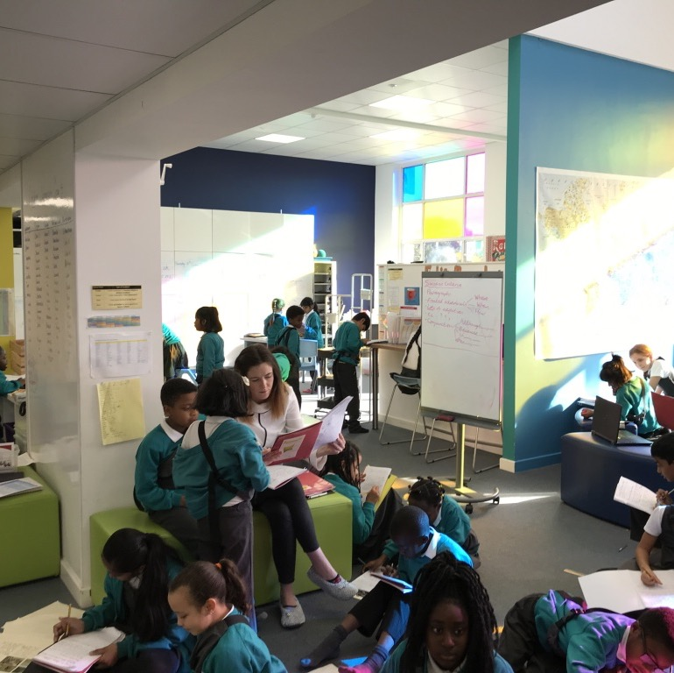
Think of space as part of the learning system
Notes:
Spaces for learning must be thought of as part of a whole ‘learning system’, not separate from it. Therefore to design coherent learning spaces it is crucial that all aspects of the system are considered from learning itself, teaching, curriculum, students. This is because a change in one thing necessarily affects another including the spaces used. Managing change is a key aspect of creating effective spaces. The ability of the spaces and indeed the organization to be able to respond to change.

Slide 7
Everything affects everything else
Space
Pedagogy
Resources
Learners
Teachers
Content

Slide 8
Everything affects everything else
Space
Pedagogy
Resources
Learners
Teachers
Content

Slide 9
What is spatial Inclusive Design?
Inclusive [spatial] design is about making places everyone can use.
Inclusive design aims to remove the barriers that create undue effort and separation. It enables everyone to participate equally, confidently and independently in everyday activities.
CABE 2006

Slide 10
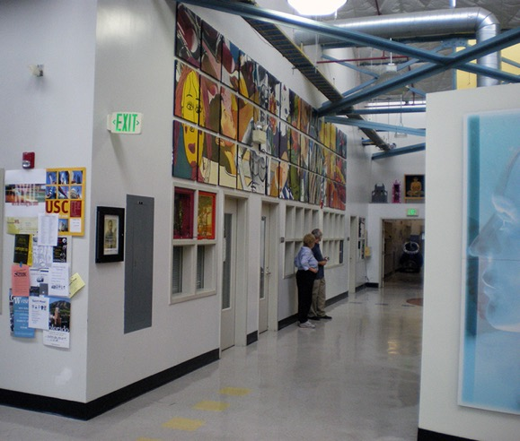
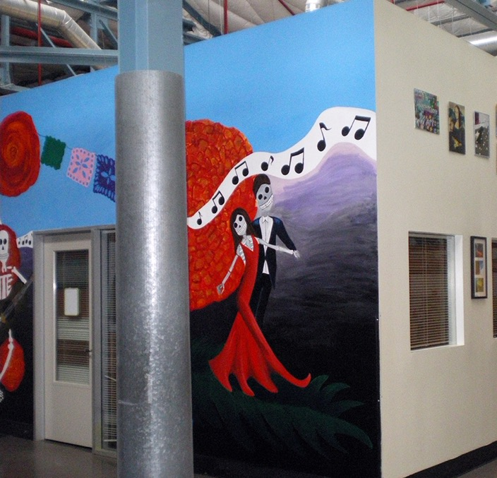
Inclusive design …
Places people at the heart of the design process.
Acknowledges diversity and difference.
Offers choice where a single design solution cannot accommodate all users
Provides for flexibility in use.
Provides buildings and environments that are convenient and enjoyable to use for everyone.
CABE 2006

Slide 11
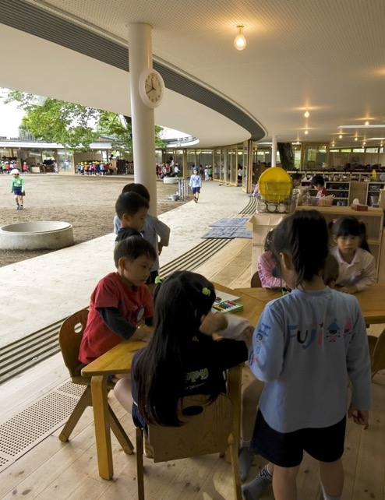
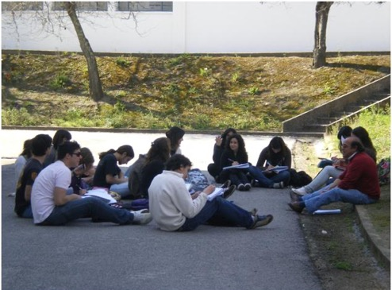
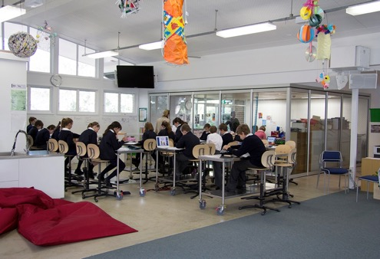
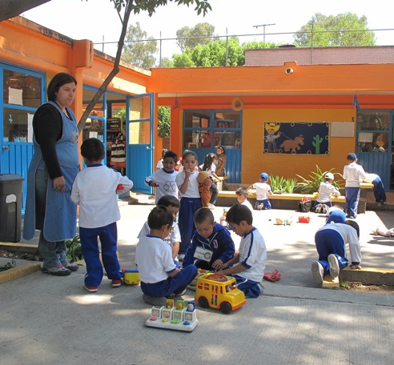
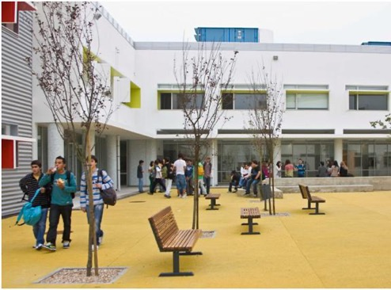
Inclusive Design
Inclusive – so everyone can use it safely, easily and with dignity
Responsive – taking account of what people say they need and want
Flexible – so different people can use it in different ways
Convenient – so everyone can use it without too much effort or separation
Accommodating for all people, regardless of their age, gender, mobility, ethnicity or circumstances
Welcoming – with no disabling barriers that might exclude some people
Realistic – offering more than one solution to help balance everyone’s needs and recognising that one solution may not work for all
CABE 2006

Slide 12
…but inclusive design is also a process
Notes:
Inclusive design is more than just the product, the thing that has been designed, it must surely be about the process too.

Slide 13
Inclusive design as a process
How do you know you have got there?
Where did you start?
Where did you want to go?
How did you get there?
Current way of Working
Set the Vision
Making the Change
Review the new position
Pedagogy
How do we want to teach/learn?
Teaching and Learning Implications:
Education brief preparing teachers
Pedagogy
Space
How should space support?
Spatial Implications
Spatial Brief
Space
OECD
School User Survey
Using the OECD School User Survey (Part 2)
OECD
School User Survey
Based on model by Terry White 2017

Slide 14
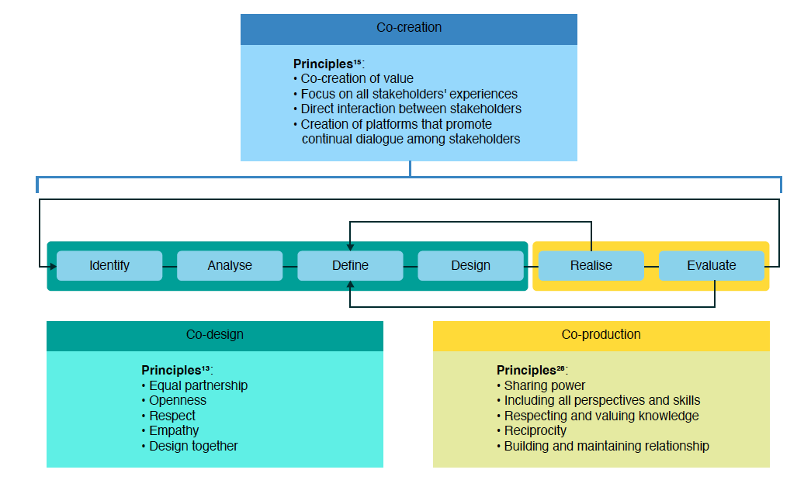
Co-creation, Co-design, Co-production
Source: Vargas et al Public Health Research & Practice June 2022; Vol. 32(2) https://doi.org/10.17061/phrp3222211

Slide 15
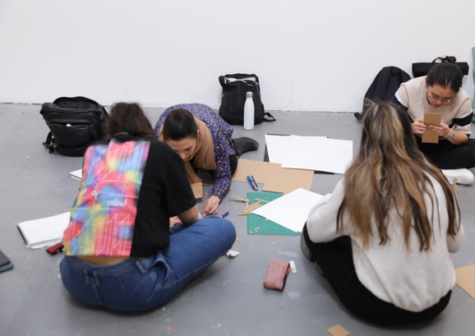
Participatory Design
Students – drawing, writing, story telling, making
Adults – 3D physical interventions

Slide 16
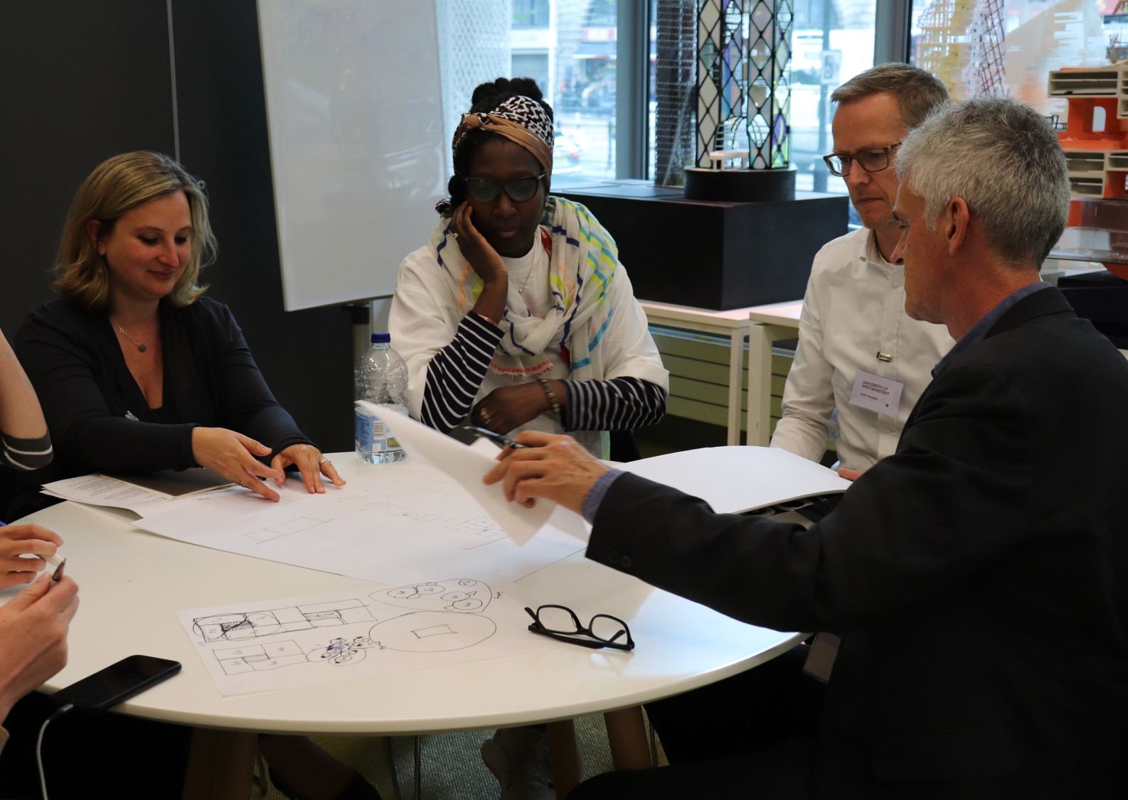
Participatory Design
Community – test ideas: drawings, making, images

Slide 17
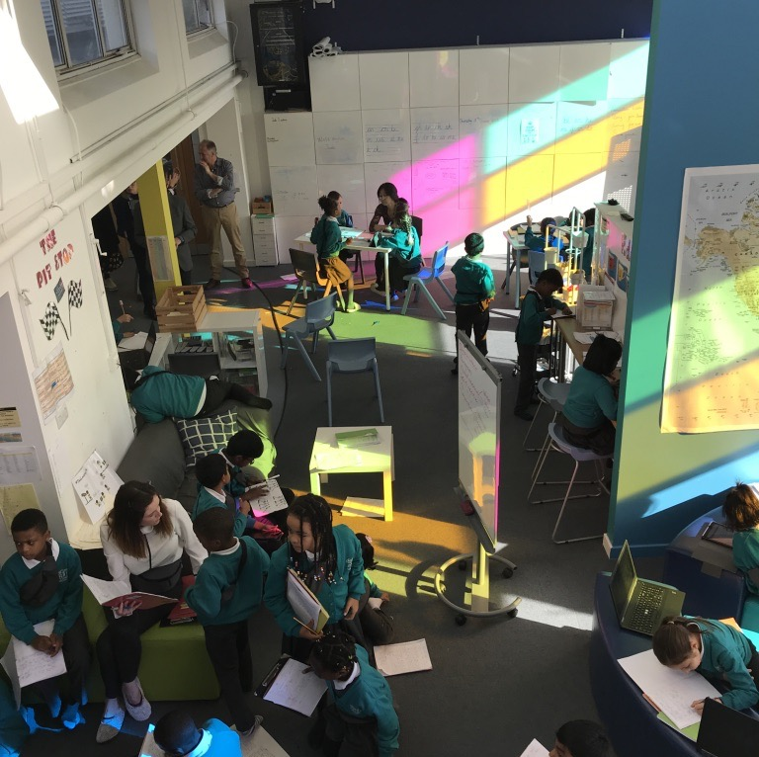
Universal Design for Learning
Making learning inclusive and transformative for everyone
CAST (2018). Universal Design for Learning Guidelines version 2.2. Retrieved from http://udlguidelines.cast.org

Slide 18
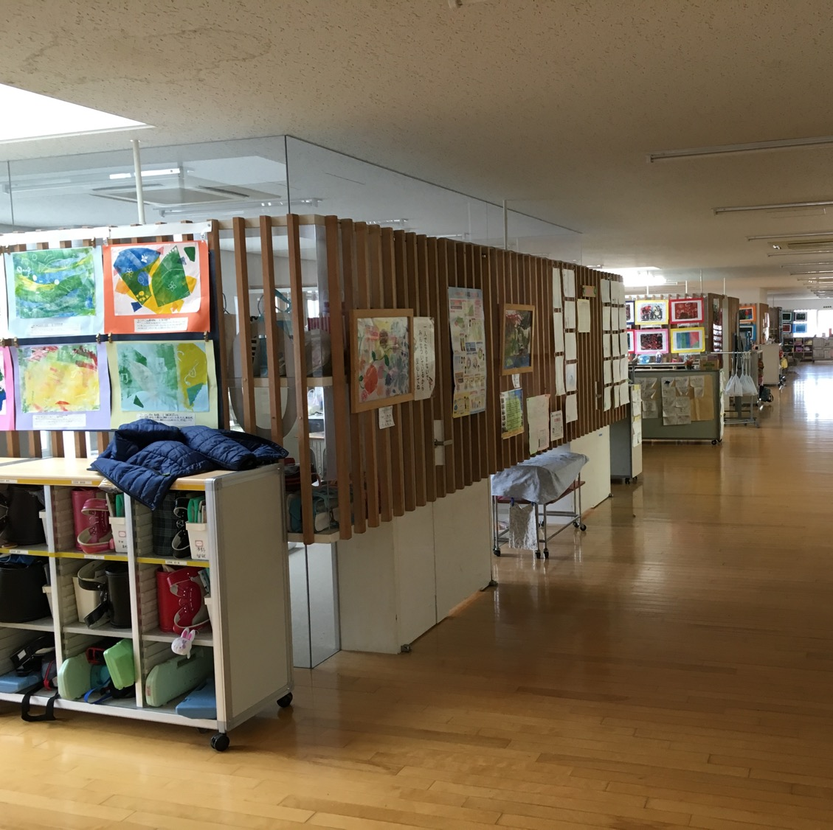
Some areas of particular focus
Acoustics: too much noise / difficult to hear
Vision and visibility:
Stimulation: is the environment visually too complex?
Movement: Moving around or between space spaces easily?
Wayfinding: Can people find their way?
Anthropometrics: Recognition that people are different in size and height
Flexibility: Ability of the environment to respond to change quickly

Slide 19
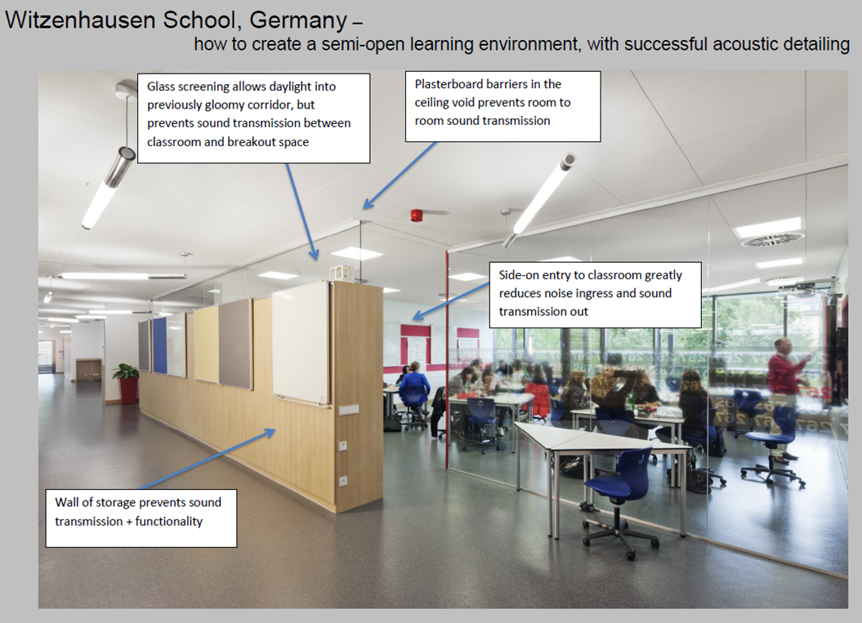
Getting the acoustics right
An example of how sound can be controlled in an innovative way
Acoustic Bulletin, Ecophon, 2017. https://www.acousticbulletin.com/how-open-should-a-learning-space-be-acoustically

Slide 20
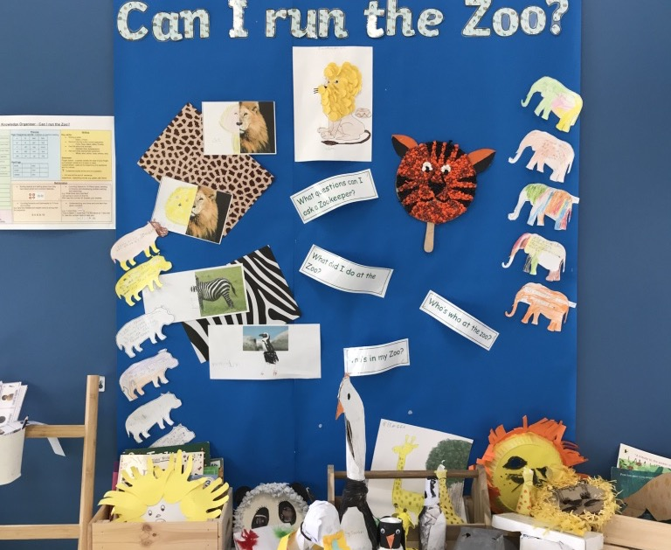
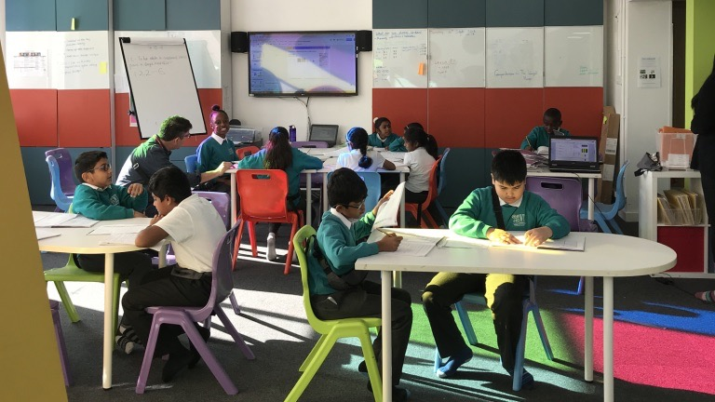
Minimize threats and distractions
Vary the level of sensory stimulation
Notes:
Engagement: For purposeful, motivated learners, stimulate interest and motivation for learning.

Slide 21
Use flexible materials with settings that can be adjusted based on needs and preferences
Notes:
Representation: For resourceful, knowledgeable learners, present information and content in different ways.

Slide 22
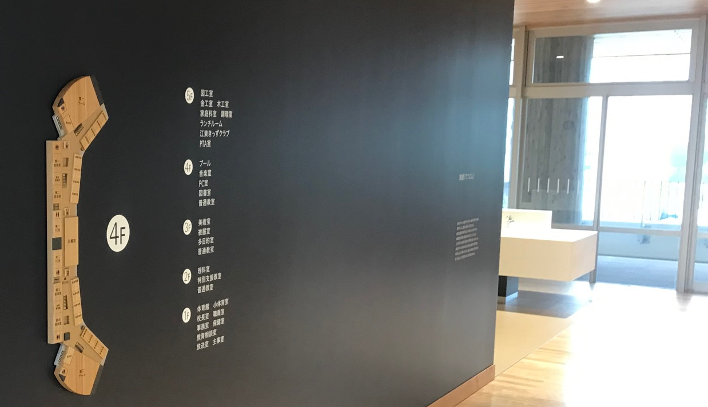
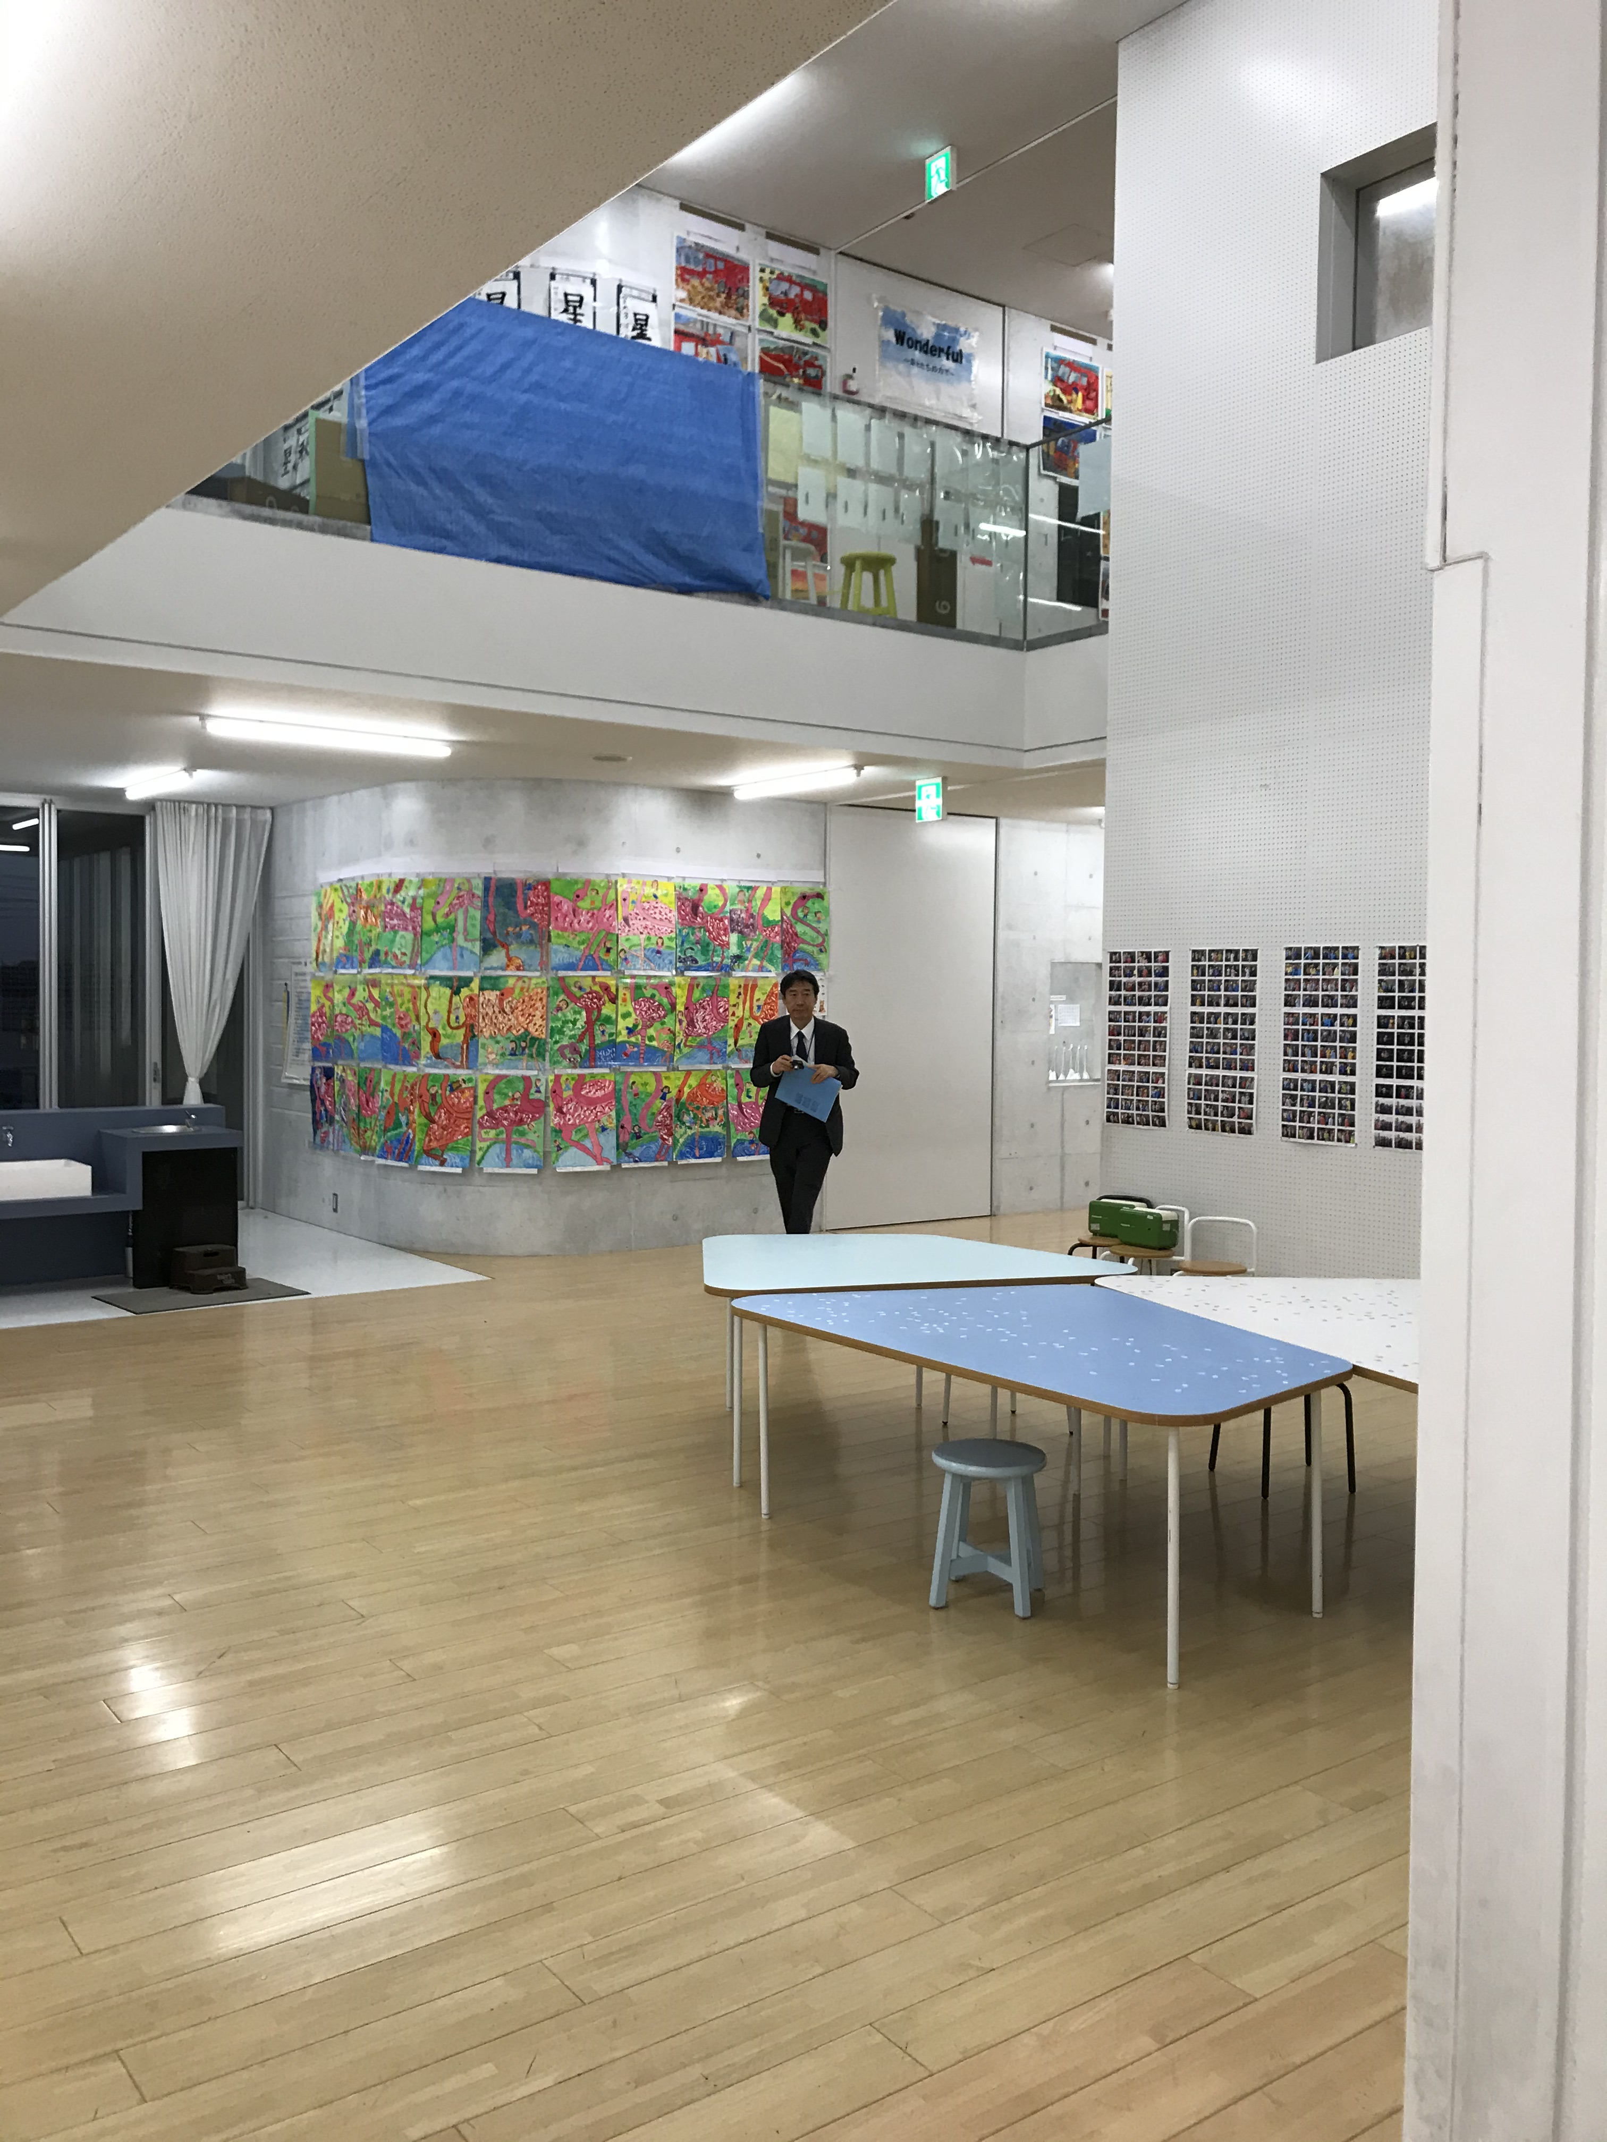
Many learners need help navigating through their environment
Notes:
Action & Expression: For strategic, goal-directed learners, differentiate the ways that students can express what they know.

Slide 23
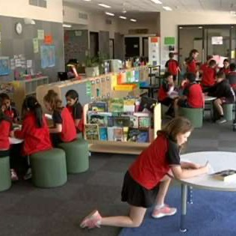
Flexibility is more than just about space
It is perhaps the ability:
To rearrange the elements in space quickly
Of the organization to change
Of technology to be responsive to support different ways of teaching and learning

Slide 24
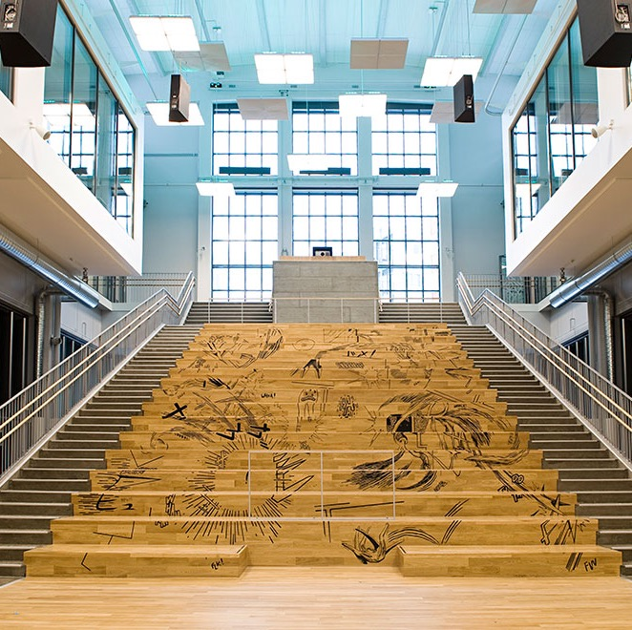
How inclusive is this?
Auditoria and stairs. But what if I use a wheel-chair?

Slide 25
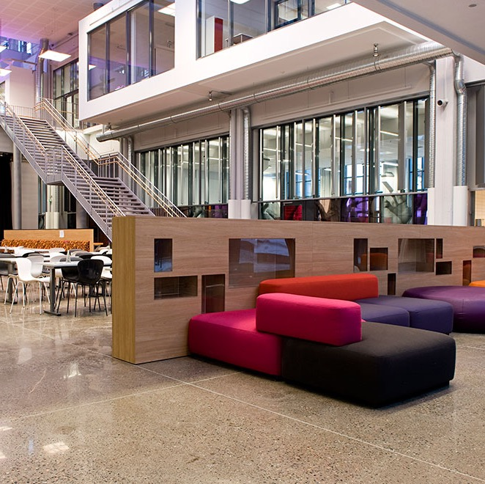
… and this?
A lot of hard surfaces – so how easy is it to hear in a space like this?

Slide 26
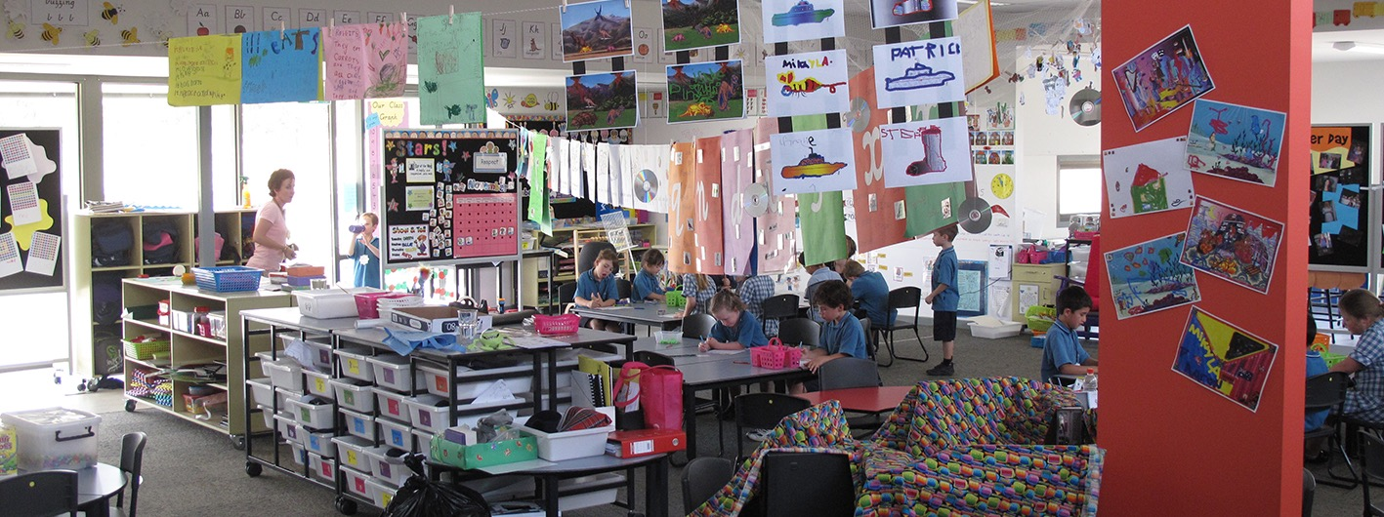
What about this?
Lots going on, but is it too much?

Slide 27
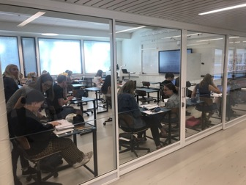
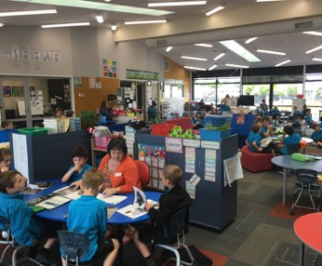
Learning activities impact on space e.g:
Direct teaching |  | Group Size | Activity | Key features
 |  | 2 - 5 6 - 10 11 - 25 | Receiving information Learning through teaching others | Classroom Size of room Shape of room Audibility Lighting control
Collaborative teaching |  | Group size | Activity | Key features
 |  | 25 – 90 + | Collaborating Communication Supporting others Team work Sharing ideas | Large space Adaptable for different sizes Multiple focal points Audibility Control of lighting Unobstructed visibility

Slide 28
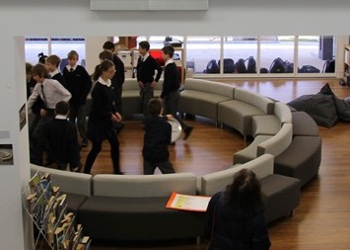
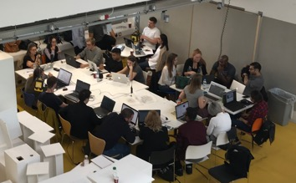
Learning activities impact on space e.g:
Dialogue; conversation; story-telling |  | Group size | Activity | Key features
 |  | 2 - 5 6 - 10 | Collaborating; shared experience | Classroom Size of space Shape of space Audibility Lighting control
Seminars |  | Group size | Activity | Key features
 |  | 2 - 5 6 - 10 11 -20 | Collaborating Communicating | Enclosed space Suppression of external noise Control of lighting Unobstructed visibility of displays

Slide 29
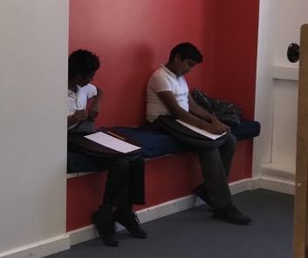
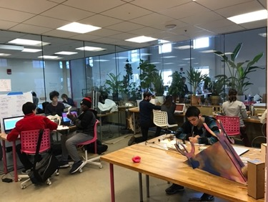
Learning activities impact on space e.g:
Quiet reflective activities (research; reading; thinking ) |  | Group size | Activity | Key features
 |  | 2 - 3 | Thinking individually Reflecting | Enclosed Quiet Adjacent to passive learning settings/spaces
Creative activities: e.g. media, arts |  | Group size | Activity | Key features
 |  | 2 - 5 6 - 10 11 -20 | Self-expression Creative expression Communication in range of modes/media | Suppression of noise from adjoining areas Specialised or generalised (activity dependent)

Slide 30
Grazie mille!
Alastair Blyth
A.Blyth@Westminster.ac.uk

