Slide 1
May 2026
BAFA Accounting Education Conference
Embedding Employability in the Accounting Curriculum
Dr Emma Elkington – Head of School Finance and Accounting

Slide 2

Session today
Aim: focuses on innovative strategies for embedding employability within the accounting curriculum. The core purpose is to share a holistic approach to curriculum design that integrates lifelong professional skills and fosters social capital and belonging within and beyond higher education.
Structure:
Embedding into curriculum
Building employer links into curricula
Authentic Assessment (and learning)
Mentoring programmes

Slide 3

Embedding into Curriculum
Why?
What it looks like?
How?
Notes:
Optional extras: Limited reach.
Signposted opportunities: Better access; weak discipline links.
Embedded, assessed, reflected: Strongest model; inclusive, coherent development.
Why it matters: Reaches all students, not only opt-ins; builds confidence to link study to work.
Theme 1: Skills and employability sessions in modules
Career awareness, communication, teamwork, problem-solving, digital skills.
Application writing, workplace language tied to subjects; timed for teaching, assessment, transitions.
Theme 2: Completely mapping the whole syllabus
Defined a shared set of skills and graduate attributes across all programmes. Took a programme‑centred, not module‑by‑module, approach. Aligned learning outcomes, teaching, and assessment with employer expectations. Made employability everyone’s responsibility, not confined to a single module. Asked every module leader to confirm: which skills were developed which skills were assessed. Mapping exercise revealed a key challenge: staff selected all skills
but struggled to evidence where or how they were taught or assessed. Identified a cultural and pedagogic gap: limited shared language uneven confidence about what “skills development” actually looks like. Introduced structured skills‑mapping templates: skills introduced skills developed skills assessed Result: shift from disconnected modules to a coherent student journey. Ongoing tension: strong focus on skills in practice no explicit requirement for skills or graduate attributes in periodic review documentation

Slide 4
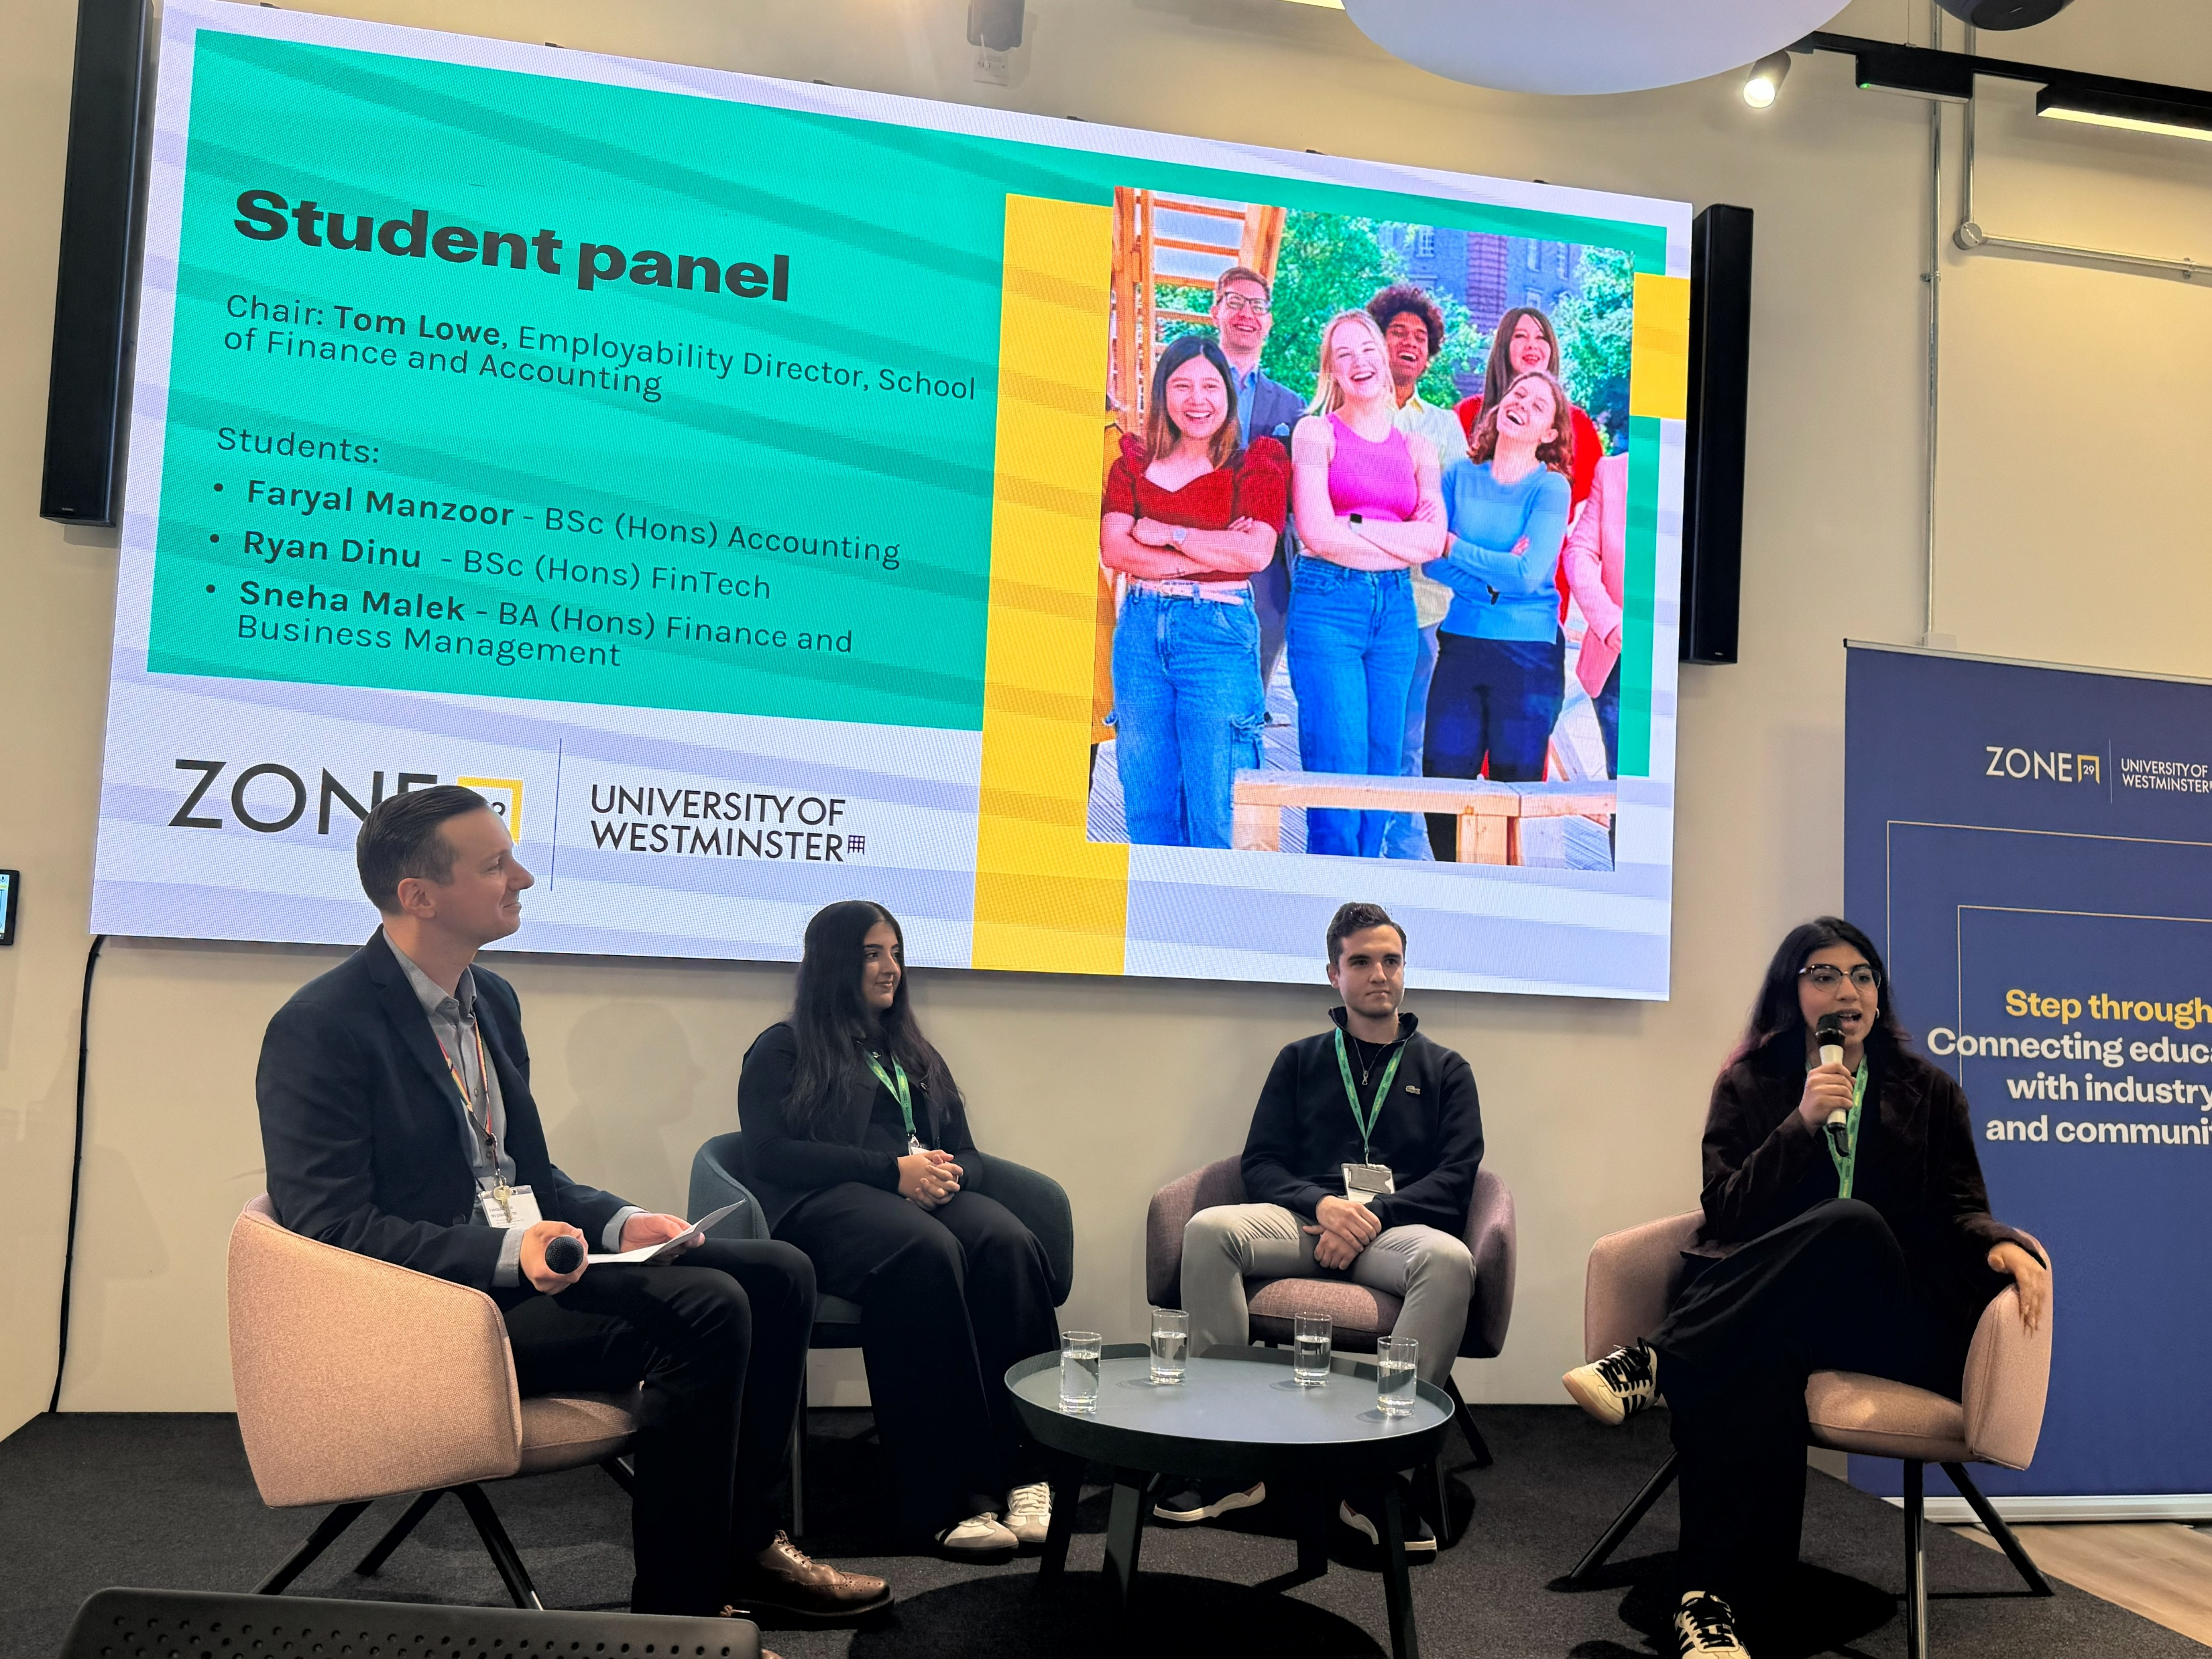
Building employer links into curricula
Notes:
Guest input
Short talks, case examples, panels, or recorded insights show how disciplinary knowledge is used in practice. They work best when linked to module outcomes and followed by guided discussion or reflection.
Exercise: Employer link brainstorm
Groups identify one low-, one medium-, one ambitious employer link; note barriers, enablers, first contact for one realistic option.

Slide 5
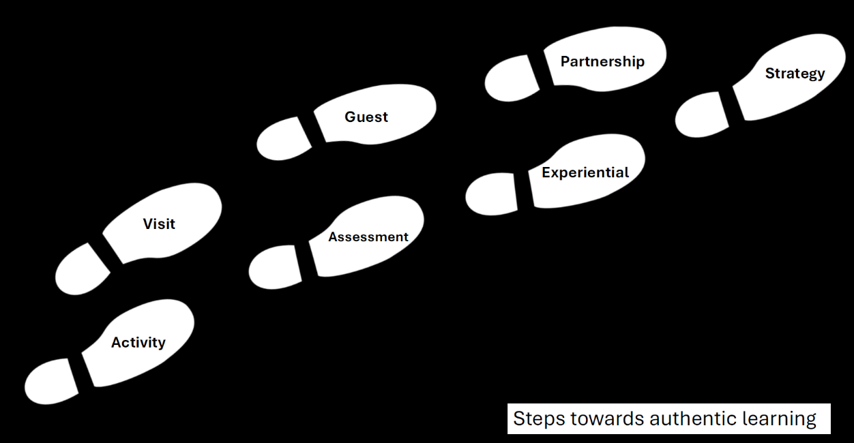

Slide 6
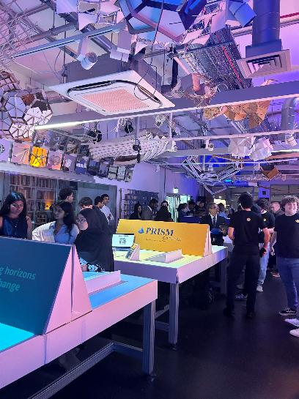
Authentic Assessment (and learning)
Moved from 100% exams to 100% authentic assessment
Learning and assessments redesigned to reflect real professional work
Focus on judgement, application and decision making and not rote learning
Driven by engagement,progression and employability
Notes:
This slide highlights a whole‑programme move away from traditional exams towards fully authentic assessment.
The redesign focused on what graduates actually do in professional contexts — applying knowledge, exercising judgement and making decisions rather than recalling information under time pressure.
The change was motivated by student engagement, progression and employability outcomes, with standards maintained through clear criteria and careful design.
The key takeaway is that assessment change can be a powerful driver of learning transformation.

Slide 7
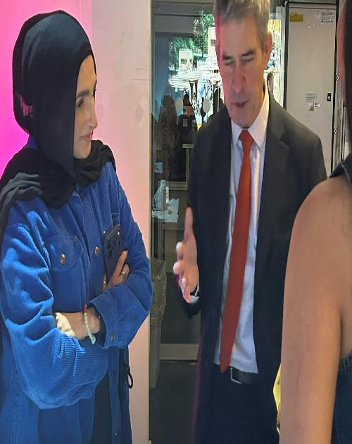
Mentoring programmes
Why belonging matters?
Reframing employability
Key Takeaways for educators
Notes:
Why belonging matters
Many accounting and finance students reported that they “didn’t see themselves” in the profession
This mirrored my own early experiences of social dissonance as an audit trainee
Aligned with wider sector concerns about:
lack of diversity
limited access to social capital
Led to a key insight:
graduate outcomes are shaped by culture and relationships, not just skills or knowledge
Reframing employability
Moved from a narrow skills focus to an ecosystem of belonging
Employability as:
identity formation
access to professional networks
confidence navigating unfamiliar spaces
Project 1: Deloitte One Million / Five Million Futures
Partnership providing:
bursaries
professional mentoring
Targeted first‑year students from under‑represented backgrounds
Mentoring delivered by:
Blueprint for All
Deloitte professionals
Outcomes:
mixed academic results due to significant personal challenges
mentoring consistently valued by students
Key learning:
mentoring helped students imagine themselves belonging in the profession
Legacy:
senior Deloitte alumnus continued mentoring beyond the formal programme
Project 2: ICAEW BBH mentoring reform
Longstanding bursary originally awarded to highest‑performing student
Redesign focused on:
social mobility
widening participation
mid‑tier firm talent needs
Replaced financial award with:
structured mentoring by member firms
Additional intervention:
funded student attendance at professional networking events
explicit support on how to navigate professional social spaces
First cohort launched in 2023 and continues beyond my direct involvement
Key takeaways for educators
Employability is not just curriculum‑based
Belonging, identity, and social capital are critical pedagogic concerns
Mentoring can be more powerful than financial support alone
Small, relational interventions can have disproportionate impact
Effective employability work sits at the intersection of:
curriculum
community
professional networks

Slide 8
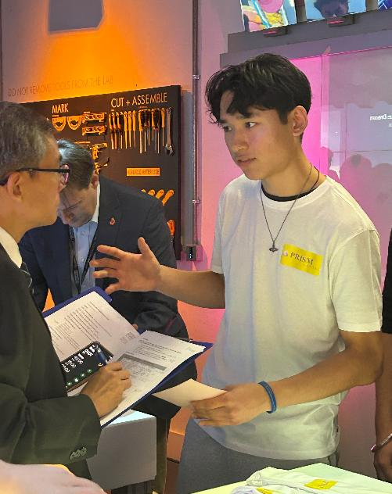
Summary
Some curricula focus on one of these areas and make a claim for this being a golden bullet
Our hypothesis is that all areas are important, especially with students with low social capital and where there are widening access students

Slide 9

May 2026
BAFA Accounting Education Conference
Embedding Employability in the Accounting Curriculum

