Slide 1
Moving from evidence to Action: creating caring reflective practitioners
Dr Regina Murphy Keith

Slide 2
What is our role in Higher Education?
Create opportunities for experience and research
Ensure competencies for employment
To create enabling environments for students to explore their chosen field to determine the next step in their career pathway
Support professional and personal growth

Slide 3
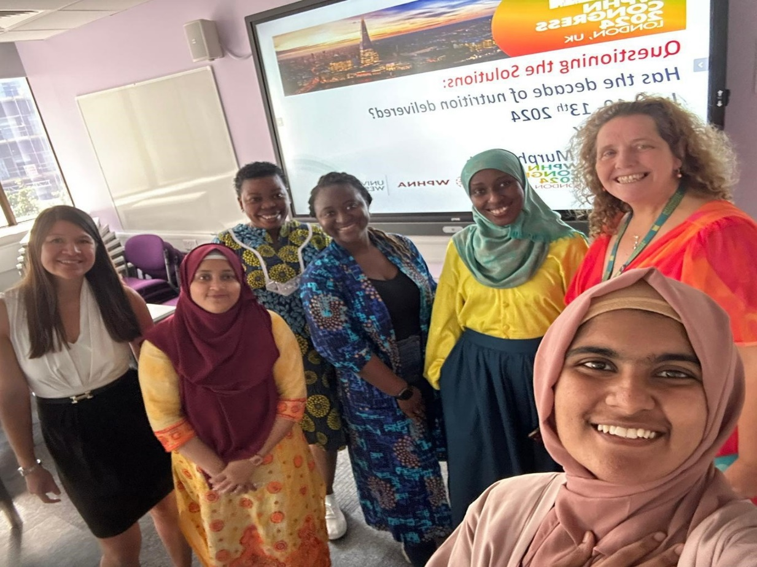
VALUE LED : BEING THE CHANGE
COMPASSION
INTERNATIONAL
INNOVATION
RESEARCH INTO TEACHING
EMPLOYABILITY

Slide 4
Merging social science with professional skills

Slide 5
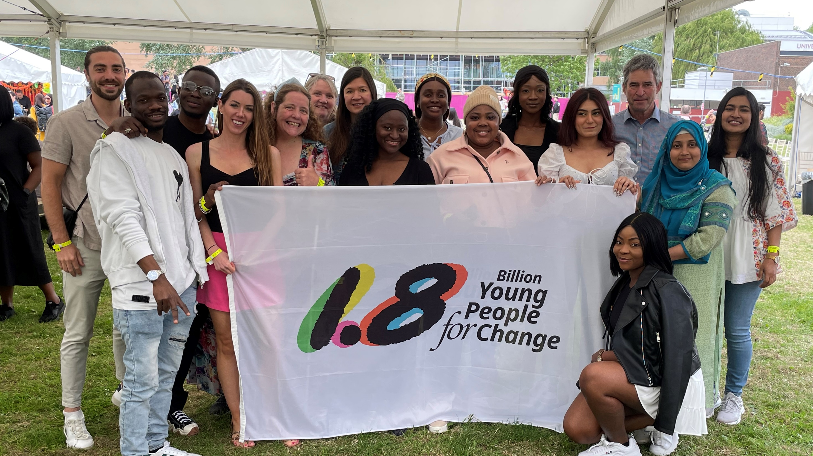

Slide 6
Voice reduces the risk of AI challenges
Encourage voice
Building listening skills
Participatory management styles
Course committees
Social interactions
Assessments which encourage personal areas of interest
Interviews
Posters
Presentations
News programmes
Use of reflective tools such as Gibbs
Debates
Role play
Profiles
Group work training
Group work assessments
Mindfulness sessions
Respect
Secret Friends
Weekly sessions on professional skills
Problem Hat
JISC surveys
Module assessments

Slide 7
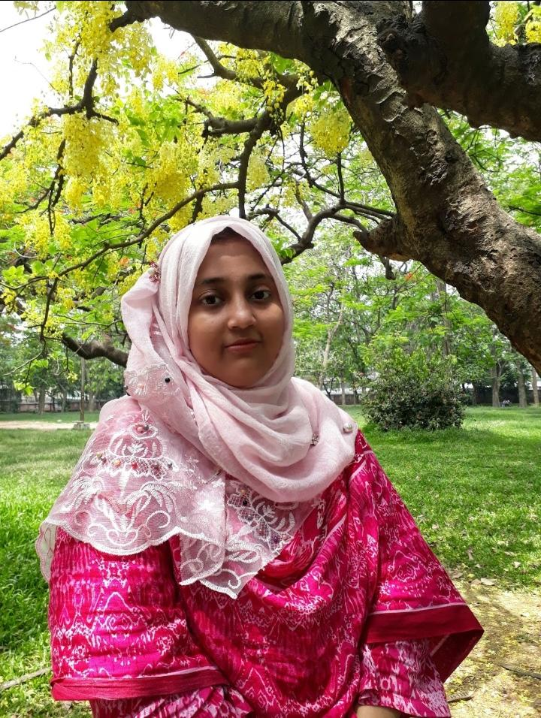
Fabia Hannan Mone
Country of origin: Bangladesh
Country where your heart is: Bangladesh, UK, Ireland and Canada.
Course: MSc Global Public Health Nutrition/FT (GREAT Scholarship)
Career background: MBBS, MPH(Psychosocial-Health)
I have clinical experience in working at Medical College Hospitals and Rohingya Refugee Camp in Cox's Bazar, Bangladesh. I worked for the World Health Organization (WHO) as a Surveillance and Immunization Medical Officer (SIMO) focusing on Surveillance, immunization & Vaccination, and child health nutrition in Bangladesh.
What area of PHN am I interested in?
Childhood Obesity and Undernutrition, Nutrition in Elderly Population, Nutrition Burden in Health Emergency, Nutrition problems and its effects in Mental Health, Strategies and Planning for improving GPHN, Sustainability and Equity in GPHN.

Slide 8
EQUITY (can AI reduce inequalities)?
Competency training
Alumni mentoring
Course alumni group on X and Linked in
Secret Friends
Weekly sessions on professional skills
Internships
Employer sessions
Access course
English classes
Sharing skills
Stories
Rivers of Life
Health system assessments
Class selected awards
Mentorship rewarded
Reflections on lived experiences
Training and assessments using Participatory Learning Skills

Slide 9
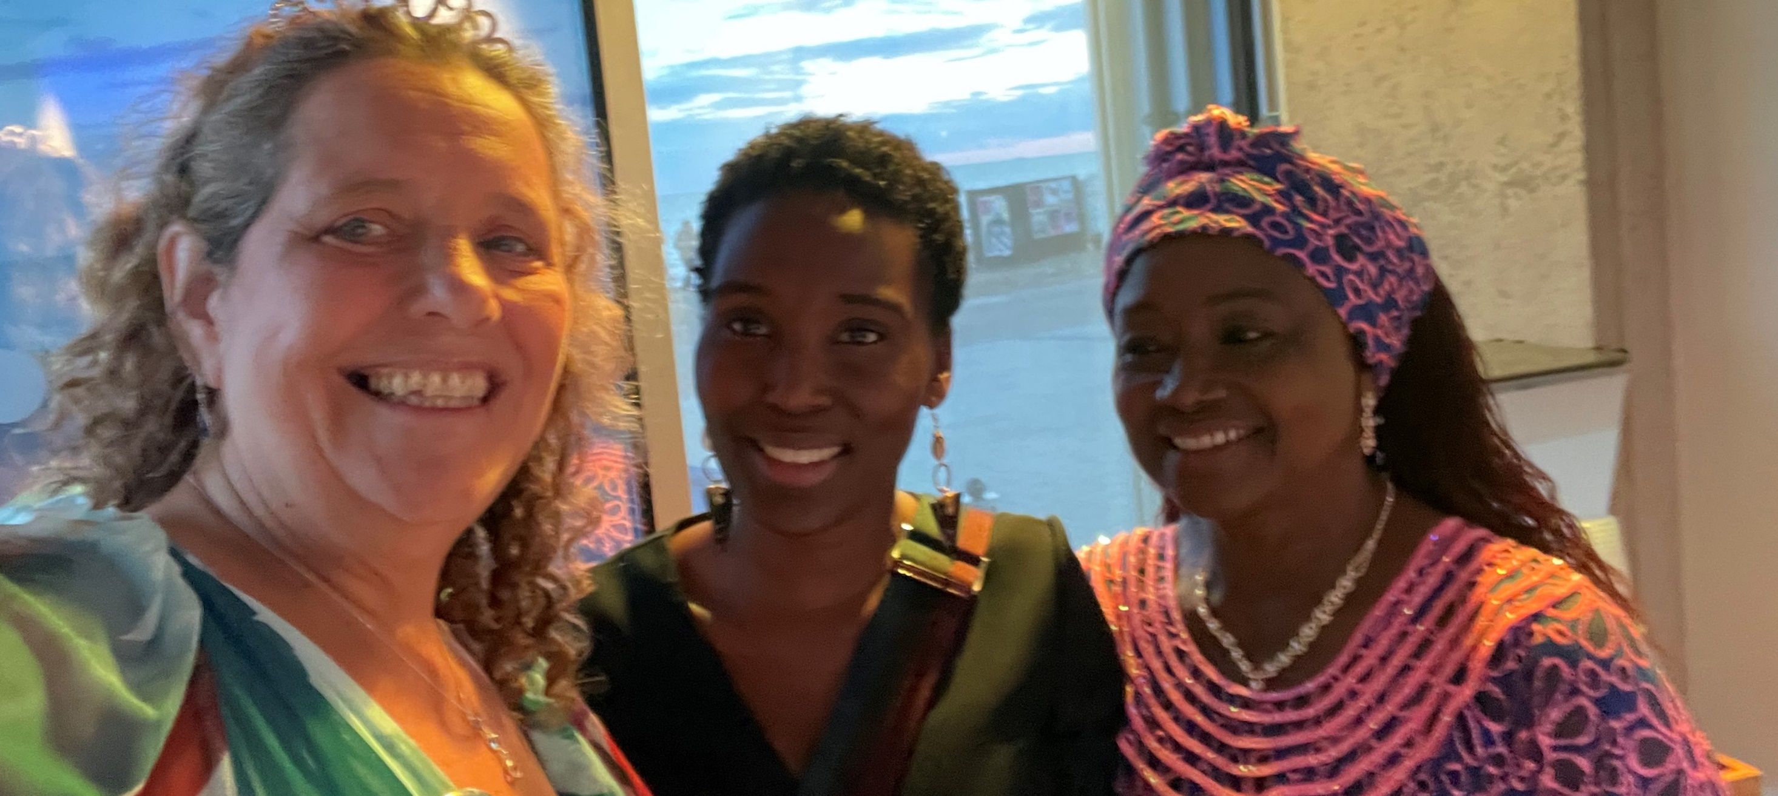

Slide 10
Governance and Leadership
Co creation opportunities
Regional and Gender Class Representation
Clear instructions
On site days limited for inclusion
Induction builds class cohesion
Self-development and professional responsibility
Accreditation of course
Research into action
Policy changes
Listen
Implement
change
Assess
Feedback
Co create solutions

Slide 11
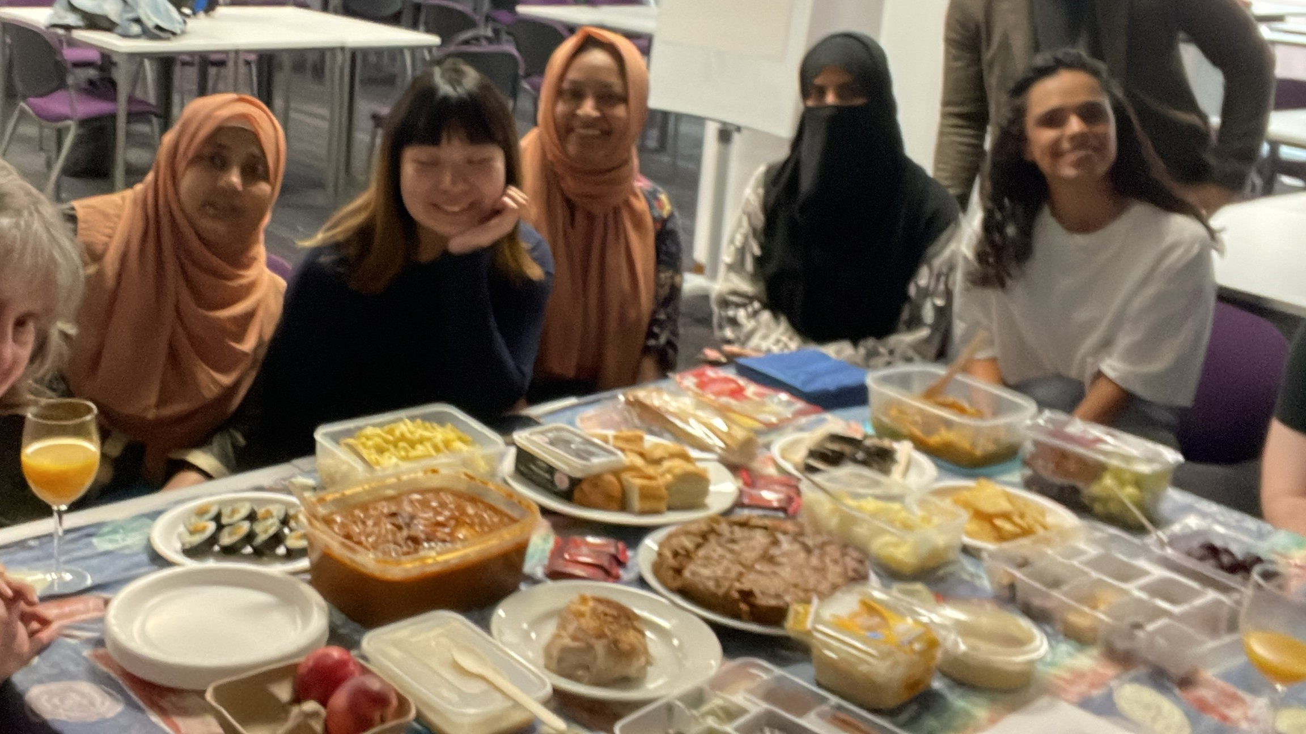

Slide 12
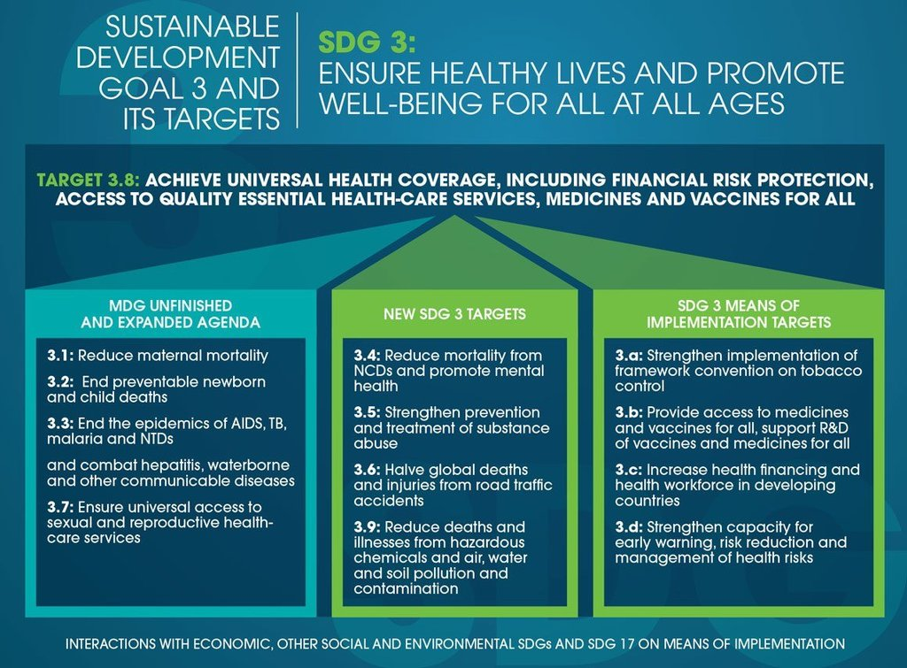
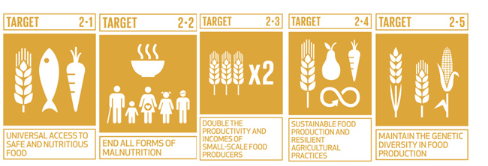
SDGs and Social Determinants of Health: Investing in other sectors
HEALTH
NUTRITION
FOOD SECURITY
WATER
REDUCING INEQUALITIES

Slide 13
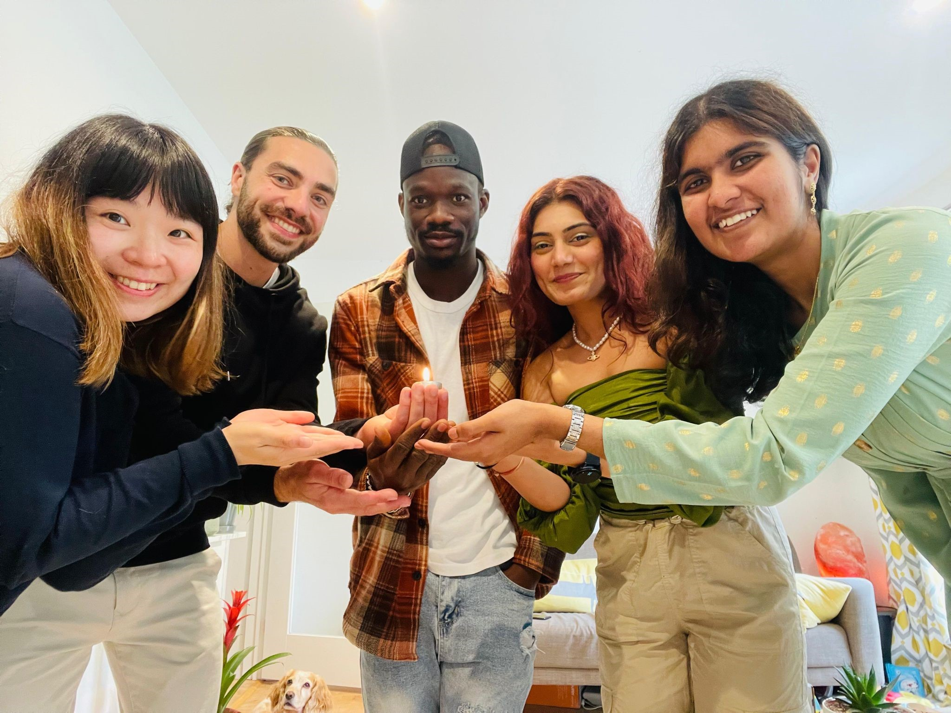
ADDRESSING POWER
POWER WITHIN
POWER TO
POWER OVER
POWER WITHIN
POWER WITH
CREATING ENABLING ENVIRONEMENT FOR GROWTH

Slide 14
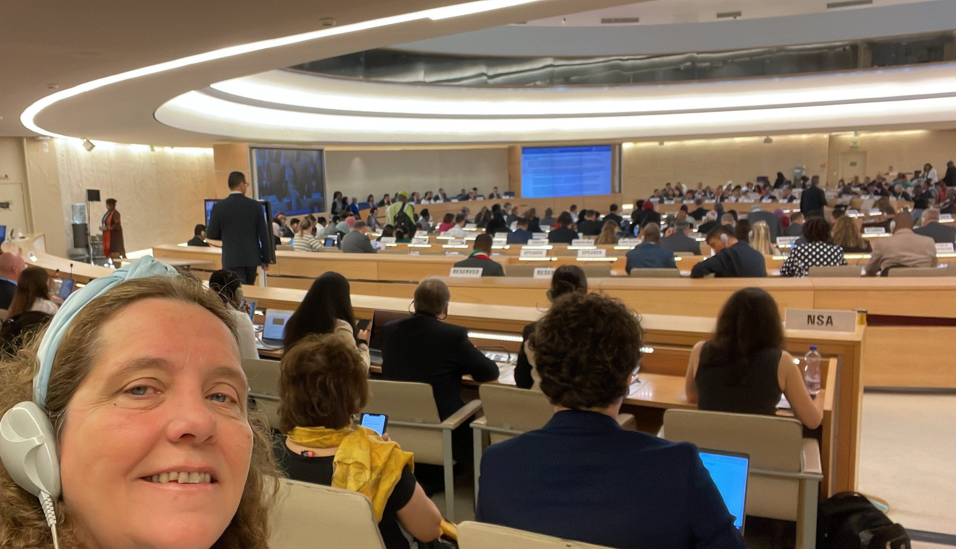

Slide 15
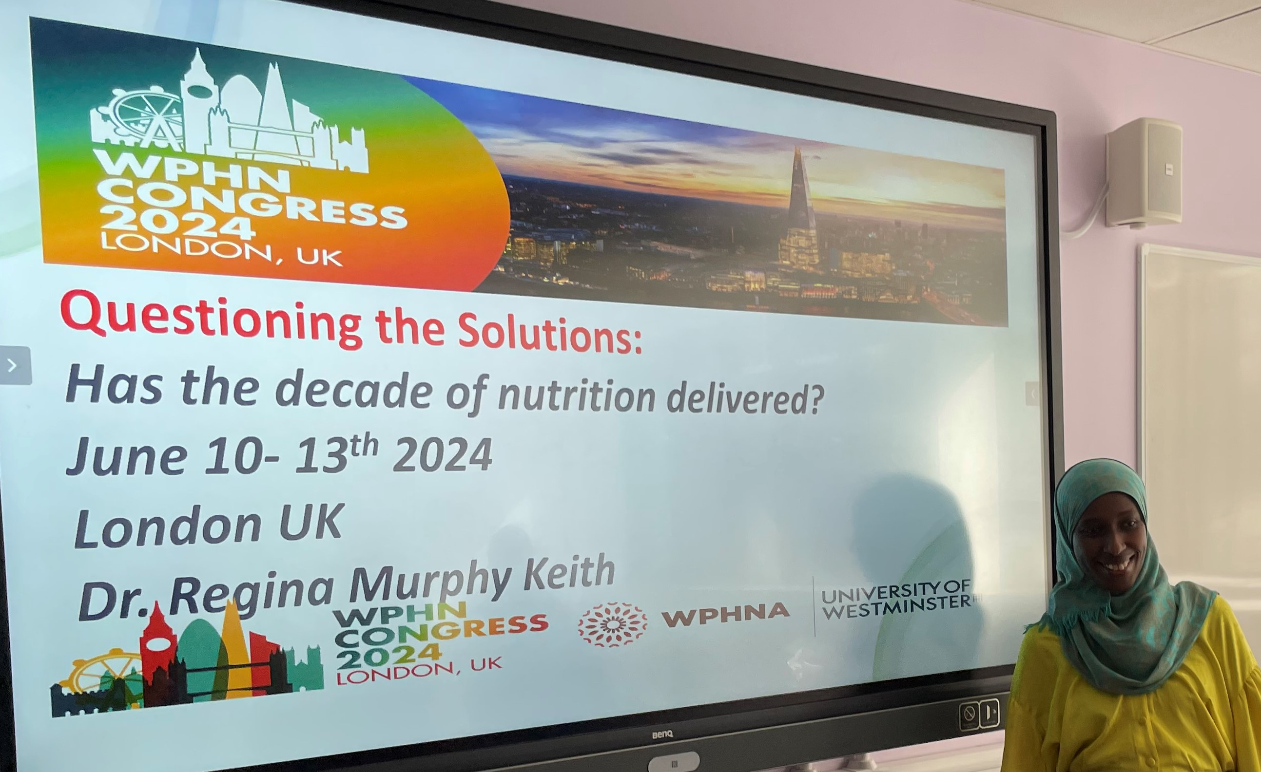

Slide 16
Call for abstracts is open: submit by October 15th, 2023
Sustainable, resilient food systems supporting health.
Health systems delivery for optimal nutrition.
Social protection to ensure food security for all.
Trade and investment for improved nutrition.
Safe and supportive environments for nutrition.
Strengthened governance and accountability for nutrition.
Building capacity for public health nutrition action.
Please register and submit your abstract
World Public Health Nutrition Congress 2024 | Ex Ordo

Slide 17
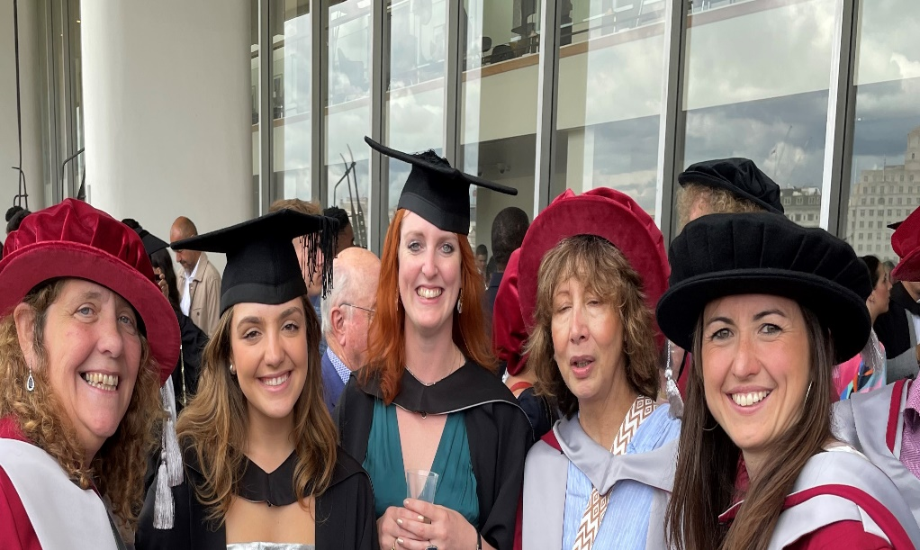
BE THE CHANGE
BE WESTMINSTER

