Slide 1
Council of Bars and Law Societies of Europe: Training of Lawyers, Challenges and Opportunities
Gamification and
Legal Education
Dr. Paresh Kathrani
Westminster Law School
University of Westminster, London, UK
Email: p.kathrani@westminster.ac.uk Twitter: @Pkathrani

Slide 2
Introduction
Dr Paresh Kathrani
Senior Lecturer in Law, Westminster Law
School, University of Westminster, London, UK
Module Leader of Criminal Law
Research: Technology in the Legal Profession
and in Legal Education

Slide 3
Serious Games at Westminster (SG@W)
https://www.westminster.ac.uk/serious-games-at-westminster-research-group
Colleagues including:
Vassiliki Bouki (Computer Science)
Daphne Economou (Computer Science)
Markos Mentzelopoulos (Computer Science)
Frands Pedersen (Politics and International Relations)

Slide 4
Use of Computer
Games in Legal
Education

Slide 5
Sound advice to a client

Slide 6
Facts
Application
Sound advice to a client
Law

Slide 7
Formal Learning Outcomes of Criminal Law, including:
A broad understanding of the knowledge base…
The ability to apply the legal knowledge of Criminal Law to solve legal problems
A research strategy that encompasses the identification and selection of a range of authoritative and reliable materials
Effective communication of outcomes…
Etc

Slide 8
Traditional methods:
Law Hypothetical
Problem Question

Slide 9
…Coincidence of the AR and MR…
Max sets out to commit a robbery and attacks Simon with his bare fists, knocking him out. Max then leaves to use Simon’s bank card and when he returns, sees that Simon is still unconscious. He thinks Simon has died from the blows and he throws Simon into the river to hide the body. In fact, Simon is not dead, but subsequently dies from drowning. Discuss the liability of Max...

Slide 10
Read, arrange and absorb the facts
Legal Reasoning
Judgement and Advice
Law on AR and MR

Slide 11
Skateboards!

Slide 12
Written Problem Question
-Law
-Read, arrange and absorb the facts
-Legal reasoning
-Judgement and advice

Slide 13
-Law
-Read, arrange and absorb the facts
-Legal reasoning
-Judgement and advice
Limits

Slide 14
-Law
-Read, arrange and absorb the facts
-Legal reasoning
-Judgement and advice
Technology

Slide 15
Games
-Law
-Read, arrange and absorb the facts
-Legal reasoning
-Judgement and advice
Technology

Slide 17
By Vassiliki Bouki, Daphne Economou and Paresh Kathrani

Slide 18
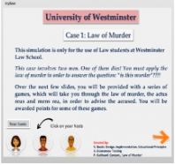
By Vassiliki Bouki, Daphne Economou and Paresh Kathrani

Slide 19
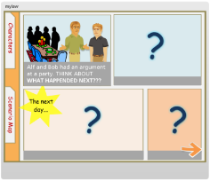
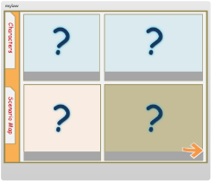
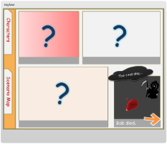
Law of murder
Experimentation with gamified solutio
The "story" is about two friends: Alf and Bob. After an argument Alf makes an action that results in Bob"s death.
Preparation
Students are given the first and the last in a series of events and they are asked to fill the gaps.
They are asked to write down their own answers and then compare them with the correct answer.
After that they are given the full events (in a format of a comic story).
Articulate Storyline

Slide 20
Drag and Drop & Cognition
Gamified Elements
Cognitive Processes
Question points

Slide 21
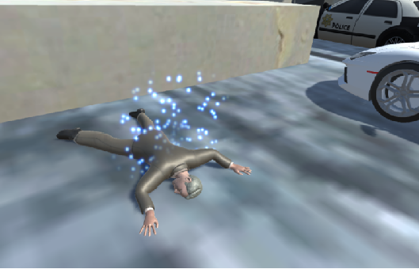
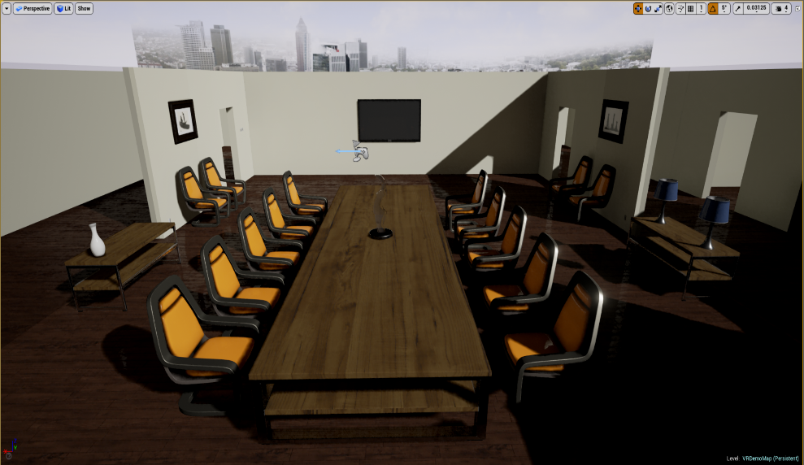
By Paresh Kathrani, Markos Mentzelopoulos, James Parrish

Slide 22
- Expansive and affective
Gamified elements:
time, points, levels
Strategy
Growth
- Goal orientated
Games

Slide 23
- Expansive and affective
Gamified elements:
time, points, levels
Strategy
Growth
- Goal orientated
Problem Question
-Law
-Read, arrange and absorb the facts
-Legal reasoning
-Judgement and advice
Games

Slide 24
Law
Read, arrange and absorb the facts
Legal reasoning
Judgement and advice
Expansive and affective Gamified elements: time, points, levels Strategy Growth Goal orientated

Slide 25
Three law games

Slide 26
Press

Slide 27
Professional Bodies

Slide 28
More games
planned, especially
augmented reality

Slide 29
Thank you

