Slide 1
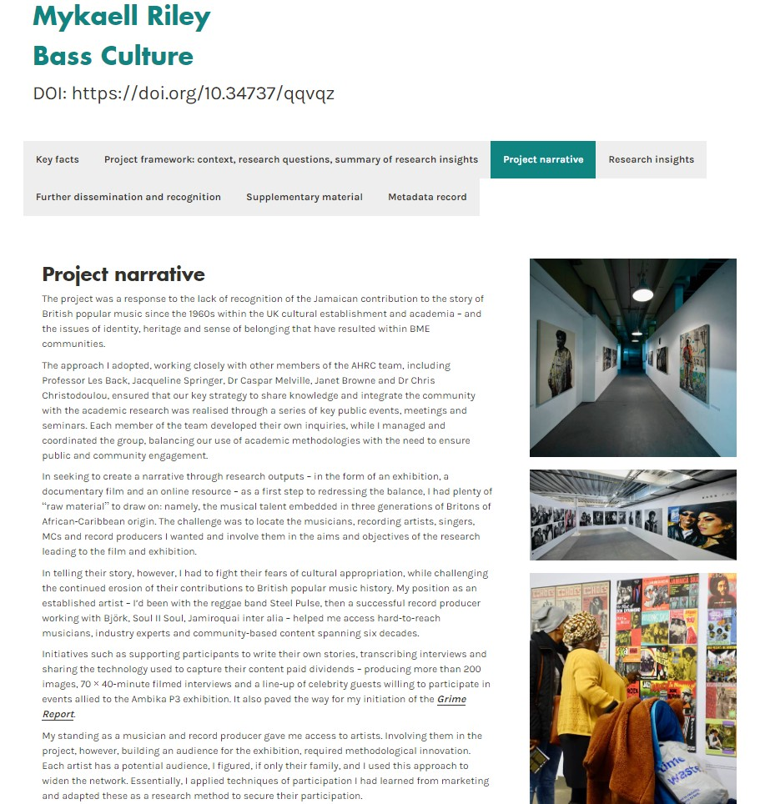
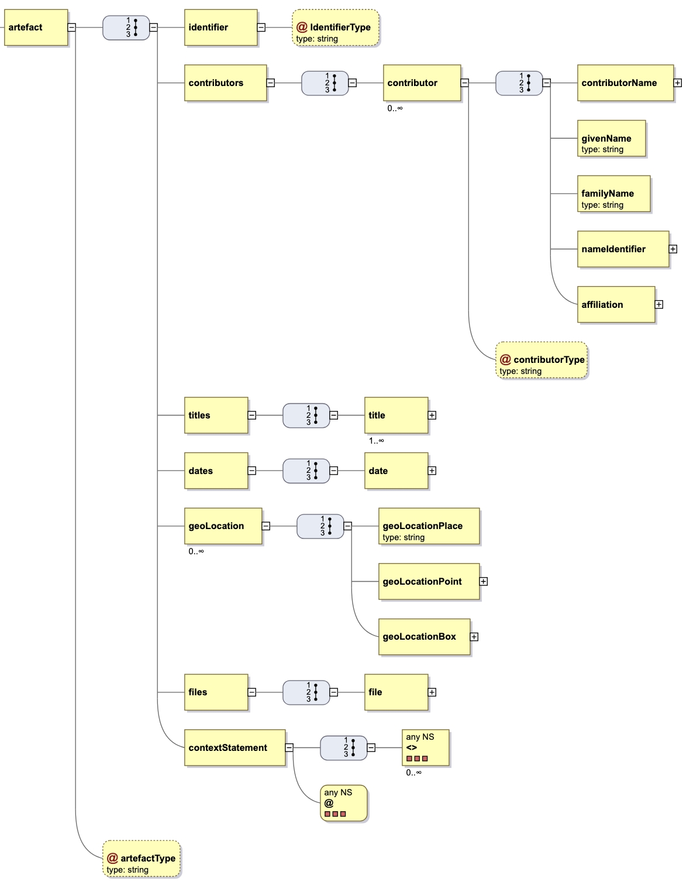
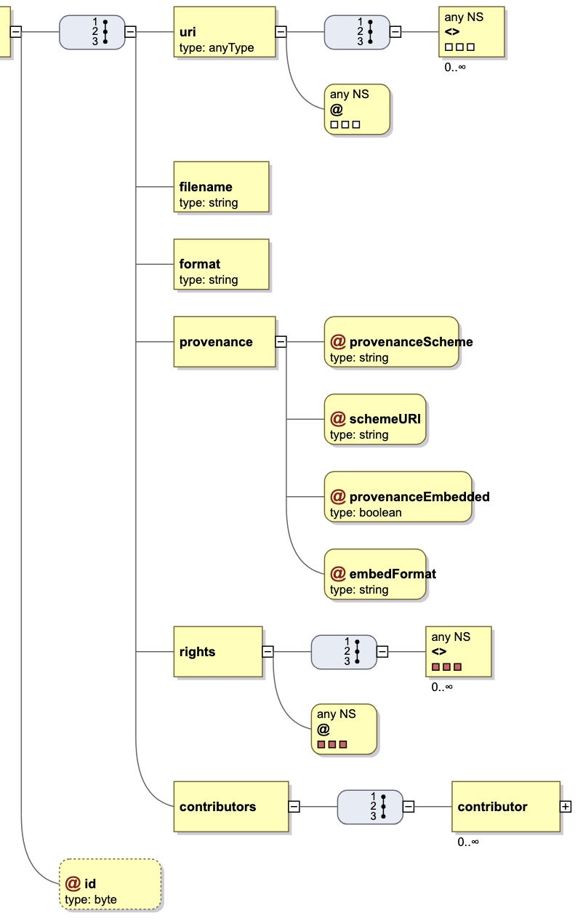
Bridging the Gap: A Standardized Schema for Practice Research Outputs
Adam Vials Moore¹ • Jenny Evans² • Rory McNicholl³ • Eleanor Dumbill³ • Nina Watts²
1. Jisc • 2. University of Westminster • 3. CoSector, University of London
Background & Motivation
Traditional repositories and metadata schemas don’t effectively support
Need for standardized approach to enable flexible, non-linear presentation
Existing infrastructure designed for text-based outputs
Portfolio concept groups related outputs meaningfully
Supports narrative and contextual elements
Flexible metadata structure accommodating diverse content types
Integration with existing repository systems and standards
Support for multiple contributor roles and relationships
Implementation Benefits
Enhanced visibility and recognition for practice research
Improved discoverability through standardized metadata
Better support for non-traditional research outputs
Seamless integration with existing repository infrastructure
Flexible structure supporting diverse documentation needs
Traditional vs. Practice Research
Traditional Research | Practice Research
Journal articles Conference papers | Artefacts Performance
Linear, text-based format | Portfolio-based, multiple items
Standard bibliographic metadata | Rich, customizable fields
j.evans2@westminster.ac.uk adam.vialsmoore@jisc.ac.uk
Future Directions
Community-driven refinement and expansion
Integration with metadata standards
International adoption and standardization
Call to Action
We invite feedback and collaboration from the RDA community
Practice Research?
“An umbrella term that describes all manners of research where practice is the significant method of research conveyed in a research output”
https://doi.org/10.23636/1347

